Slide 1
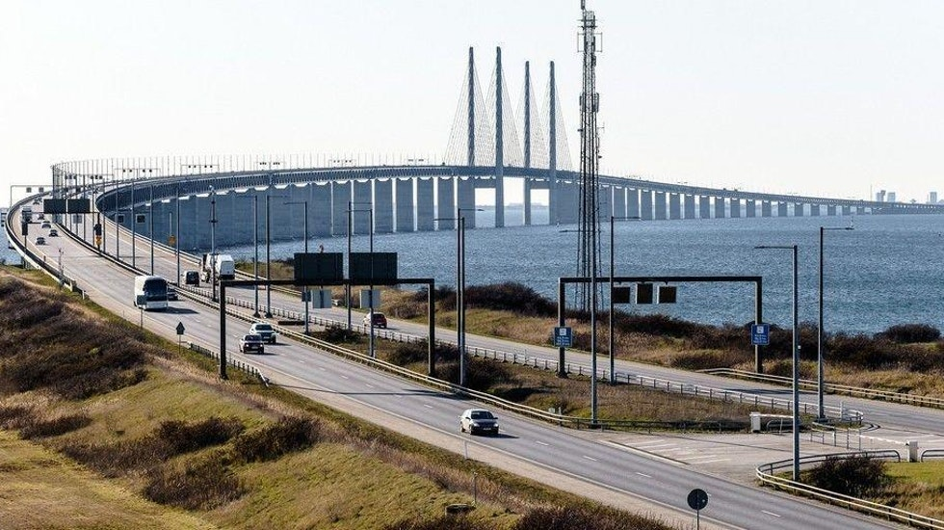
Internal borders of Schengen: Sweden-Denmark

Slide 2
Temporary Border Controls within Schengen
A maximum of 2 years discontinuation is allowed
Foreseeable events (30 days): such as sport events
Denmark and Sweden:
“Case of serious threat to public order/policy and internal security”
Art. 29 of the Schengen Border Code: serious deficiencies in the carrying out of external border control

Slide 3
Schengen Crisis
Official statement: “Shortcomings of the EU's external borders”
SBC states that these are last resort measures
Tanja Fajon (MEP): “These prolongations are not justified and there is no evidence to prove they are.”
Adopted amendment of 29 Nov 2018: “Migration and the crossing of external borders by a large number of third-country nationals should not, per se, be considered to be a threat to public policy or internal security.”

Slide 4
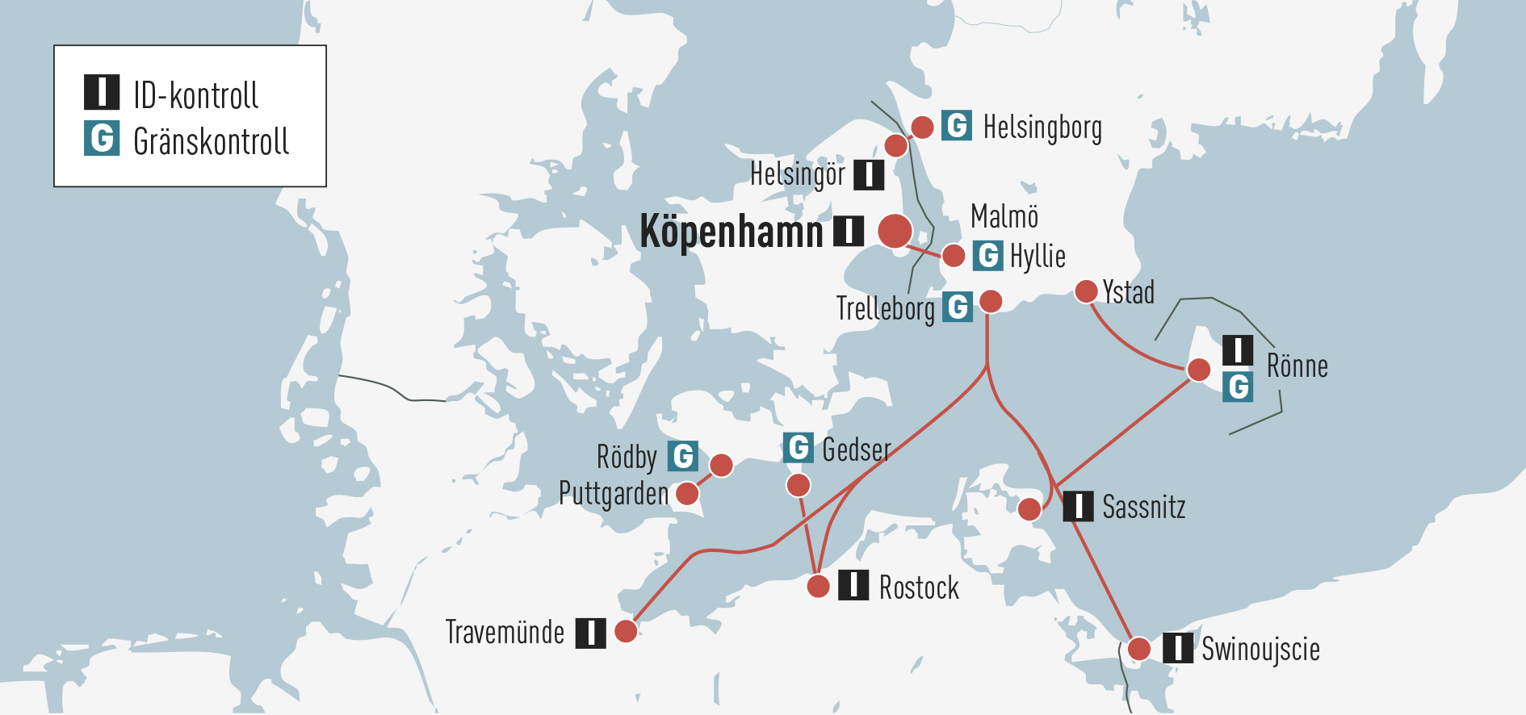
ÖRESUND REGION

Slide 5
Cross border cooperation between Denmark and Sweden in the Öresund region
Vision - to see the Øresund Region emerge as a new European powerhouse – in cultural as well as in economic terms
Helsingborg ↔ Helsingør (ferry),
Malmö ↔ Copenhagen (oresund bridge)
Increased economic integration since year 2000
Boosting employability
More than 15 000 commuters a day (in 2014 was 93% of the commuters living in Sweden and commuting to Denmark)
Economic hub, accounting for around 25 % of total gross domestic product in both countries.
source: https://webgate.ec.europa.eu

Slide 6
Border controls in the Öresund region
When?
First introduced November 12th 2015
Continuously new extensions every 10 days, 30 day,s 6 months, 3 months
Why?
Several changes in the arguments and reasoning of the Swedish government

Slide 7
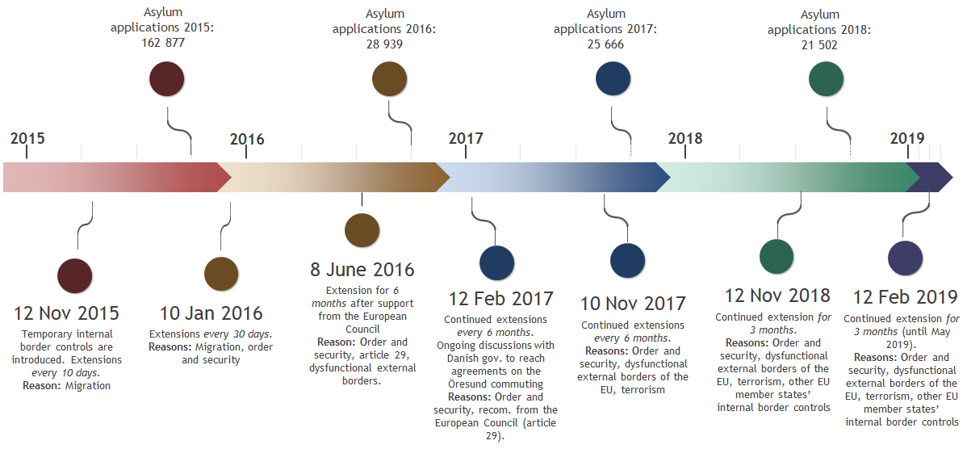
Time line - Decisions and reasoning of the Swedish gov.
Source: www.regeringen.se & www. migrationsverket.se

Slide 8
Negative consequences
-Ineffective borders controls resulting in severe delays and fewer train departures
- Significant economic loss both for individuals as well as transport companies operating in the region
-Increase in commutes by car over the bridge
-Many people gave up on commuting and moved to Denmark (40% increase of people moving from Skåne to eastern Denmark in 2017 in comparison to earlier years )
-Of the companies that have business between Sweden and Denmark, 23% responded that they were negatively affected by the the border controls
source: https://handelskammaren.com/2017/01/27/problematiken-kring-granskontrollerna-vart-fjarde-foretag-paverkas/

Slide 9
What is the EU saying?
Back to Schengen - a road map
On preserving and strengthening Schengen
European Parliament Resolution on 30 May 2018
Evaluation of Sweden in the Field of Management of the External Borders

