Slide 1
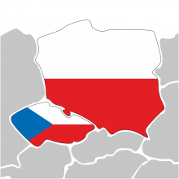
EUROPEAN UNION POLICY THE POLISH AND CZECH CONFLICT APPROACH?
Source: https://www.kolejedolnoslaskie.eu
Strasbourg, 6.11.2018

Slide 2
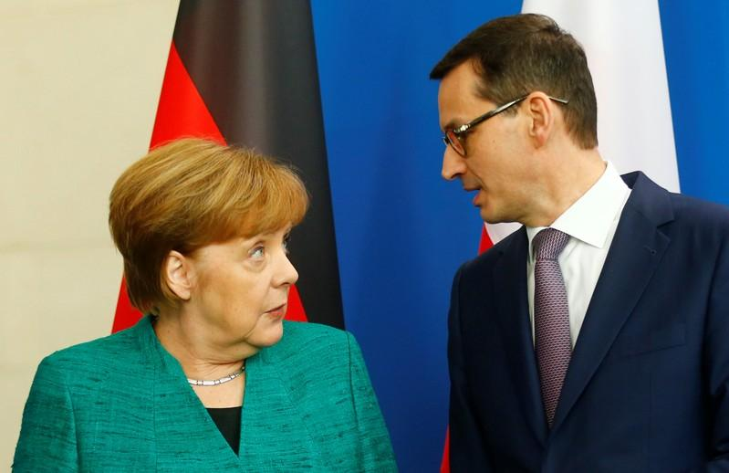
Source: https://www.reuters.com/article/us-germany-poland/merkel-sees-no-threat-in-new-gas-pipe-to-russia-poland-disagrees-idUSKCN1G01DJ

Slide 3
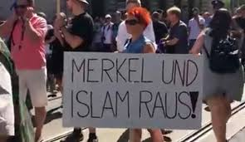
Meanwhile in Prague...

Slide 4
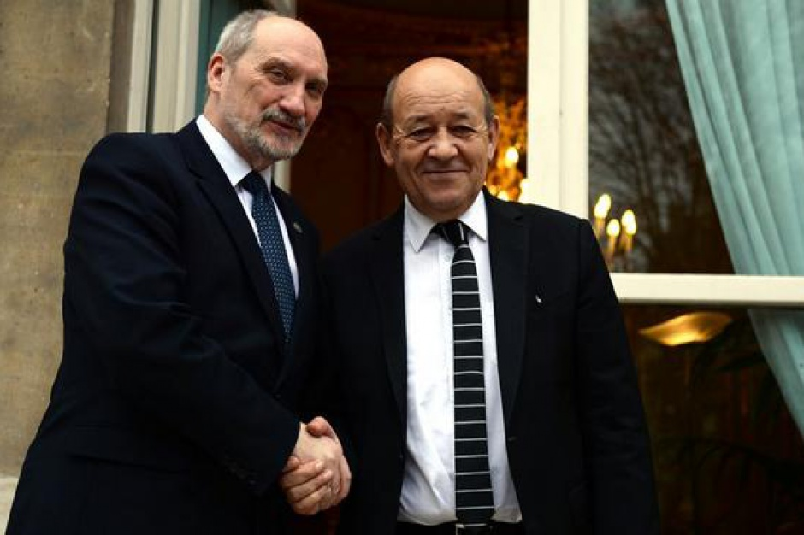
Source: https://www.wnp.pl/parlamentarny/wydarzenia/antoni-macierewicz-zakonczyl-wizyte-we-francji,5015.html

Slide 5
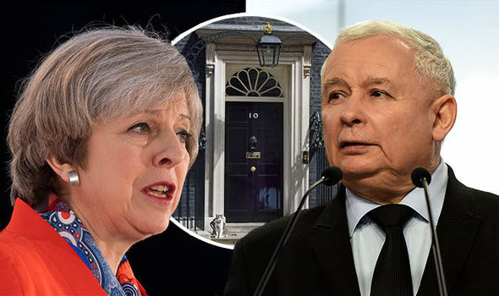
Source: https://www.express.co.uk/news/politics/783134/Theresa-May-Brexit-Poland-EU-Jaroslav-Kaczynski-meeting

Slide 6
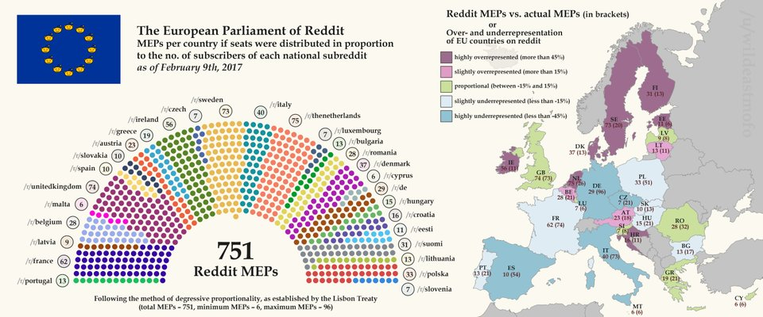
Source: https://www.reddit.com/r/Polska/comments/5tbop5/podzia%C5%82_mandat%C3%B3w_w_parlamencie_europejskim_wg/

Slide 7
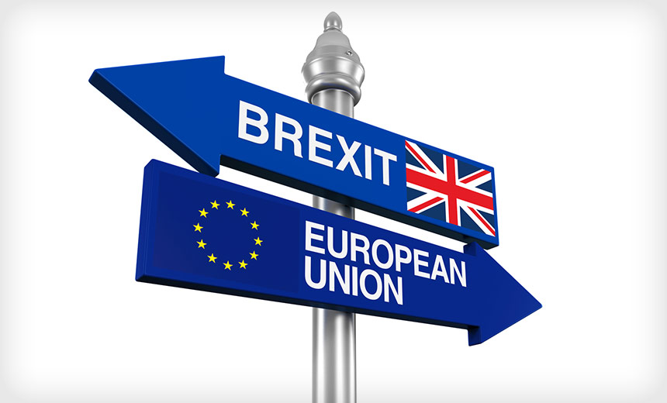
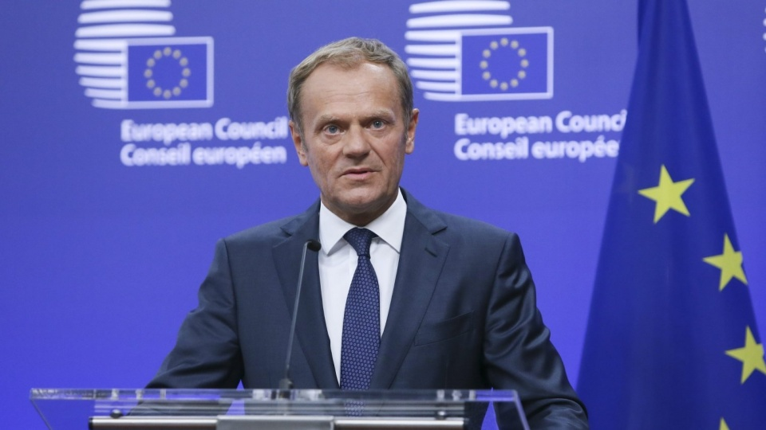
Source: https://www.bankinfosecurity.com/blogs/brexit-referendum-5-cybersecurity-implications-p-2160mencie_europejskim_wg/
Source: http://www.radiopik.pl/3,45028,tusk-chwila-historyczna-dla-ue-ale-nie-czas-na-h&s=1&si=1&sp=1

Slide 8
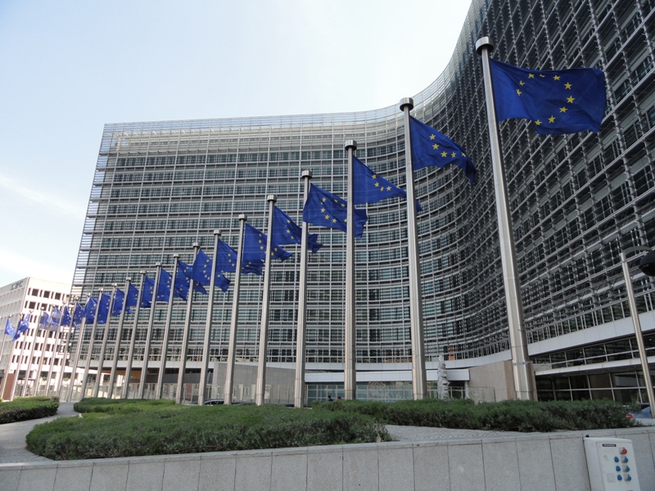
Source: http://www.gazetagazeta.com/2017/09/25-wrzesnia-rada-ue-zajmie-sie-polska/#prettyPhoto/0/

Slide 9
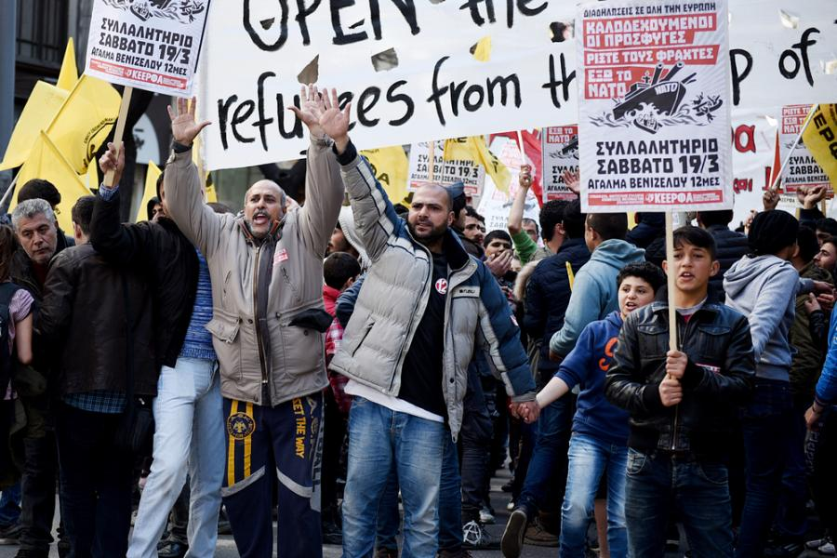
Source: http://wiadomosci.dziennik.pl/polityka/artykuly/552355,uchodzcy-ke-pis-pytanie-procedury-kary-relokacja.html

Slide 10
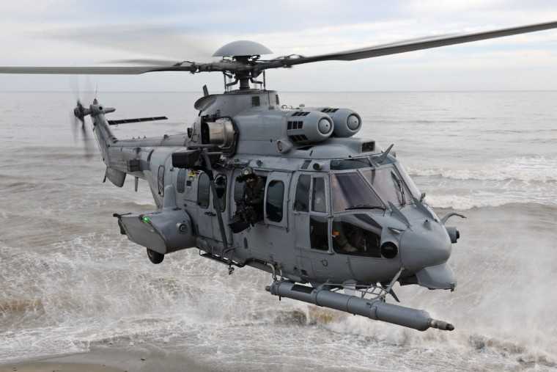
Source: http://biznesalert.pl/francja-niemcy-krytycznie-o-decyzji-polski-ws-caracali/

Slide 11
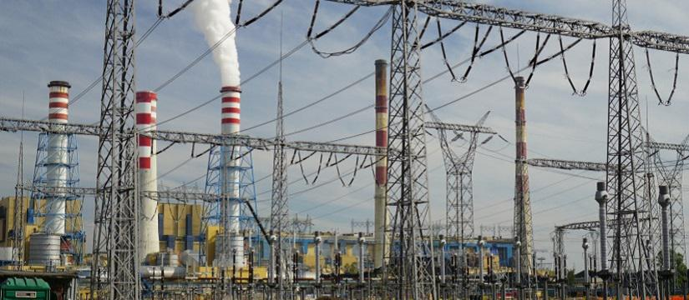
Source: https://wpolityce.pl/gospodarka/306433-raport-pism-polski-sektor-energetyczny-wymaga-modernizacji-trzeba-uwzglednic-polityke-klimatyczna-ue

Slide 12
Euroscepticism

Slide 13
Euroscepticism in V4 countries
Despite the rhetorics of Polish and Hungarian governments is much more anti-European as those of Slovak and (mainly) Czech ones, the public opinion on EU-membership shows surprisingly the opposite
Some reasons of Czech euroscepticism will be provided

Slide 14
Reasons for Czech euroscepticism
EU is universally blamed for almost everything since the start of pre-accession negotiations
Negative role of Václav Klaus, ex-prime minister and ex-president, who is an explicit Czexiteer
Eurocrisis and mainly migration crisis sharpened ever-existing anti-German sentiments, which evolved into more profound ant-European sentiments

Slide 15
Euroscepticism in Czech borderlands
No research focusing on this topic has been conducted yet.
However, we can estimate that higher level of Eurocepticism is in areas where the people tend to vote conservative and nationalistic parties – and that has been happening mainy in the borderlands, formerly inhabited by the expelled German population

Slide 16
Euroscepticism in most borderlands

Slide 17
THANK YOU FOR YOUR ATTENTION !

