Slide 1
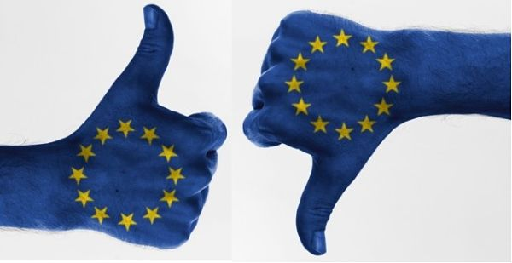
European identity face to the diversity of identities in Europe : towards re-emmergence of borders ?
MARCK Kévin
MEYER Justine
PERRIET Morgane

Slide 2
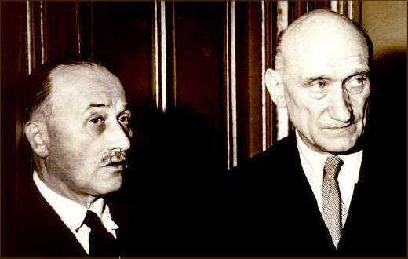
INTRODUCTION
« Europe will not be made all at once, or according to a single plan. It will be built through concrete achievements which first create a de facto solidarity. »
Robert Schuman’s declaration

Slide 3
. Europe suffers from an existential crisis
no solidarity about migrants
no European defense
important rate of abstention for elections
national identity often overrides european identity, overshadows european identity

Slide 4
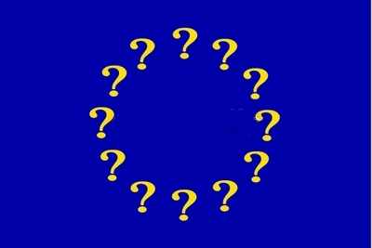
So the question is, is the diversity of member states compatible and consistent with one single european identity ?

Slide 5
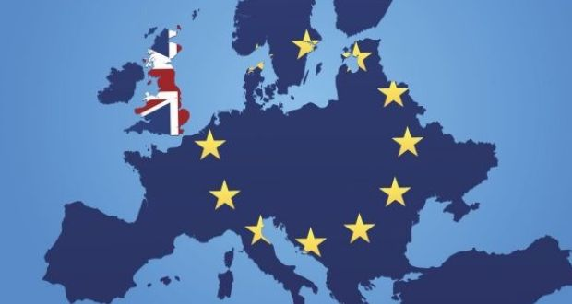
European identity is undermined
The motto « united in diversity »
challenged as evidenced by the Brexit and more widely by euroscepticism.
Europe is more and more fragile

Slide 6
We are going to strive to give you some responses ands some food for thought.
I ) A european identity under construction
II) The issues to perfect the construction of the European identity

Slide 7
I : AN IDENTITY UNDER CONSTRUCTION
A) The European identity in the texts
1 - European identity for external purposes
2 - Common values as a component of the European identity
3 - European citizenship

Slide 8
I : AN IDENTITY UNDER CONSTRUCTION
A) The European identity in the texts
1 - European identity for external purposes
Single European Act 1986 Article 30§6.a
« The High Contracting Parties consider that closer cooperation on questions of European security would contribute in an essential way to the development of European identity in external policy matters… ».

Slide 9
I : AN IDENTITY UNDER CONSTRUCTION
A) The European identity in the texts
1 - European identity for external purposes
Preamble of the 1992 Maastricht treaty
« Resolved to implement a common foreign and security policy including the eventual framing of a common defence policy, which might in time lead to a common defence thereby reinforcing the European identity and its independence in order to promote peace, security and progress in Europe and in the world »

Slide 10
I : AN IDENTITY UNDER CONSTRUCTION
A) The European identity in the texts
2 - Common values as a component of the European identity
Article 2 of the Treaty on European Union (TEU)-Preamble of the European Charter of Fundamental Rights
Respect for human dignity
Freedom
Democracy
Equality
Rule of law
Respect for human rights
The rights of persons belonging to minorities…

Slide 11
I : AN IDENTITY UNDER CONSTRUCTION
A) The European identity in the texts
2 - Common values as a component of the European identity
Article 2 of the Treaty on European Union (TEU)-Preamble of the European Charter of Fundamental Rights
A membership criterion (article 49 TEU)

Slide 12
I : AN IDENTITY UNDER CONSTRUCTION
A) The European identity in the texts
3 - European citizenship
Traditional definition of the citizenship
The European citizenship: Rights and duties
Article 20§1(TFEU)
Freedom of movement
Voting and eligibility
Diplomatic protection
Petitions and Mediator

Slide 13
I : AN IDENTITY UNDER CONSTRUCTION
B) An identity challenged and weakened by the very nature of the Union
1 - European identity facing the recognition of the national identities
The european citizenship: a limited scope
Article 20§2 (TFEU):
«Citizenship of the Union shall be additional to and not replace national citizenship ».
Article 4§2 (TEU):
« The Union respects the Member «states national identities, inherent in their fundamental structures, political and constitutional, inclusive of regional and local self-government.»

Slide 14
I : AN IDENTITY UNDER CONSTRUCTION
B) An identity challenged and weakened by the very nature of the Union
2 – An elusive territory
A consequence of a differentiated integration
Definition of the differentiation method

Slide 15
AN ELUSIVE TERRITORY

Slide 16
AN ELUSIVE TERRITORY

Slide 17
AN ELUSIVE TERRITORY

Slide 18
I : AN IDENTITY UNDER CONSTRUCTION
B) An identity challenged and weakened by the very nature of the Union
2 – An elusive territory
A consequence of a differentiated integration
Definition of the differentiation method
The respect of European values: a blurry border

Slide 19
I : AN IDENTITY UNDER CONSTRUCTION
B) An identity challenged and weakened by the very nature of the Union
3 – European Identity: an unfinished political project
An identity which remains to be built
Difficulties to find political legitimacy
Are borders a component of identity ?

Slide 20
I: AN IDENTITY UNDER CONSTRUCTION
How the strengthening of the national identity have lead to euroscepticism in Europe ?
Furthemore, it would be interesting to look how the lack of democracy, the strengthening of the national identity can also, promote euroscepticism.
Therefore, improving the democracy is an important issue to fight euroscepticism.

Slide 21
II : THE ISSUES TO PERFECT THE CONSTRUCTION OF THE EUROPEAN IDENTITY
A) Euroscepticism and its consequences
B) Transcend the borders by improving the democracy

Slide 22
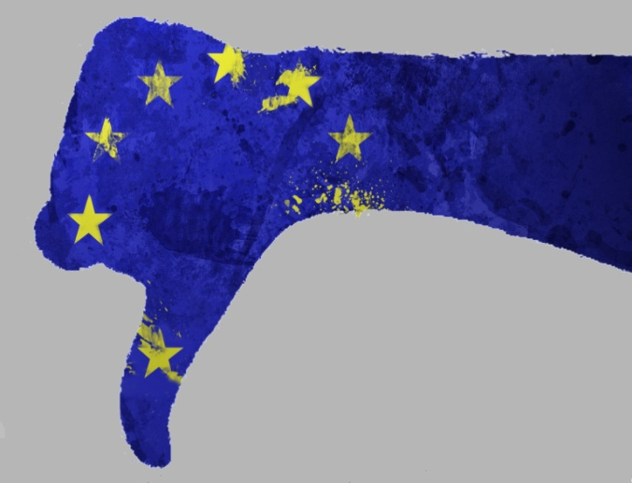
A) EUROSCEPTICISM AND ITS CONSEQUENCES
1 - Euroscepticism and populism
2 - The situation in Hungary
3 - Euroscepticism and Brexit

Slide 23
A) EUROSCEPTICISM AND ITS CONSEQUENCES
Europhobia : Europhobia is a fear of Europe. The Europhobes fear a disappearance of national cultures and are therefore against European policies. The Europhobes want the preservation of national identity. Consequently, the Europhobes really wants to leave the EU, the euro zone and the Schengen area.
Euroscepticism : Euroscepticism are doubts or criticisms of the effectiveness or results of the programs of the European Communities. The eurosceptics denounce a too strong European integration. Indeed, a too strong integration make their fear a disappearance of the national indentity in favor of a European identity. Therefore, Euroscepticism is a criticism of the European construction.

Slide 24
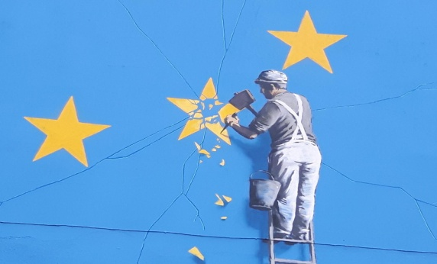
1 - EUROSCEPTICISM AND POPULISM
Populism is a rejection of institutions, European constraints. Therefore, populist political parties are generally eurosceptic.
Populists surf on national identity to impose a new vision of Europe which could be contrary to its identity and have significant impact to its border.
Populist Europe is opposed to Merkel's traditional Europe, which welcomes migrants and respects the values of the European Union such as Human Rights. Therefore, the protection of national identity could be in opposition to the European values.

Slide 25
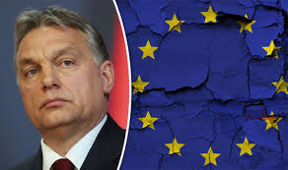
2 – THE SITUATION IN HUNGARY :
Illiberal democracy : Elections must be respected but not necessarily democracy, the rule of law and the separation of powers.
Article 7 of Treaty on European Union against Hungary : The county isn't in agreement with initial EU project. Therefore, this decision could have an impact on EU's borders.

Slide 26
2 - THE SITUATION IN HUNGARY :
According to Orban, European countries must be united to defend commun values. However, this commom values are the values wanted by Orban for the Europe and not the current values of the EU.
Euroscepticism in Europe can lead to a strengthening of European Union's external borders and can lead to a reapperance of EU's internal borders.

Slide 27
2 - THE SITUATION IN HUNGARY :

Slide 28
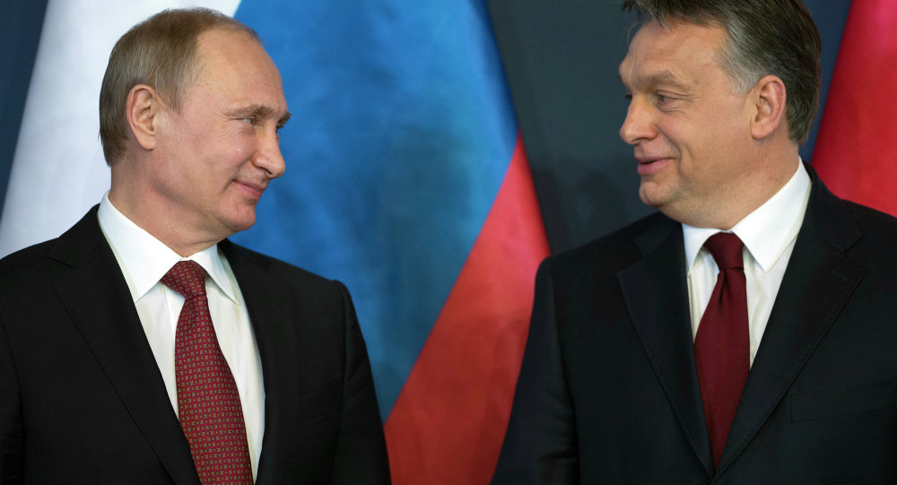
2 - THE SITUATION IN HUNGARY :
What are the commun values, the commun identity between the European Union and a country turned towards Russia ? Does Hungary still have a place in Europe ? Consequently, if the answer to this question is "no" the borders of the European Union could be changed.

Slide 29
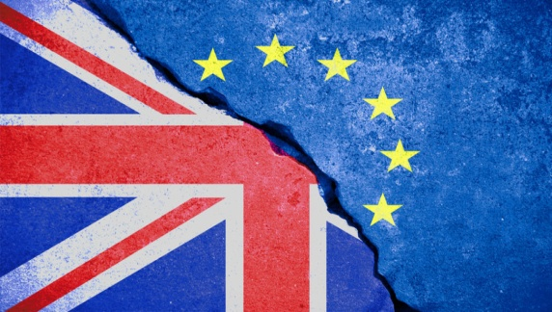
3 - EUROSCEPTISISM AND BREXIT
On 23 June 2016 the UK decided to leave the EU: It's the Brexit.
The fact that the European countries try to preserve their national identity and the democratic deficit which suffered Europe have consequences in terms of European border.

Slide 30
B) TRANSCEND THE BORDERS BY IMPROVING THE DEMOCRACY IN EUROPE
1 - The need to respond to democratic deficit
2 - To address lack of communication and transparency
3 - Advances regarding democracy

Slide 31
1 - THE NEED TO RESPOND TO DEMOCRATIC DEFICIT
European Union was created by governments, leaders but not by citizens.
European Union may be equated to a loss of sovereignty. Democratic deficit results from a poor shared sense of identity
The European identity comes up against national identities of member states Euroscepticism
State constitutes the privileged entity for the construction of political identity
European Union is still relegated to the background.

Slide 32
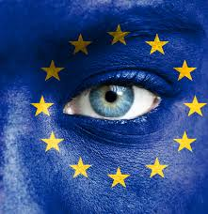
2- TO ADDRESS LACK OF COMMUNICATION AND TRANSPARENCY
European citizenship is an abstract concept
whereas borders, different languages, cultural differences are real, concrete, visible
European Union is underrated, underestimated, but also unknown and misunderstood.
The concept of Europe is poorly taught.

Slide 33
2 - TO ADDRESS LACK OF COMMUNICATION AND TRANSPARENCY
citizens are submitted to the representatives
European integration is more undergone than chosen.
It is necessary to find out ways to talk
The aim of a dialogue consists of blurring borders because it is difficult to trust in something opaque or unknown

Slide 34
3 - ADVANCES REGARDING DEMOCRACY
The right to petition (Article 227 TFEU)
“Any citizen of the Union, and any natural or legal person residing or having its registered office in a Member State, shall have the right to address, individually or in association with other citizens or persons, a petition to the European Parliament on a matter which comes within the Union's fields of activity and which affects him, her or it directly”

Slide 35
3- ADVANCES REGARDING DEMOCRACY
European citizen's initiative (article 11§4 TEU, article 24 TFEU)
Règlement (EU) No 211/2011 du Parlement et du conseil du 16 février 2011 relatif à l’initiative citoyenne
an innovative way to shape Europe by inviting the European Commission to present a legislative proposal
7 citizens from 7 states are required.
So that encourages overcoming borders.
Through these two examples, we notice that efforts try to:
- improve democracy
- fight against euroscepticism
- transcend differences
- and in fine borders

Slide 36
CONCLUSION
- A weak European identity
- Strong national identities
- We must introduce more democracy in Europe
If we doesn't apply this solution, there is a risk that borders will reappear within the EU and challenge the initial European construction project.

Slide 37
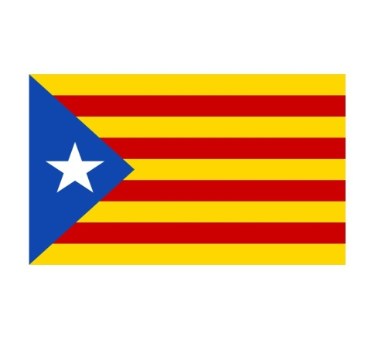
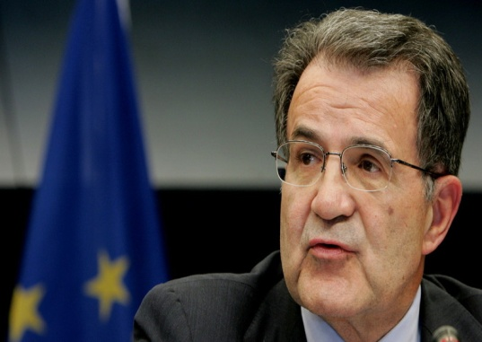
CONCLUSION
European identity is not only confronted to the rise of national identities but also to the rise of regional identities for example in Catalonia
Regionalist movements can be pro-Europea and weaken the EU thanks to the creation of new EU’s external borders because of the Prodi doctrin.
Prodi Doctrin : When a region of an European Member State gets its independence it doesn't automatically become part of the EU. It's only if it totaly fulfills the membership criteria alone that it can become part of the EU again.

