Slide 1
THE EUROPEAN UNION FACING THE CHALLENGE OF ITS BORDERS

Slide 2
INTRODUCTION

Slide 3
Migration and Refugee Crisis – Mediterranean routes

Slide 4
The reintroduction of the borders in the European Union, is it the solution to the migration crisis ?

Slide 5
I. The reintroduction of internal borders : The response of European member States to migration crisis
A) The Schengen area deeply weakened
B) The consequences of a weakened Schengen area
II. The European alternative to the migration crisis : The search for a convergence of states interests
A) The inefficiency of the common migration policy
B) The preservation of the Schengen area

Slide 6
I. The reintroduction of internal borders : The response of European member states to migration crisis A) The Schengen area deeply weakened

Slide 7
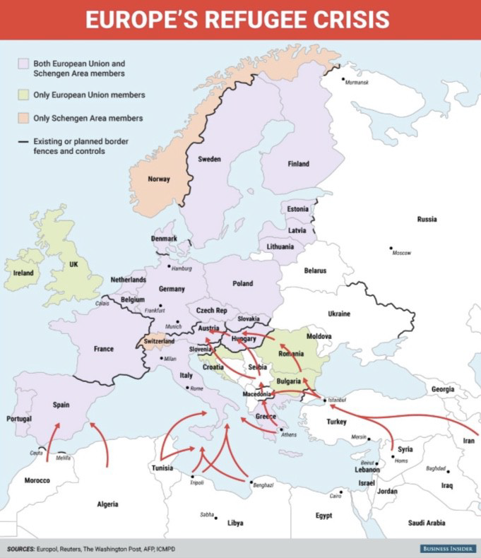
The Schengen Area
The Schengen area is a common space in which people are unrestricted to move from one member country to another.
The Schengen Agreement was signed by 26 states (22 of 28 EU members of the EU, and 4 associated non-EU states) in June 14, 1985.
It has been entered into force since March 26, 1995.

Slide 8
EU Regulation
Articles 25 and next ones of the Schengen Borders Code state that : « However, the member states of the Schengen area have the possibility of restoring temporarily checks at their national borders, in case of threats to public policy or internal security, for renewable periods of 30 days up to 6 months ».
Since 2013, this period has been extended to two years in case of « a serious breach of control obligations by a member state of the European Union at the external borders ».

Slide 9
Does the arrival of a large number of migrants constitute a real threat to public order or internal security ?
According to the European Court of Justice, it seems not :
« Derogating from the fundamental principle of the free movement of persons must be interpreted as a restrictive way »
« The danger to public order presupposes the existence of a real, current and sufficiently serious threat, affecting a fundamental interest of society »

Slide 10
Several proposals
The European Commission
Coordinated approach of temporary border controls
The Netherlands
« Minimal Schengen Area »
Not including Greece from the Schengen Area

Slide 11
B) The consequences of a weakened Schengen area

Slide 12
The potential consequences…
1
Economic, Political and Social Costs for the European Union and each of its member states
2
A judicial and policial cooperation compromised between the Member States of the EU
3
Economic prosperity in danger
4
The end of a frontierless area ? According to a study, member states of the EU will have to pay about 470 billion euros in ten years

Slide 13
Possible issues :
Member states have to learn how to work together
The European Union should be able to pursue a common migration policy

Slide 14
II. The European alternative to the migration crisis : The search for a convergence of states interests A) The inefficiency of the common migration policy

Slide 15
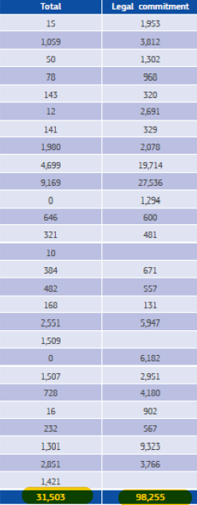
The Solidarity Principle / The Dublin Regulation
European agenda on migration
Relocation plan
This plan distributes the asylum seekers from Greece and Italy all around the EU
The asylum seeker has to register in the member state where he originally entered
Dublin Regulation
November 2017

Slide 16
The failure of the solidarity system
Two factors
A different reception policy in every member state
The refusal of application by certain East EU countries

Slide 17
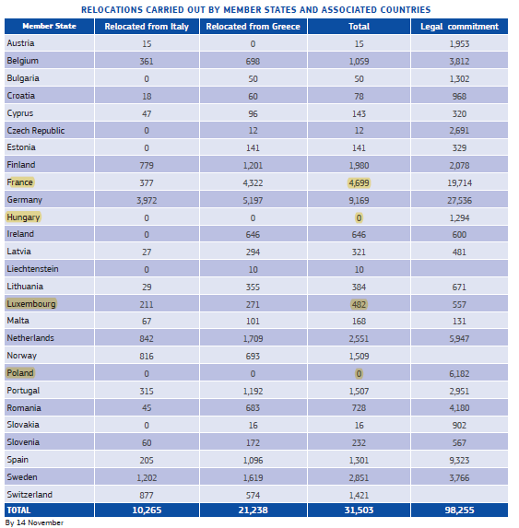
The failure of the solidarity system
November 2017

Slide 18
The EU decided to intervene in two different ways :
1
With a strict position towards these
2
With the conclusion of agreements with certain third countries

Slide 19
A strict position towards certain East EU countries
CJEU on September 6, 2017 : Reaffirm the solidarity principle between Europeans regarding the immigration management.
Law Soros on June 20, 2018 : Makes illegal for individuals or organizations to support the asylum seekers.
On July 2018 : The European Commission engaged a procedure under the article 7 of the Treaty of the EU
On September 12, 2018 : The European Parliament voted in favor of the article 7 of the Treaty of the EU
Vote
Symbolic
Political

Slide 20
The EU - Turkey refugee agreement
1
An allocation of 6 billion euros to help Turkey care millions of refugees hosted in the country
2
To open the Turkey’s road to EU membership
3
A visa liberalization for Turkish citizens who want to travel to the Schengen Area

Slide 21
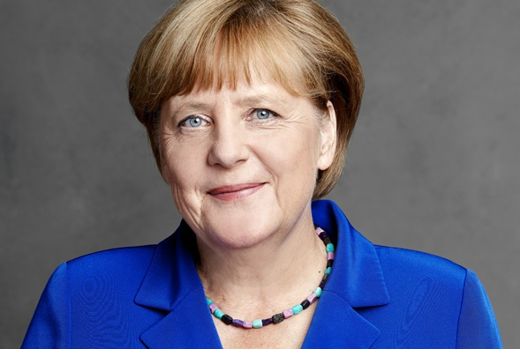
Angela MERKEL : The German chancellor
« Future agreements with North Africa will be structured like the agreement between the EU and Turkey »

Slide 22
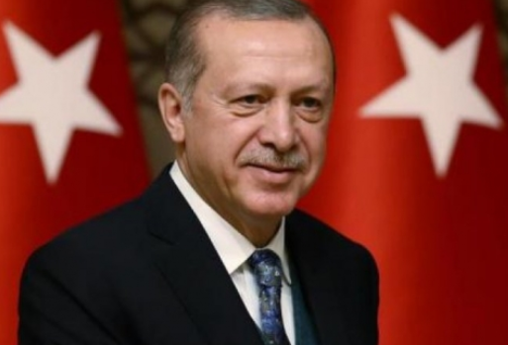
RECEP TAYYIP ERDOGAN : The president of the Republic of Turkey

Slide 23
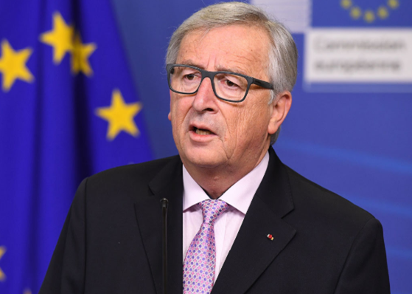
Jean Claude JUNCKER : The president of the European Commission
« We clearly need immigration in the the coming decades. If we don’t opening legal pathways for migrants towards Europe and inside Europe, we will be lost ».
On September 12, 2018 : The European Commission took this idea over and quoted that the legal pathway is a key element for border’s management

Slide 24
B) The preservation of the Schengen Area

Slide 25
The closure of the Balkans route
At the beginning of March 2016, the migration route of the Balkans gradually closed. Indeed, Macedonia, Serbia, Croatia and Slovenia, but also Austria closed their borders. Moreover the Balkans and Central Europe countries didn’t come back on their unilateral decisions to close the borders.
Their goal was to discourage new migrants to come in Europe, but the measure did undoubtedly aggravate the humanitarian crisis in Greece as well as increased pressure on the European Union and Turkey to finalize their agreement to manage the flow of refugees.

Slide 26
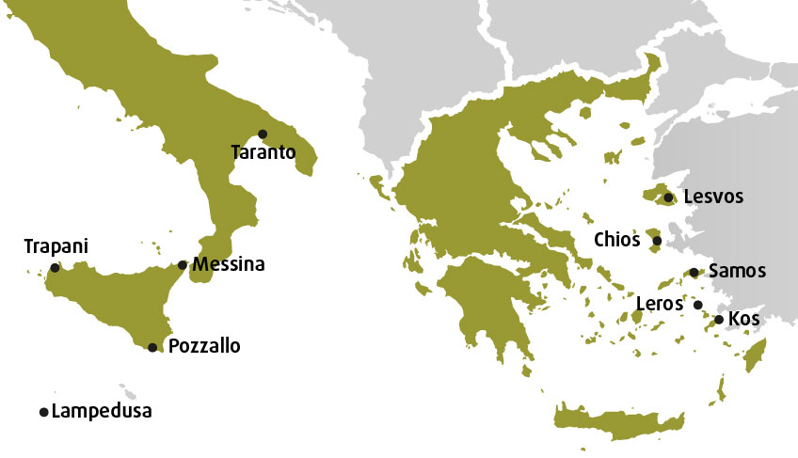
Map of hotspots in Greece and Italy as of February 2018
Hotspots are facilities set up at the EU’s external border (in Greece and Italy) for the initial reception, identification and registration of asylum seekers and other migrants coming to the EU by sea. They also serve to channel newly-arrived people into international protection, return or other procedures.
There are currently five hotspots in Greece (on the islands of Chios, Kos, Leros, Lesvos and Samos) and five in Italy (in Lampedusa, Messina, Pozzallo, Taranto and Trapani).

Slide 27
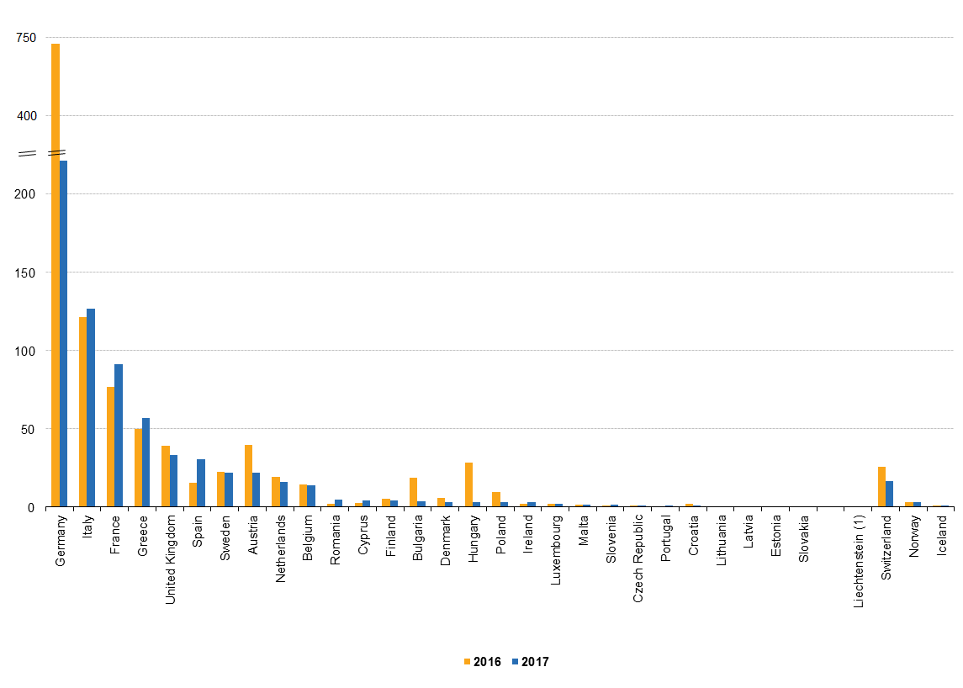
About asylum applications….
Countries of destination: Germany, Italy and France the main
With 198 thousand applicants registered in 2017, Germany accounted for 31 % of all first-time applicants in the EU-28. It was followed by Italy (127 thousand, or 20 %), France (91 thousand, or 14 %), Greece (57 thousand, or 9 %), the United Kingdom (33 thousand, or 5 %) and Spain (30 thousand, or 5%).

