Slide 1
The Japanese government's response to the migration crisis
(1) Refugee and immigration policies
Noriko Suzuki (Waseda University)
(2) Specific problems relating to the Technical Intern Training (TIT) Program
  Kei Ageta(Waseda University)
  Jan.18, 2021

Slide 2
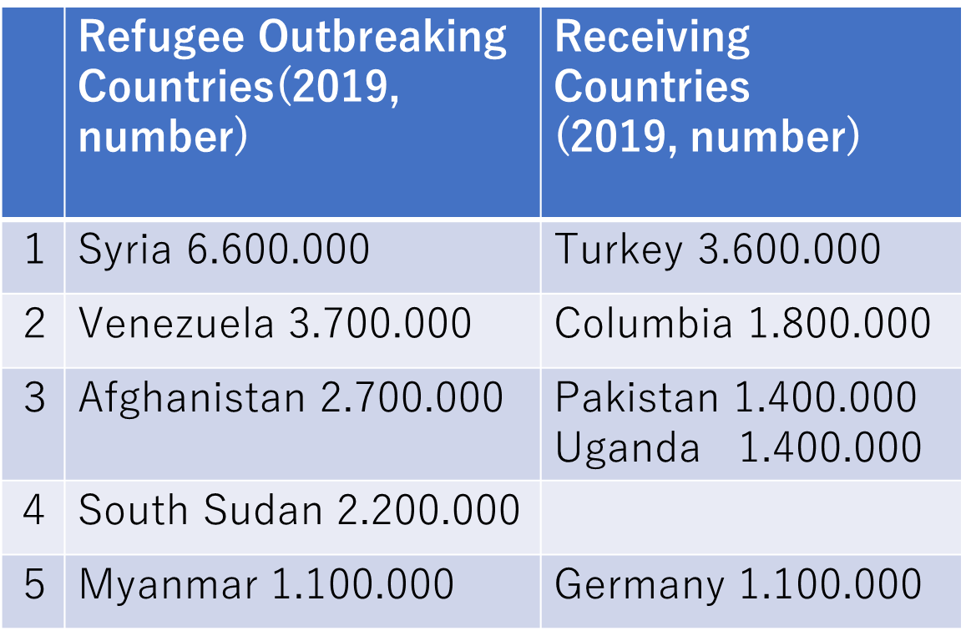
1. The Japanese government's response to the refugee crisis
Number of refugees in the world [UNHCR 2019]
persons forced to move due to conflict or persecution 79,500,000
  Internally displaced persons 45,700,000
  Refugees 29,600,000
  Asylum applicants 4,200,000

Slide 3
The number of asylum applications
New asylum applications 2,000,000[UNHCR 2019]
USA 301,000
Peru 259,800
Germany 142,500
France 123,900
Spain 118,300
increasing in Japan,
7,586(in 2015)→10,901(2016) →19,628(2017)
But, the number of recognized refugees remains low at around only 20 (Ministry of Justice, 2020).

Slide 4
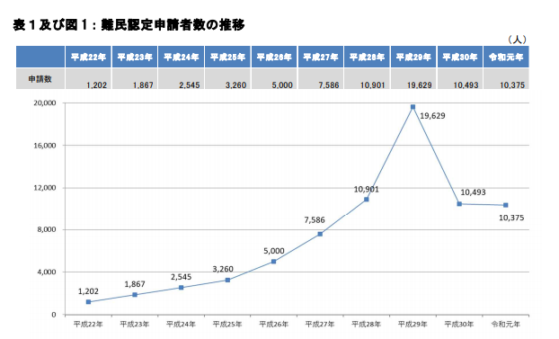
Ministry of Justice, http://www.moj.go.jp/isa/content/930005069.pdf

Slide 5
(1) Japanese Regime for Refugees
International : In 1981, the Japanese government joined the 1951 Refugee Convention and its 1967 Protocol (came into effect in 1982).
National : Immigration Control and the Refugee Recognition Act
The Immigration Services Agency in the Ministry of Justice
It only accepts refugees who are recognized by the 1951 Refugee Convention : forced to leave their home countries due to conflicts or natural disasters
Only 20 people recognized as refugees among 19,628 in 2017 (0.1%): EU28 (23%), USA(42.5%), Canada (67.3%)(Kondo 2019, p.253)

Slide 6
Resettlements from Myanmar: only 87 people were accepted (2010-2014), compared to the annual acceptance limit of 30.
  employment possibilities
  small-scale refugee communities
  difficulties of social integration(learning Japanese)
Financial support to international refugee organizations :
voluntary contributions of 20 to 30 billion yen to UNHCR and other institutions each year
a total of \200 billion (\ 97 billion, to support IDP and refugees in Syria and Iraq）
⇒these contributions should be re-evaluated

Slide 7
(2) Japanese Immigration Regime
Officially denying immigration policy...
1,280,000 foreign workers in 2017: due to the reform of the Immigration Control Acts in 1989
  foreign students
  highly skilled foreigners
  permanent residents and their Japanese spouses and descendants : Nikkei-jin (144,000 Brazilians and Peruvians in 2017)
  Technical Intern Trainees (in 1993, young Asians: Chinese, Vietnamese )
Public support and information for foreigners living in Japan are insufficient.
A decreasing labor shortage due to the declining birthrate (1.36 in 2019!) and aging population forced changes in the immigration policy
  To reform their Immigration and Control Act(Dec. 2019)
  To introduce the status of Specific Technical Intern
  high skills and expertise to work for five years maximum

Slide 8
(3) Some inconveniences for refugees and foreigners coming to Japan
Some reasons for the small number of asylum
practical inconveniences as regards procedures: documents in Japanese ; not having the status of legal, they cannot work
Geographical reasons: isolated by the sea ; high cost of visiting and living.
The annual budget for resettlement programs for 30 people is 130 million yen (calculated at 4 million yen per person)
this can help 40 refugees in underdeveloped countries (Takizawa 2016, p.21)
an image as being intolerant to refugees : no refugee chain

Slide 9
Although this intolerance for refugees is recognized,…
An asylum seeker having residence status can work and, if the application is denied, he or she can object and reapply.
Those applying for refugee status with the purpose of finding work are increasing among Nepalese, Vietnamese, Indonesians, etc.

Slide 10
Hathaway, James C., The Rights of Refugees under International Law, Cambridge University Press, 2005 (佐藤安信・山本哲史訳『難民の権利』日本評論社, 2004)
Kondo, Atsushi, Multicultural coexistence and Human rights (『多文化共生と人権』), 2019, Akashi Shoten (in Japanese).
Ministry of Health, Work and Welfare, “Official statement about Employment status of foreigners”(外国人雇用状況の届出状況), October 2017 (in Japanese).
Ministry of Justice, “About the number of refugees recognized in the first year of Reiwa”, March 27, 2020 (in Japanese). [http://www.moj.go.jp/isa/content/930005069.pdf] January 8, 2021.
Satoshi Yamamoto, “International Human Rights Law: a Perspective on the Current Status and Issues of Refugee Protection in Japan”, Migration Policy Review, 2016, Vol.8, pp. 26-42 (in Japanese).
Takizawa, Saburo, “The Dynamism surrounding Refugees and Internally Displaced Persons: From the Perspective of Global Public Goods”, Migration Policy Review, 2016, Vol.8, pp.6-25 (in Japanese).
UNHCR, 数字で見る難民情勢(2019)[https://www.unhcr.org/jp/global_trends_2019]（January 8 2021）

