Slide 1
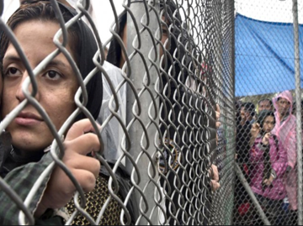
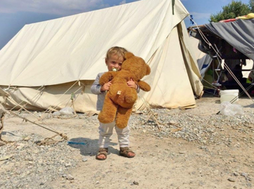
Greek hotspots in Lesbos :
reception centres, registration areas or detention camps ?
Clémence ENJELVIN, Juliane BARBONI, Léa SABRE, Pauline GARTISER, Viola CATTANI

Slide 2
Outline
Introduction
The contradictions of the EU common asylum policy
Case-study : the Moria Camp
The increasing role of NGOs
Concluding debate
Bibliography

Slide 3
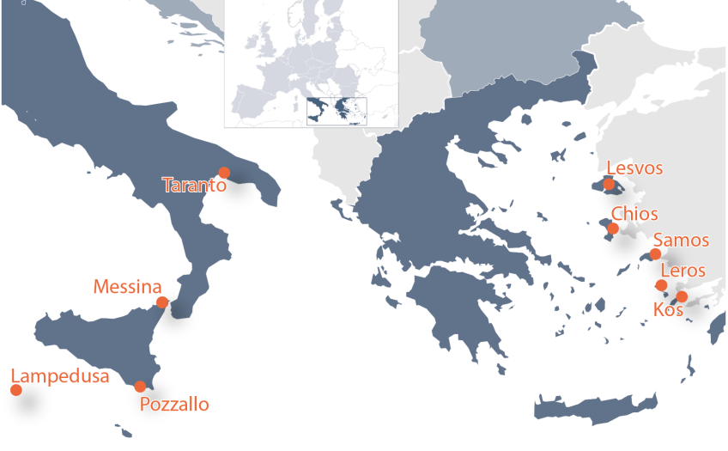
Introduction
What is a hotspot ?
Review on the ongoing refugee crisis

Slide 4
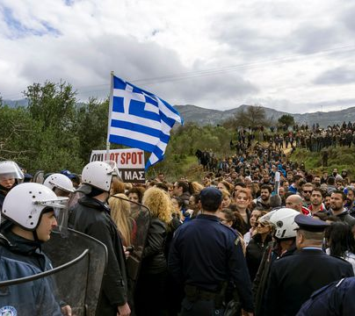
The contradictions of the EU common asylum policy
Increased EU cooperation regarding the asylum system and the control of external borders
A crisis revealing internal legal challenges of a common EU asylum policy (absence of effective mechanisms for responsibility-sharing)
Living conditions in Greece’s hotspots : a humanitarian disaster

Slide 5
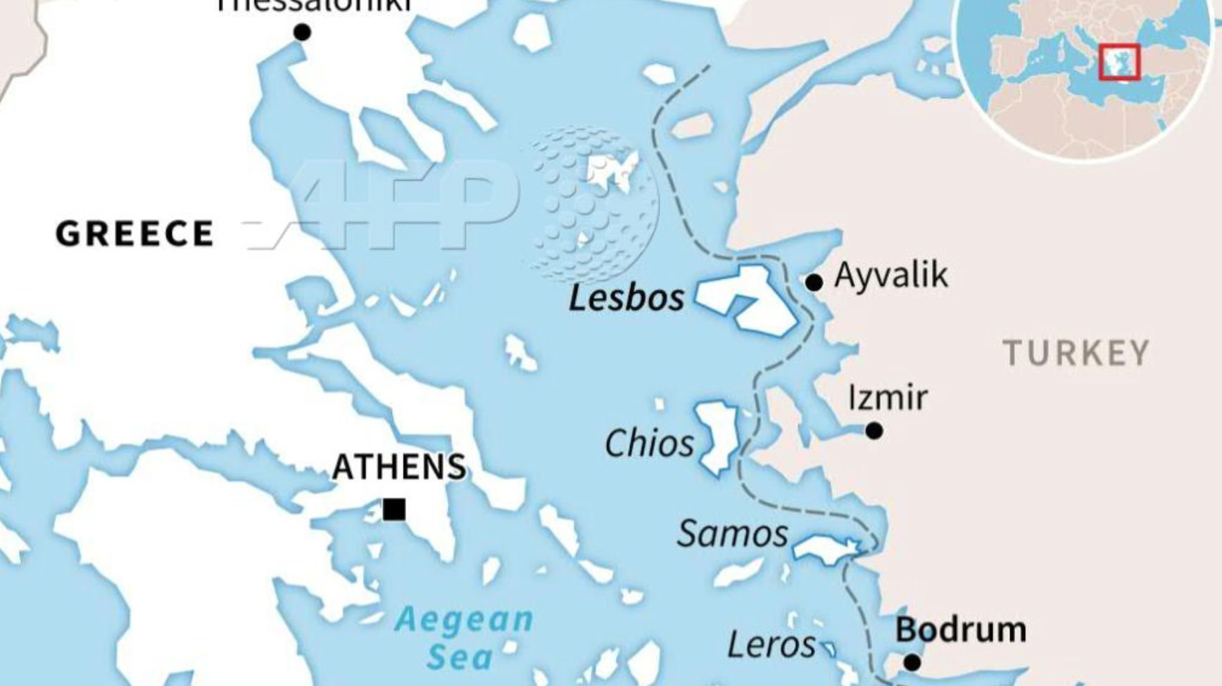
Tensions at the borders : Greece and Turkey
-> a tense political climate between the Turkish and the Greek governments
-> direct impact on the situation within hotspots

Slide 6
A case-study : The Moria Camp
• Set up by the EU in 2015 : the biggest refugee camp in Europe
• No basic services guaranteed (showers, toilets, running water, food) → mental and physical diseases
• Planned for 3,000 migrants ; it hosts more than 20,000 migrants → overpopulation leading to a Covid-19 cluster
• 43% children, often unaccompanied minors

Slide 7
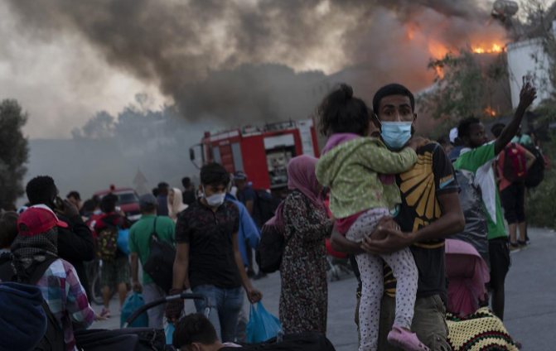
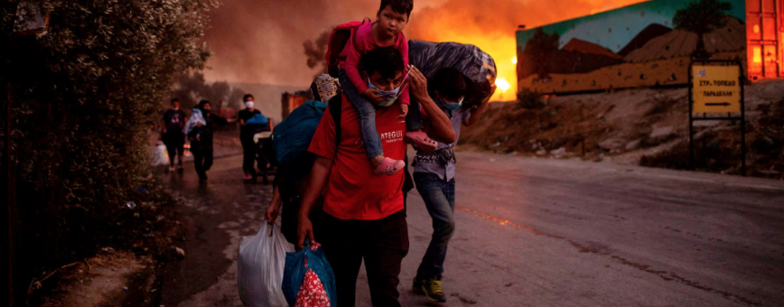
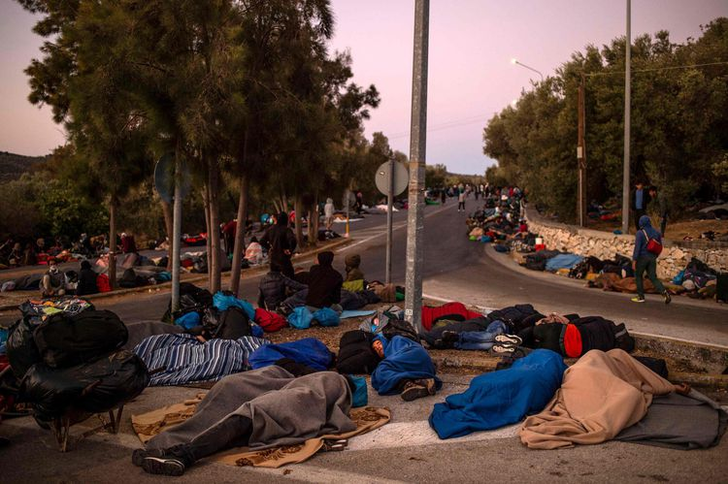
A precarious situation increased by the fire
At the beginning of September 2020, a huge fire broke out in Moria. The causes remained unknown, but it was probably linked to the criminal life in the camp.

Slide 8
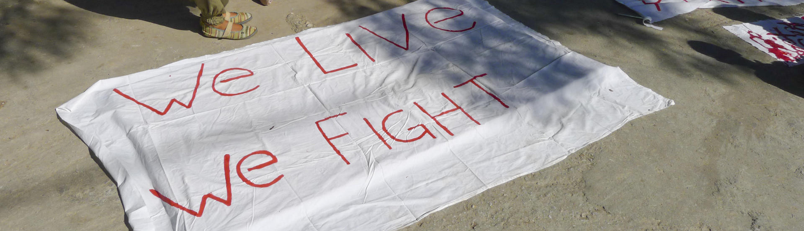
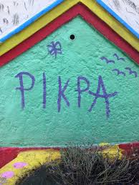
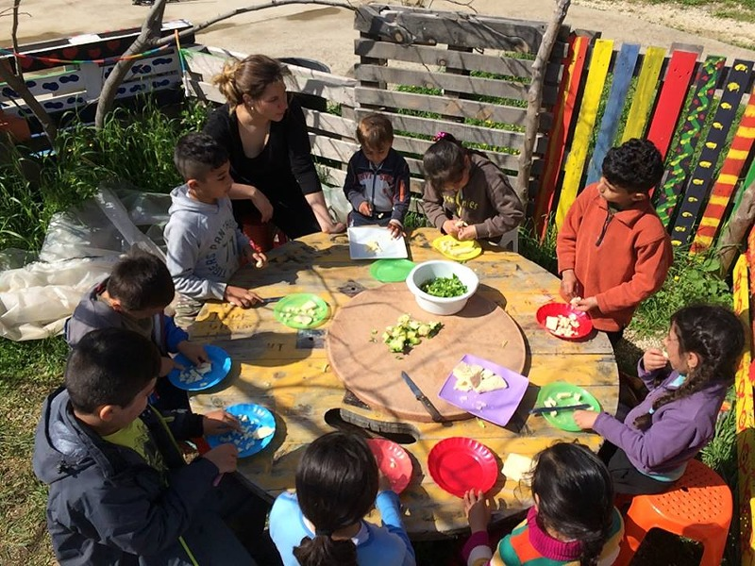
NGOs’ Essential Help
Food Assistance
Sanitary equipment
Legal support
Psychological support
Educational Activities

Slide 9
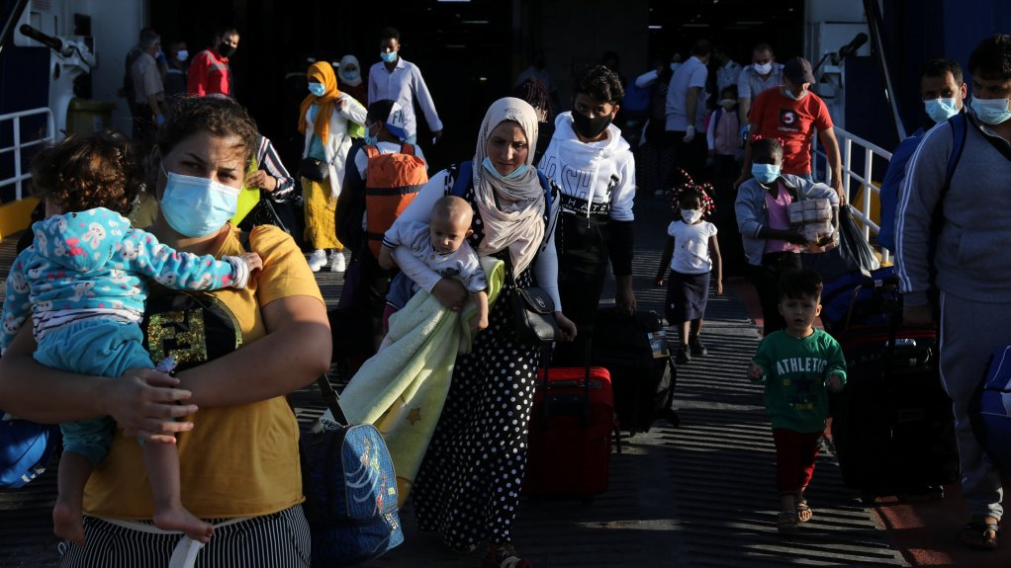
Criminalizing NGOs’ work
Paradox of NGOs’ actions
Overtake EU’s prerogatives
Relieve refugees
Assistance criminalized
Camps dismantled

Slide 10
Cooperation or Opposition ?
The Aquarius
Human Rights Issue
Failure of the State and the Institutions
Discordance at every level
Battle between the local and institutional level
Need for Global Discussions
Rethink Europe’s Migration policy

Slide 11
Concluding debate
Is the crisis Europe has been facing since 2010 a refugee crisis or a crisis of the EU institutions ?
Given the examples of Greece and the Mexican borders, we can ask ourselves if there is only one way to respond to this so-called « migrants crisis »

Slide 12
Thank you for your attention !

Slide 13
Bibliography
Books and scientific analyses
Jean Ziegler, Lesbos, la honte de l’Europe, Seuil, 2020, 132p.
Lendaro, Annalisa, Claire Rodier, et Youri Lou Vertongen. La crise de l'accueil : frontières, droits, résistances. La Découverte, 2019
Articles
https://guitinews.fr/ici-et-la-bas/2019/05/25/hot-spots-2-lesbos-a-bout-de-souffle/
https://www.ecchr.eu/en/case/greek-hotspots-complaint-against-european-asylum-support-office-to-the-eu-ombudsperson/
https://euobserver.com/migration/146541
http://www.lejournalinternational.info/incendie-du-camp-de-refugies-de-moria-a-lesbos-que-fait-leurope/
Amnesty International, « Grèce. Des réfugiés détenus dans des conditions déplorables », avril 2016 ; Human Rights Watch, « Grèce. Insécurité et insalubrité dans les « hotspots » pour réfugiés », mai 2016
Assemblée parlementaire du Conseil de l'Europe, Résolution 2118 (2016) : « Les réfugiés en Grèce : défis et risques – Une responsabilité européenne », 21 juin 2016.

