Slide 1
History Education and European Integration: The Franco-German Approach
MOEKA, ALYSON, DAVID, KRISTINE, MACIEJ, LAUREN, GIACOMO

Slide 2
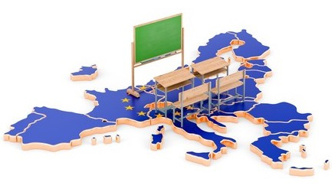
Overview
History of Educational Cooperation
History brief - Impact of World Wars
"History of nations is deeply connected to how people perceive themselves and others, and has the power both to bring people together and to hurt people"
Role of International Organisations
Council of Europe
Franco-German Cooporation
History of educational cooperation between the countries
Current projets
Case Study - Franco-German high school in Freiberg

Slide 3
Council of Europe Projects
EARLIEST TO CURRENT YEAR

Slide 4
“Council of Europe Language Policy Portal.” Language Policy Programme, Council of Europe, https://www.coe.int/en/web/language-policy/home.
Language Policy Programme
History
Objectives
Projects
PLURILINGUALISM AND INTERCULTURALISM
1990-97 'New-style' workshops
ESTABLISHED 1965
1968 Network of language correspondents
"EDUCATION FOR ALL" (COE, 2018)
1994 European Center for Modern Languages(ECML) established
LANGUAGE REFERENCE TOOLS
2005 Europass
SOCIAL AND POLITICAL COHESION, INCLUSION AND INTEGRATION
2008 Linguistic Integration of Adult Migrants (LIAM) launched
2017 Web 'toolkit' launch

Slide 5
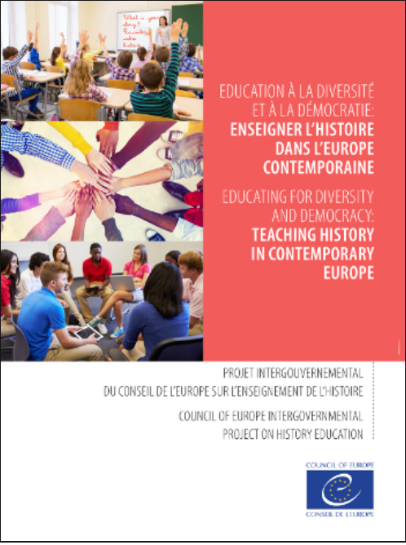
Projects
01
1954
European Cultural Convention
02
1997-2001
Learning and teaching about the history of Europe in the 20th century
03
NOW
Educating for Diversity and Democracy: teaching history in contemporary Europe

Slide 6
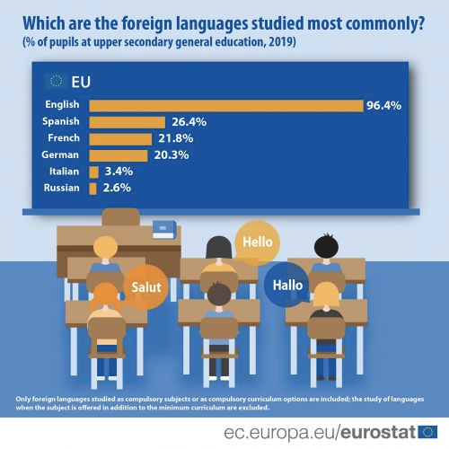
Franco-German Results:
Large percentage of compulsory language curriculum is Franco-German
-Emphasizes importance of language inclusion and cultural cooperation for educating students
“Foreign Language Learning Statistics.” Foreign Language Learning Statistics - Statistics Explained, Eurostat, Sept. 2021, https://ec.europa.eu/eurostat/statistics-explained/index.php?title=Foreign_language_learning_statistics#Primary_education.

Slide 7
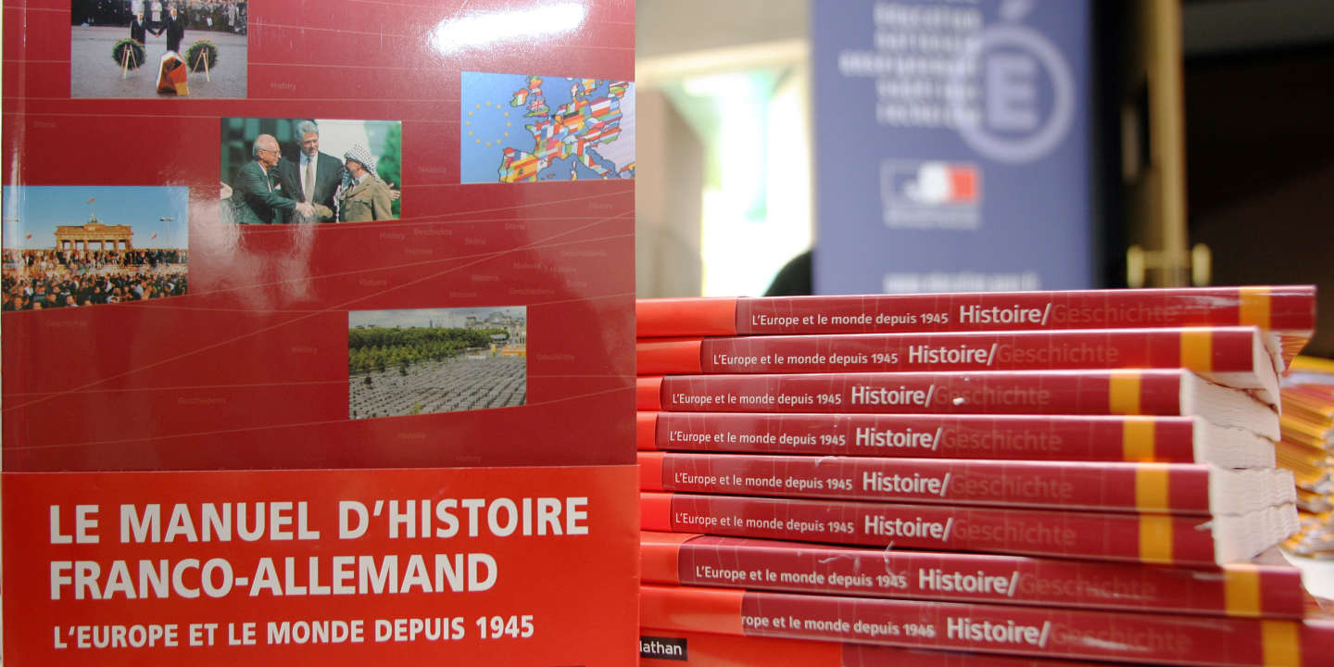
The Franco-German cooperation on history education

Slide 8
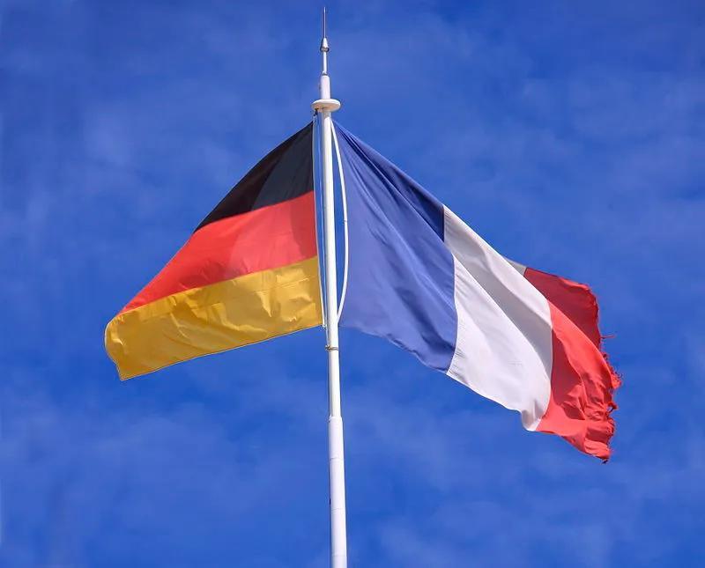
Franco-German
Educational cooperation
From high school to university

Slide 9
EXCHANGE PROGRAM
(ALL THE YOUNG PEOPLE)
01
8
over million French and German young people have participated in
Examples
02
ABIBAC(HIGH SCHOOL TO UNIVERSITY)
03
FRACO-GERMAN UNIVERSITY
4500
140
150
In 2002
http://conworld.wikia.com/wiki/Franco-German_Commonwealth
students
courses of study
universities

Slide 10
02 What is AbiBac?
intense language classes
extra lessons about partner country
from high school to university
http://www.education.gouv.fr/cid20998/l-abibac.html
additional exams during the final exams in high school
→

Slide 11
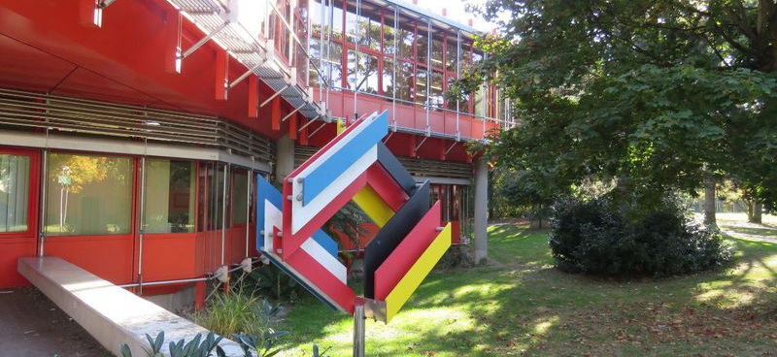
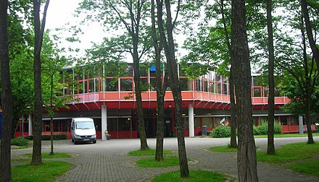
Case study
-Franco-German high school
in Freiberg-
Opened in 1972
"based on the objective to educate young people from both nations... to prepare them for the challenges of a coalescent Europe" -Martin Wedel, former headmaster
Issues
Hiring process and legal situations
Different teaching styles
Teaching History

Slide 12
National Identity and Memory Politics

Slide 13
Narratives of war have an important impact on national identity
Implications
France and Germany have strong economic and political ties
Will this approach work for other nations?

Slide 14
Sources
・Master_Thesis_G._Deiana-Schoeninger (2).pdf
・Briefing European Parliamentary Research Service (europa.eu)
・Franco-German Youth Office (FGYO)--https://rm.coe.int/CoERMPublicCommonSearchServices/DisplayDCTMContent?documentId=090000168049443a
-Goodson, Ivor. (2006). European Cooperation in Education: Historical background and contemporary experience. European Journal of Teacher Education. 5. 19-28. 10.1080/0261976820050104.
https://www.coe.int/en/web/language-policy/history
https://www.coe.int/en/web/history-teaching/educating-for-diversity-and-democracy-teaching-history-in-contemporary-europe
https://www.coe.int/en/web/history-teaching/learning-and-teaching-about-the-history-of-europe-in-the-20th-century
"Disarming Hatred" by Mona Siegal and Kirsten Harjes, History Education Quarterly, 2012

