Slide 1
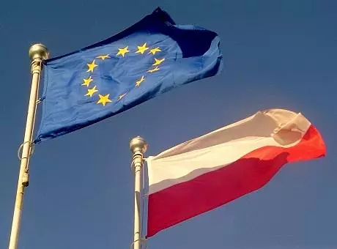
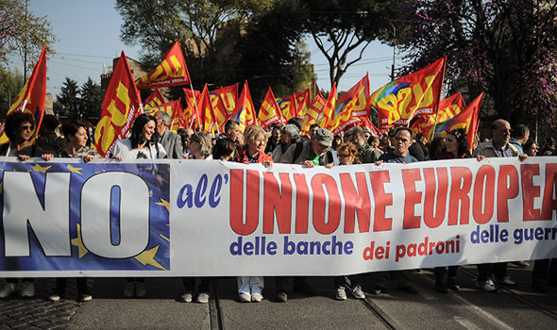
How Backlash in European Rule of Law affects European Values
Aisling McEvoy, Thayne Macey, Joshua Gaither, Simon Gehrmann, Madelyn Olvera, Oliver Neale, Hanil Yoo

Slide 2
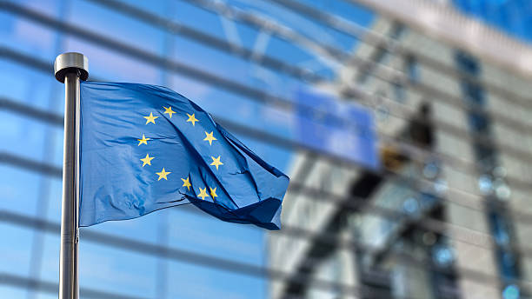
Introduction
Memory politics and shared values
Contradictions between values
Reconciling contradictory values has been a challenge
Integration is showing early signs of unravelling
Foundation of shared values regarding European integration, backlash towards integration in Poland and Hungary, and its impact on European values and integration moving forward

Slide 3
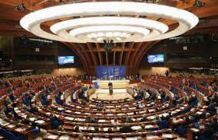
Council of Europe and Core Values
Council of Europe early example of shared values (May 5th, 1949)
The European Convention on Human Rights enshrined these values
Equality, social justice, dignity of the person, common heritage, and sovereignty
Values are co-opted and resemble modern EU
Human rights, Democracy, and Rule of Law
European governance: “governing with values”, “governed by values” and “governing values” (Calligaro, pg. 5)
Memory politics are a cornerstone of integration

Slide 4
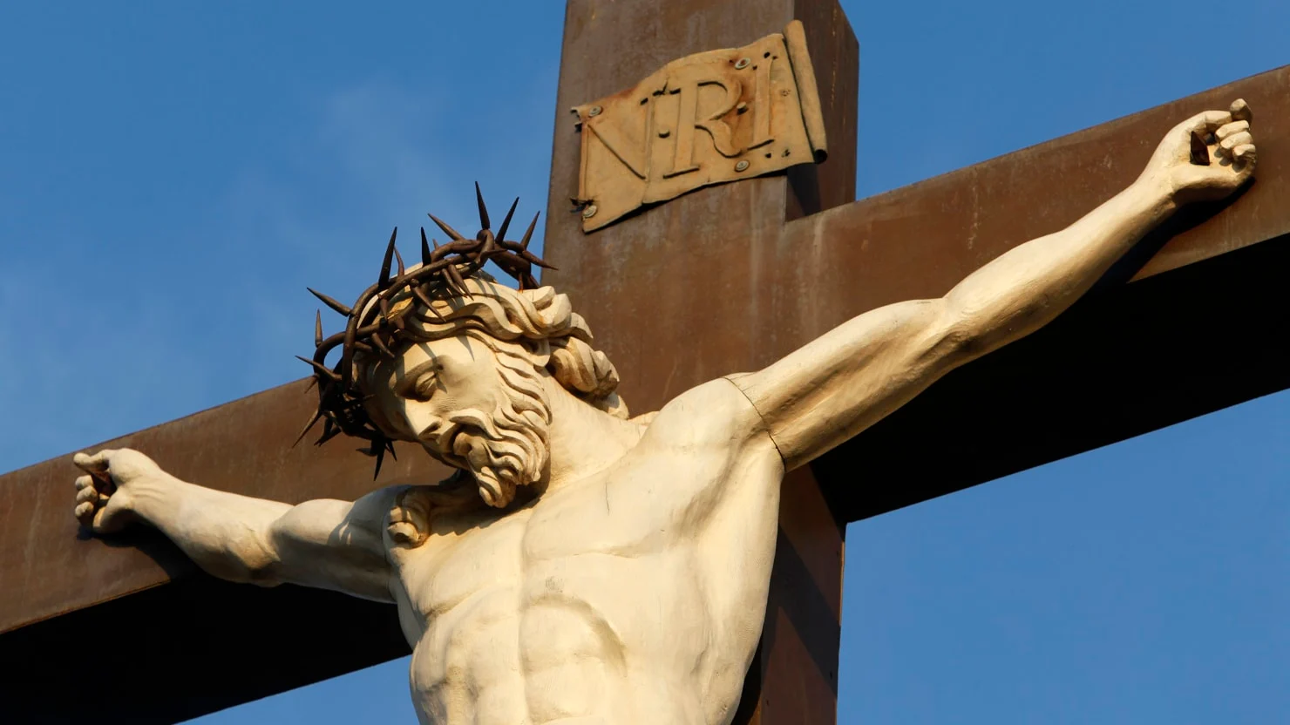
Christianity as a Shared Value for Integration
- Healthy alternative as extremism counters Christian teachings-“one characteristic feature of Christian democratic ideology is the forthright rejection of the extreme doctrines put forth by capitalism on the one hand and Marxism on the other, both represent forms of materialism that run counter to Christian teachings ”- Paolo Morisi (2004) pg.48
-Anti-War religious sentiment
-Values previously described are recognized as shared Christian values
-Religion is an equal value that most of Europe shared: “ the pooling of our … experience doubles the strength of our national potentialities , and preserve them in the danger of decline..”- Italian PM Alcide de Gasperi (1951)
- Influence of Catholic extranational leadership- Catholicism is a religion that is more willing to conform to extranational leadership because of the role of the Pope

Slide 5
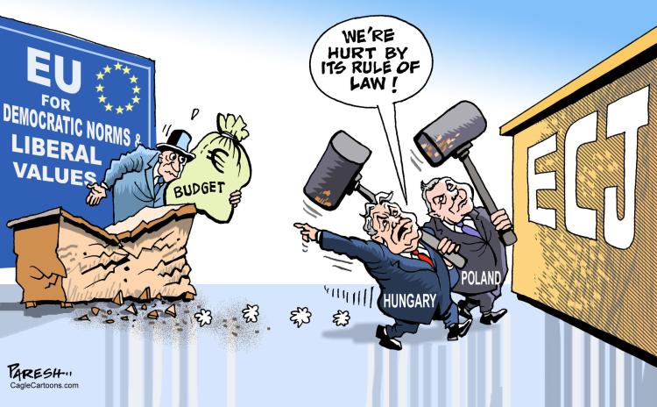
Backlash of Rule in Law in the EU
Continued backlash of rule of law in the EU
EU Rule of Law Mechanism -> Rule of Law Report
EU Rule of Law Conditionality Regulation
Observed mainly in Hungary and Poland
Hungary: undermining independence of media, justice and education, corruption, limiting civil liberties
Poland: judiciary reforms, limiting civil liberties
EU is monitoring the situation in Hungary since 2011
2019: infringement procedure against Poland
2021 letters were sent to the two countries informing them about possible financial sanctions
2022: ECJ Ruling rejecting Hungary’s and Poland’s challenge of the Rule of Law Conditionality Regulation
Notes:
Report since 2020
Also in Bulgaria, Romania and Czech Republic
Hungary only country in EU that is only partly free (Freedom House)

Slide 6
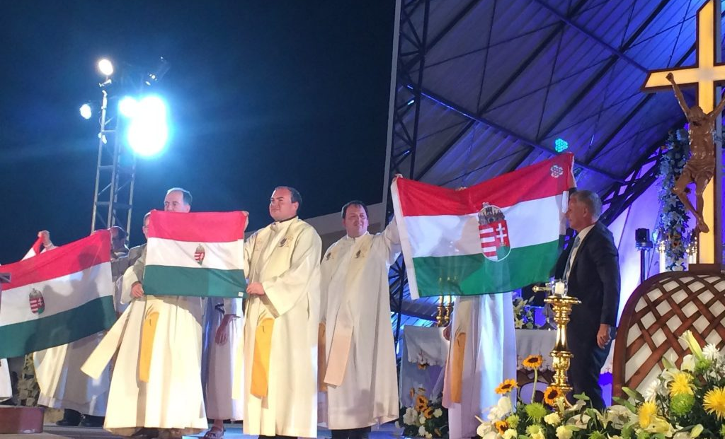
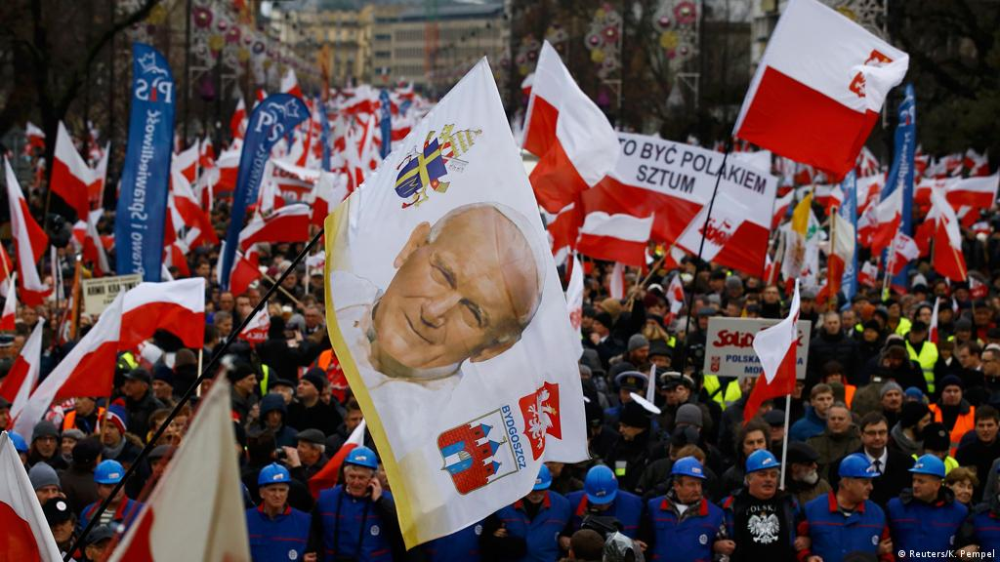
National and Religious Values Causing Backlash
-National Constitutional Supremacy
-God’s Creationary Intentions
-Gender Complementarity: Passages Genesis 1 and 2
-Christian Family Values

Slide 7
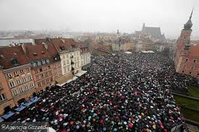
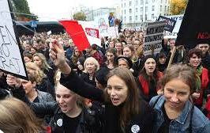
Backlash due to Religion: Abortion
Poland
Law passed that banned abortions due to fetal abnormality
Placed a blanket ban
Women Strike
Condemned by the European Council
Hungary
Abortion is still legal but with fear of Orban’s administration finding a loophole
“No abortion” condition to funding hospitals

Slide 8
Backlash due to Religion: LGBTQ+
Poland
Large sections of western Poland claim to be “LGBT ideology free”
Church sermons and school teachings endorse Law and Justice Party values
Terrorist threats, violence, and government intervention have cut pride parades short
No legal recognition of same-sex marriage or civil unions
Hungary
Law passed that bans the promotion and display of “homosexual and transgender propaganda” to minors
Led to a surge in attacks
Same-sex marriage is banned
No legal recognition of transgender Hungarians

Slide 9
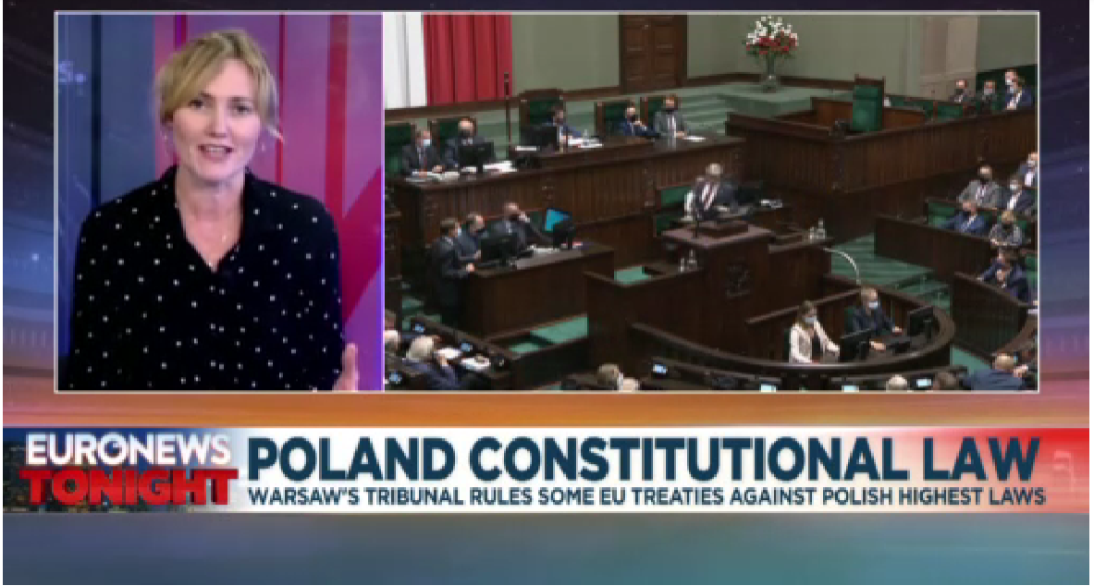
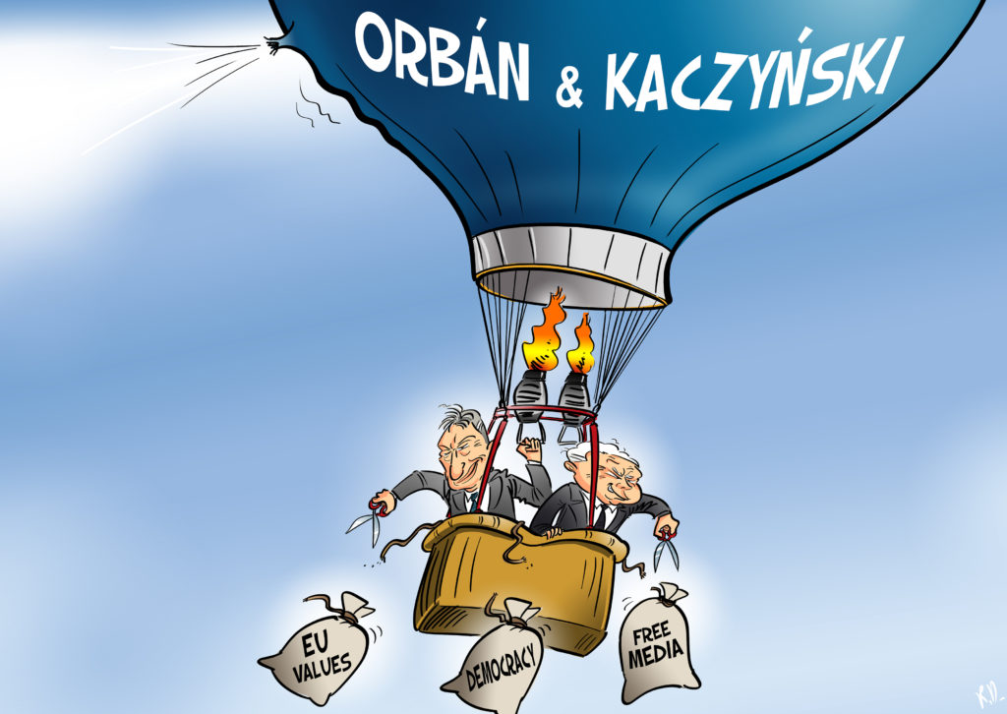
Rejection of Policy and The Rule of laws In Poland and Hungary

Slide 10
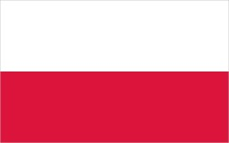
Damaged Check and Balance
Administration's intervention in the judiciary
Lowering the retirement age of judges
Possibility of opposition about election and referendum results.
-Chamber of Extraordinary Control and Public Affairs
The Minister of Justice concurrently serves as the Prosecutor General.
Continuing constitutional amendment
Can fire the Chief Justice and Supreme Court Justices.
Highering the retirement age of judges
Separate administrative court system.
Reduced ombudsmen from 4 to 1

Slide 11
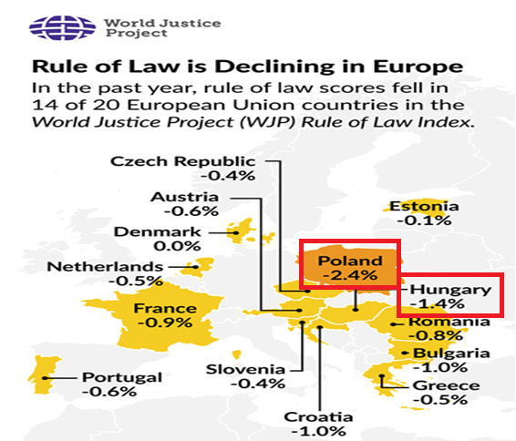
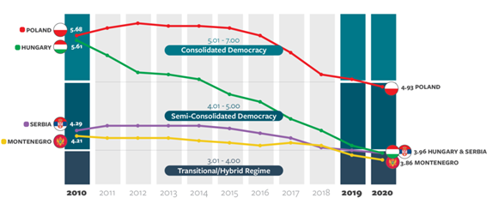
Setback in Democracy

Slide 12
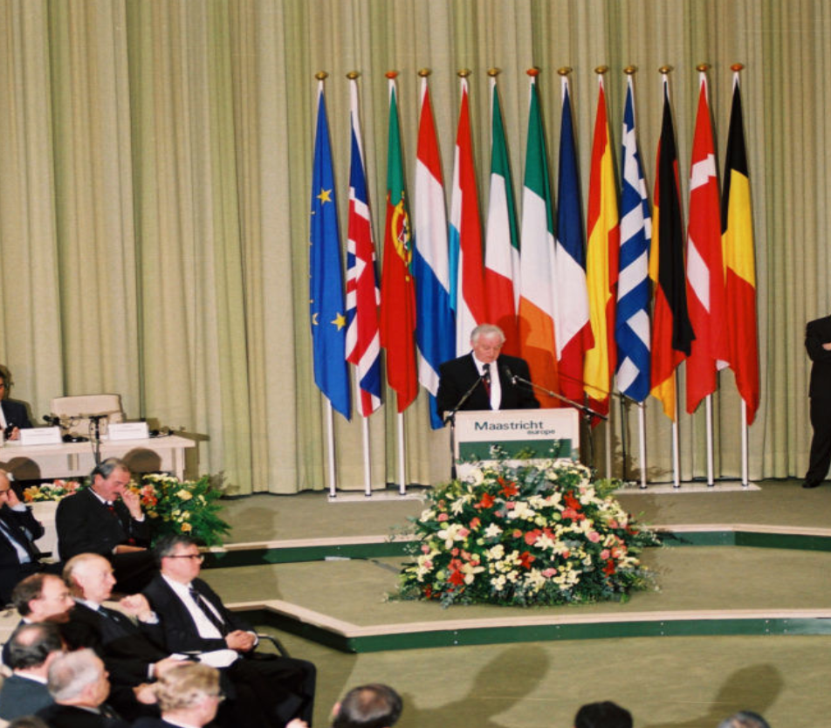
Impact on European Values
1992 Treaty of the European Union Article 2 defines EU values
Legal framework on values is minimalistic compared to the framework on economic integration
EU nations’ governments must defend EU rule of law to maintain the integrity of the EU
Image: (European Commission, 1992)
(Grabbe, 2017), (Buchanan, 2021)

Slide 13
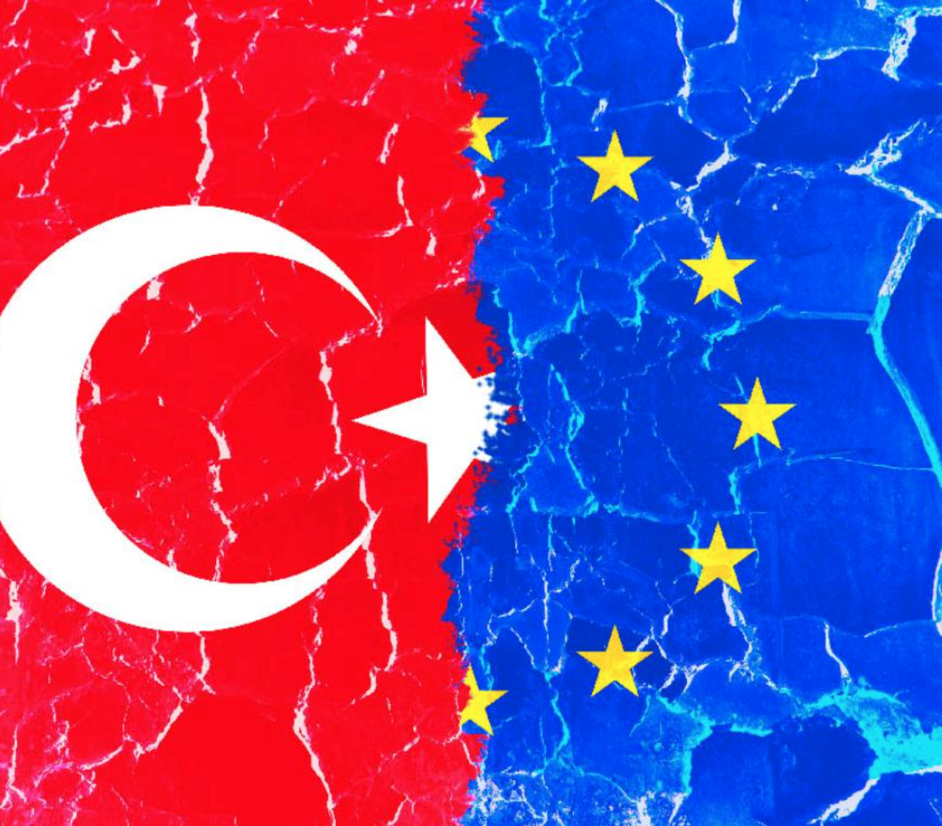
What does it mean for the future?
Turkey’s values are not always aligned with the EU’s
Could the backlash from member states inspire further backlash from Turkey?
(EEAS, 2020), (Scazieri, 2021)
Image: (European Parliament, 2016)

Slide 14
Conclusion
Memory politics is vital to European integration with the most shared values promoting dignity and democracy.
The democratic backslide occurring in Hungary and Poland represent an existential crisis for the EU
Backlash stems from Religious values : hypocritical considering the process of European integration was built as a means to preserve those same Christian values
EU can no longer solve the problems of damaged democracy through simple regulation
Consequences of the backlash include the potential of other European countries include potential EU member states to object to European values

Slide 15
Bibliography
Adam Holesch & Anna Kyriazi (2022) Democratic backsliding in the European Union: the role of the Hungarian-Polish coalition, East European Politics 11-12
Barbara Schumacher. (1970, January 1). The influence of the Council of Europe on the European Union: Resource Exchange and domain restriction as venues for inter-institutional influence. SpringerLink. Retrieved March 24, 2022, from https://link.springer.com/chapter/10.1057/9780230369894_10
BELLAMY, KRÖGER. “Countering Democratic Backsliding by EU Member States: Constitutional Pluralism and ‘Value’ Differentiated Integration” Swiss Political Sci Review 2021
Buchanan, Cordelia. “What Can We Do about Poland and Hungary? | CEPA.” CEPA, 4 Feb. 2021, cepa.org/what-can-we-do-about-poland-and-hungary/.
Calligaro, O., Coman, R., Foret, F., Heinderyckx, F., Kudria, T. & Perez-Seoane, A. (2016). Values in the EU policies and discourse. A first assessment. Les Cahiers du Cevipol, 3, 5-52. https://doi.org/
Daniel Tilles, Poland no longer rated as full democracy in new Freedom House index, Notes from poland, 6 MAY, 2020
https://notesfrompoland.com/2020/05/06/poland-no-longer-rated-as-full-democracy-in-new-freedom-house-index/
EEAS. “The Way Ahead after a Difficult 2020 for EU-Turkey Relations.” EEAS - European External Action Service - European Commission, 18 Dec. 2020, eeas.europa.eu/headquarters/headquarters-homepage/90861/way-ahead-after-difficult-2020-eu-turkey-relations-%C2%A0_en.
European Commission. “EU Rule of law conditionality”. European Commission, 2021
European Commission. “EU Rule of Law Report 2021. European Commission, 2022
Grabbe, Heather. “Defending EU Values in Poland and Hungary.” Carnegie Europe, 2017, carnegieeurope.eu/2017/09/04/defending-eu-values-in-poland-and-hungary-pub-72988.
Michael Bernhard. “Democratic Backsliding in Poland and Hungary” Slavic Review, 13 Dec. 2021 https://www.cambridge.org/core/journals/slavic-review/article/democratic-backsliding-in-poland-and-hungary/8B1C30919DC33C0BC2A66A26BFEE9553
Morisi, Paolo. “The Role of Christian Democracy in Support of European Integration.” Studies: An Irish Quarterly Review 93, no. 369 (2004): 45–53. http://www.jstor.org/stable/30095689.
Scazieri, Luigi. “From Partners to Rivals? The Future of EU-Turkey Relations.” Centre for European Reform, 23 June 2021, www.cer.eu/publications/archive/policy-brief/2021/partners-rivals-future-eu-turkey-relations.
Smolka, Theresia. “Decline of democracy—the European Union at a crossroad”. Zeitschrift für Vergleichende Politikwissenschaft, 15: 81–105, 2021
World justice project, European Union’s Top Court Rules Against Hungary and Poland in Rule of Law Showdown, 16 Februrary 16, 2022
https://worldjusticeproject.org/news/european-union%E2%80%99s-top-court-rules-against-hungary-and-poland-rule-law-showdown

