Slide 1
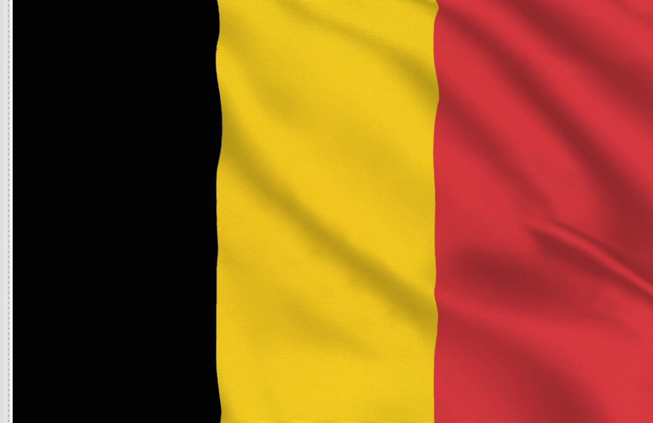
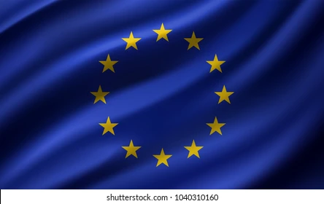
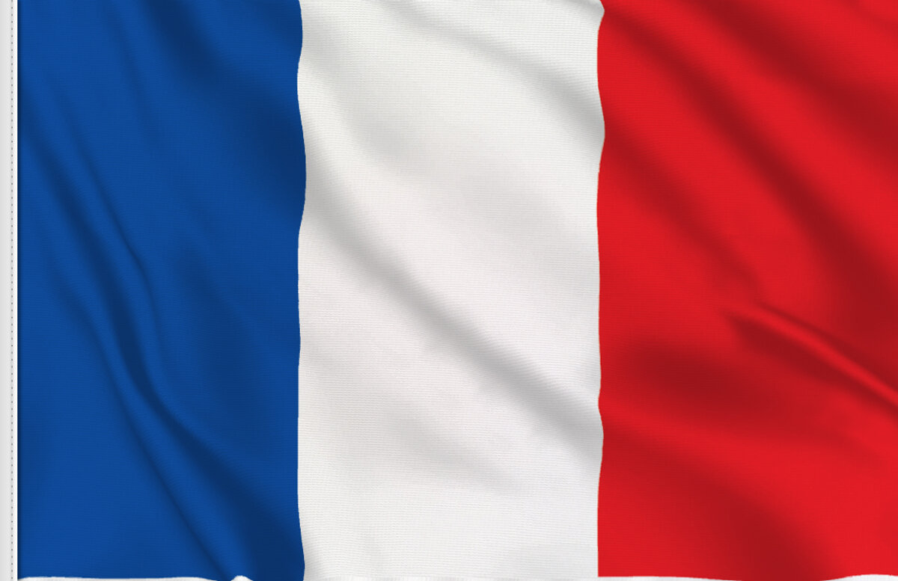
The Cultural Heritage of
European Integration
Brussels and Strasbourg
Anastasia Baila, Emma Bjarnås, Martha Neila, Foteini Palioura, Laura Pastor, Clara Roche & Isolde Slattery
Image source: vectorportal.com, flagsonline.fr

Slide 2
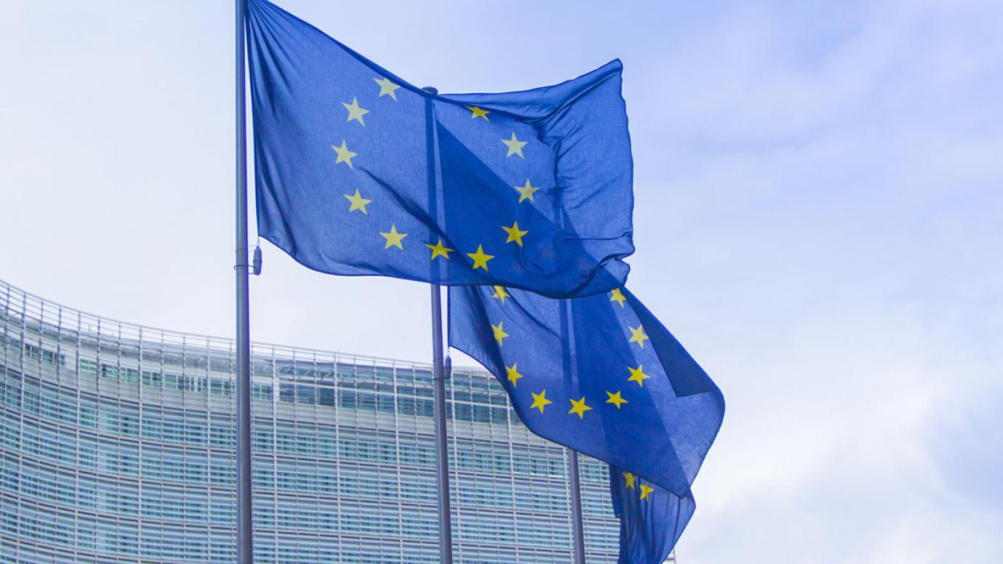
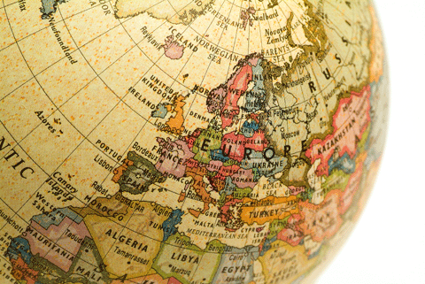
Why is the Cultural Heritage Important to Remember?
Enriches our lives
Allows us to learn from the past
Shapes our society today
Image source: culture.ec.europa.eu, efah.org
Notes:
European culture and heritage play an integral role in enriching our lives but as well as this, they reflect our way of life and dictate how we shape our society as well as its value.
We must take time to reflect on our European cultural heritage as it is the foundations of our society today. Europe is rich in cultural heritage, and it is of vital importance that we acknowledge it. In our recent history, there have been millions of deaths as a result of war in Europe. These wars have shaped the society we live in, we can see this through the institutions which have evolved in post-war Europe, including the EU, the OECD and the council of Europe.
It is of the utmost importance to acknowledge and understand our cultural heritage in order to allow us to continue to develop our society and to prevent the horrors of the past from repeating themselves. Throughout this presentation we hope to further your understanding of some of the culturally significant aspects of both Strasbourg and Brussels.
Source: Retrieved 24 March 2022, from https://culture.ec.europa.eu/policies/selected-themes/cultural-heritage.

Slide 3
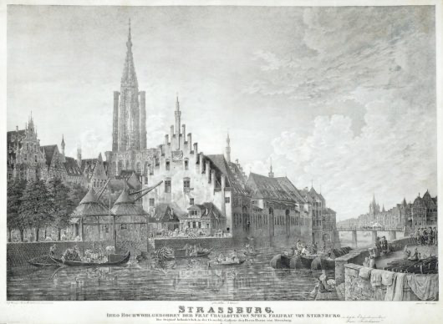
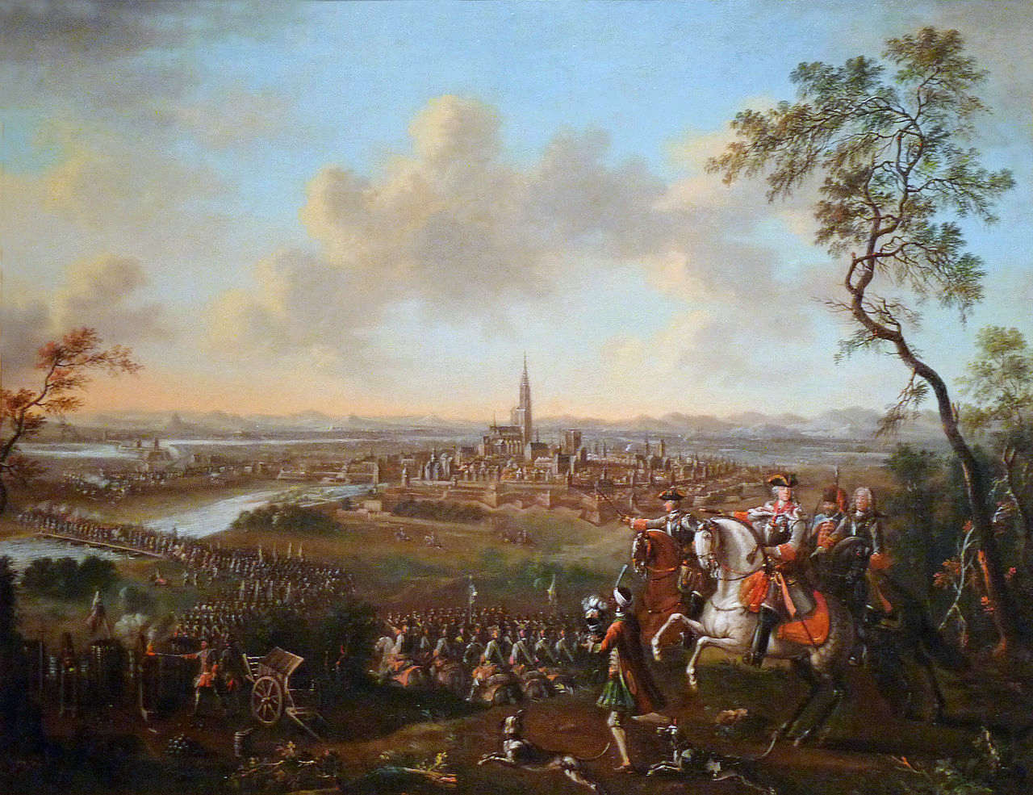
History of Strasbourg
Heart of Europe
Democracy, Rule of Law and Human Rights
Printing + Germany & France
Reconciliation and Harmony
Image source: strasbourg.port.fr, snippetsofparis.com
Notes:
Right now, as of this moment, we are in an EU-metropole, also referred to as the city of Strasbourg which is also often described as the Heart of Europe. Its description as the Heart of Europe is both due to the city being the host for the European Parliament, The Council of Europe and the European Court of Human Rights, but also as a central city for European Integration by upholding the values of democracy, rule of law and the constant defense of human rights.
The city is located in the Grand-Est region of France and is known for being the birthplace of printing because of Johannes Gutenberg. However, the city is also known for its long history of war, being in the middle of conflict, caught between Germany and France. Strasbourg started out as a part of the German Holy Roman Empire, but was annexed by France in the 1600’s and stayed in French hands for quite some time, however, in 1871 Strasbourg fell back into the hands of Germany after the so-called Franco-Prussian war. Then after World War I, France took Strasbourg back, however, Strasbourg did not remain in the hands of the French for long, it was annexed to Germany once again during the Second World War. Then at last the region of Alsace and Strasbourg was given back to France in 1944, this lead Strasbourg to become a place symbolized by reconciliation and harmony, a symbol of the conflict between Germany and France finally coming to an end, creating a long lasting peace and good foundation for what Europe stands for today.
It was therefore chosen to become the capital of Europe after the Second World War, and the city keeps on showing its symbolic status through the centrality of European values that flows through the city of Strasbourg. As Ernest Bevin, Secretary of State for Foreign Affairs in the UK, said in 1949, and I quote:
“This city which, more than any other one, was the victim of the European nations’ stupidity which thought to solve their problems with the war, now has to embody the symbol of reconciliation and peace”. End of quote.

Slide 4
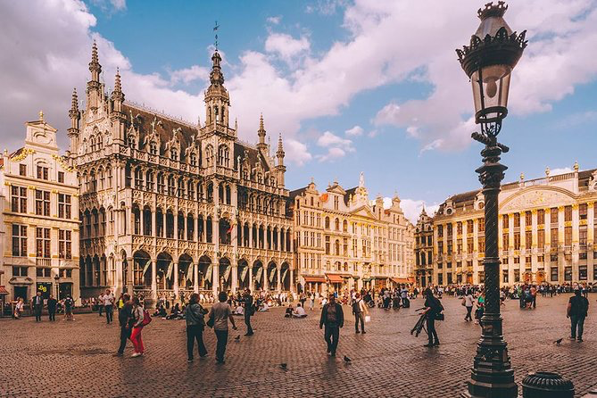
History of Brussels
The political and administrative capital of the EU
Home to many foreigners
Richness of Architecture and Heritage
The European Quarter in Brussels is home to the headquarters of the European Union and its institutions
Image source: introducingbrussels.com, viator.com

Slide 5
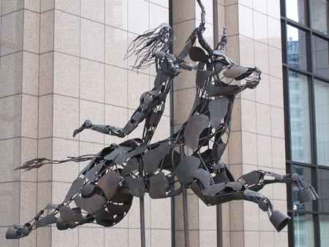
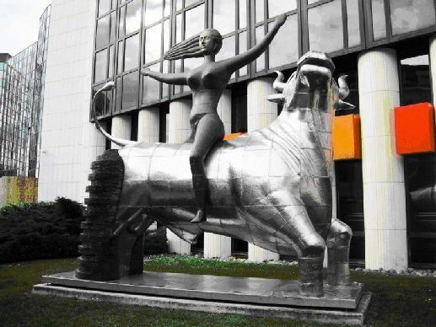
“Europa and the Bull”
Princess Europa
Brussels
Strasbourg
Notes:
The continent of Europe is named after Europa, a strikingly beautiful princess from Greek mythology. According to Homer’s Iliad, Zeus falls in love with Europa, but as he is married to his wife, Hera, he has to take the shape of a bull. He finds Europa on a beach and abducts her on his back, as depicted in these two monuments. They swam to Crete, where Europa became the first queen, and therefore, the founder of European culture. Europa is remembered as the personification of the nations and cultures of Europe.
In the European Quarter of Brussels, there is a sculptural depiction of this myth entitled “Europa Riding The Bull”. This sculpture was created by Léon de Pas and erected in Brussels in 1997 to commemorate the 40th anniversary of the Treaty of Rome, which established the European Economic Community, or, in other words, the European Union in its earliest iteration. The sculpture is constructed of a skeleton of copper and steel tubes, covered with bronze plates
Strasbourg houses its own depiction of “Europa and the bull” near the European parliament, a sculpture entitled “The Removal of Europa”. This sculpture was created by Greek brothers Nikos and Pantelis Sotiradis and given as a gift from Crete to the European Parliament in 2005. It weighs six tons and combines three materials. The bull is made out of steel, the girl is made out of bronze, and the back of the bull is made out of glass.

Slide 6
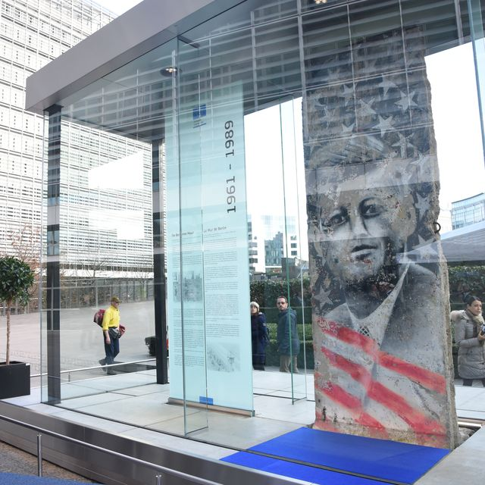
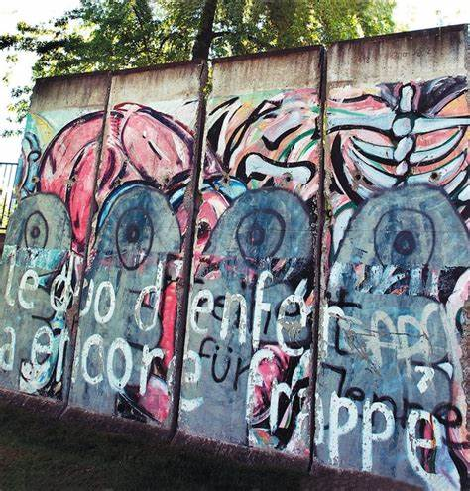
Berlin Wall
Brussels
Strasbourg

Slide 7
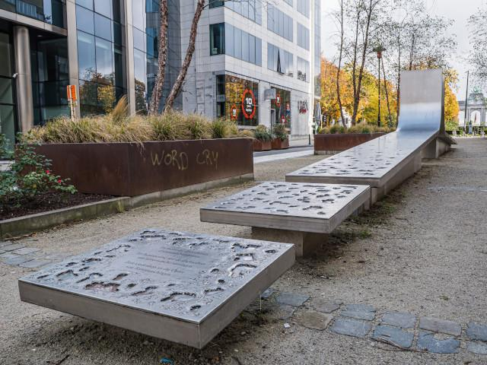
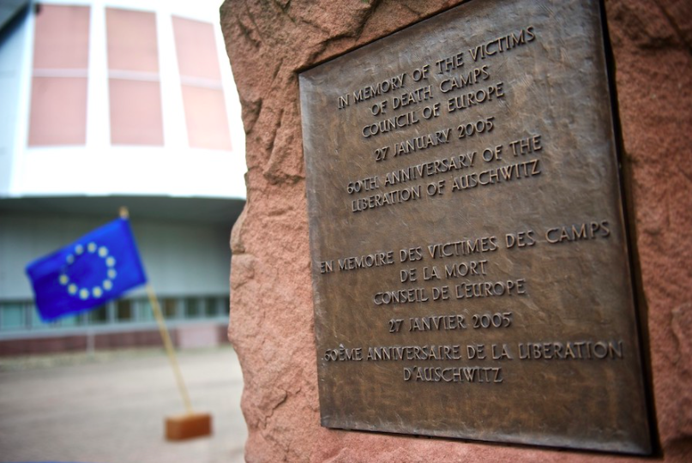
Memorials at the European District
Brussels
Strasbourg
Notes:
this memorial called "Wounded But Still Standing in Front of the Inconceivable" was inagurated the twenty second of March 2017, exactly one year after the terrorist bombings in Brussles. Additionally to commemorating its victims, it being placed in the European district of brussels, serves as a symbol of Europe’s rejection towards violence, being a symbol of how Europe has united since 9/11 to fight against terrorism. Since then, many European countries have experienced a terrorist attack, terrorism becoming a shared pain and threat. This has also helped Europe define its principles and build a stronger sense of “Europeaness” which is pivotal for strengthening Europe’s democracy and facilitating policy making. All these memorials which sadly run across Europe, have become part of our united heritage and a symbol of how although Europe has been wounded, griefs united and alway stands to protect freedom and peace,
In strasbourg’s European district, there is also a Memorial and it is the the memorial of Auschwitz which was Inaugurated in 2005. It again serves as a symbol of Europe’s rejection towards violence. Also, to remind Europeans of the common heritage we share of the atrocities that occurred in the second world war. One that brought European integration and that European institutions do not want us to forget in order for history to not repeats itself. This is especially significant as it is found near the European court of human rights wheich condems forced labour, toruture as well as Holocaust deniers, this memorial also illustrating how European instititutions believe states have a moral responsability to protect our collective memory as Europeans.

Slide 8
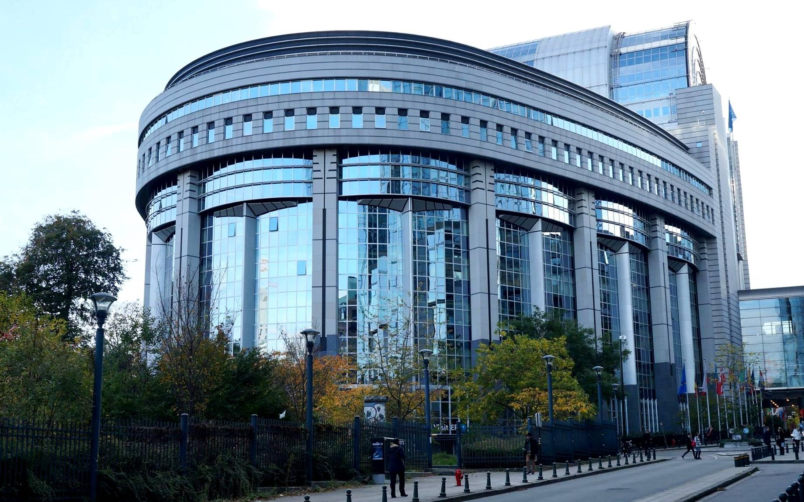
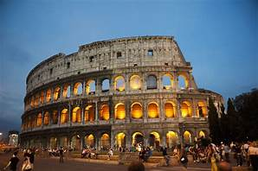
European Parliaments Architecture
Brussels
Roman Colosseum
Notes:
Now, the buildings of the different European Instititions were made not only to stand as buildings alone but to additionally stand as monuments. In this way, both the European Parliments of Brussles and Strasbourg have become a symbol of Europes power and part of the cultural heritage of European Integration. Some people have alluded Paul-Henri Spaak building of brussels, which contains the debating chamber, to be a futuristic interpretation of the Roman Collisiom, which could connote our shared past to the political entity of the Roman Empire, yet show how Europe always looks towards to the future.
This is the case also for the The Parliment of Strasbourg, which seems unfinished, connoting how European integration is still in process. Furtherore, the building is inspired by the famous painting by Peter Brueghel, the tower of babel. ” alluding to a world with a common language; in this case rule of law, democracy and human rights so everyone comes together to build a tower to reach the heavens. Finally, as with the majority of buildings of European institutions, they are usually made of glass,, symbolising the transparency of the democratic principles it is founded on.

Slide 9
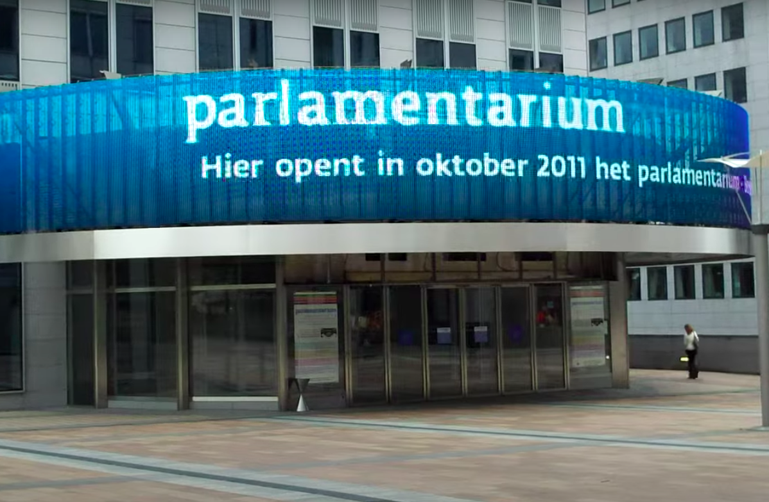
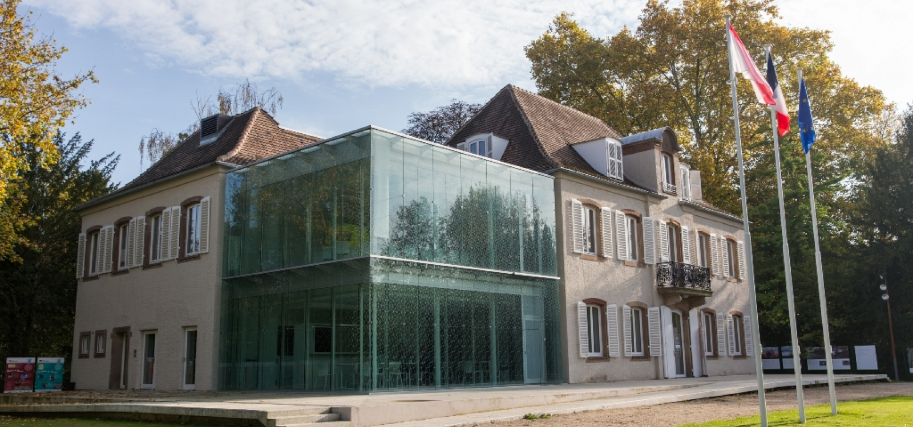
Educational
Lieu D’Europe
Brussels
Strasbourg
Image source: visiting.europarl.europa.eu, lieudeurope.strasbourg.eu
Notes:
Both Brussels and Strasbourg have educational centers for visitors, like the Parlamentarium and Lieu d’Europe correspondingly. Their aim is to educate people on the history of E.U., its institutions and their contribution to European cohesion, through their exhibitions and other means.
Parlamentarium is located in Brussels and it was officially opened for the public crowd in 2011. As its name suggests, the educational centre is mostly dedicated to the European Parliament located in Brussels. Hosted by a modern building, it is equipped with high-tech gadgets and interactive tools like a 360° cinema and a giant interactive floor map, helping people to learn easily details about how each member state works and contributes to the efficiency and effectiveness of E.U. Additionally, visitors are able to experience tours and exhibitions in any of the European Union’s 24 official languages.
On the other hand, Lieu d’Europe was first introduced as an idea in the 1980s, however it did not came through until 2009. Its expositions are hosted by Kayserguet in the Robertsau district in Strasbourg, a traditional house dating back to the 18th century. In comparison to the Parlamentarium, Lieu d’Europe provides information about all E.U. organizations equally, along with their values, goals and future anticipations.
Therefore, it is undoubtful that educational institutions enhance cultural heritage and apart from that, they have a role for voter-turn out, contributing in that way to the reinforcement of E.U’s democracy. Whatever their differences, both the Parlamentarium and Lieu d’Europe were inaugurated with the same purpose: promoting European citizenship, emphasizing the significant role and tasks of E.U. institutions, and lastly and most importantly, magnifying the cultural wealth and diversity made up from all the European countries, and thus, highlighting once more, the importance of European integration.
Sources: Retrieved 24 March 2022, from https://lieudeurope.strasbourg.eu/en/ , https://visiting.europarl.europa.eu/en/visitor-offer/brussels/parlamentarium

Slide 10
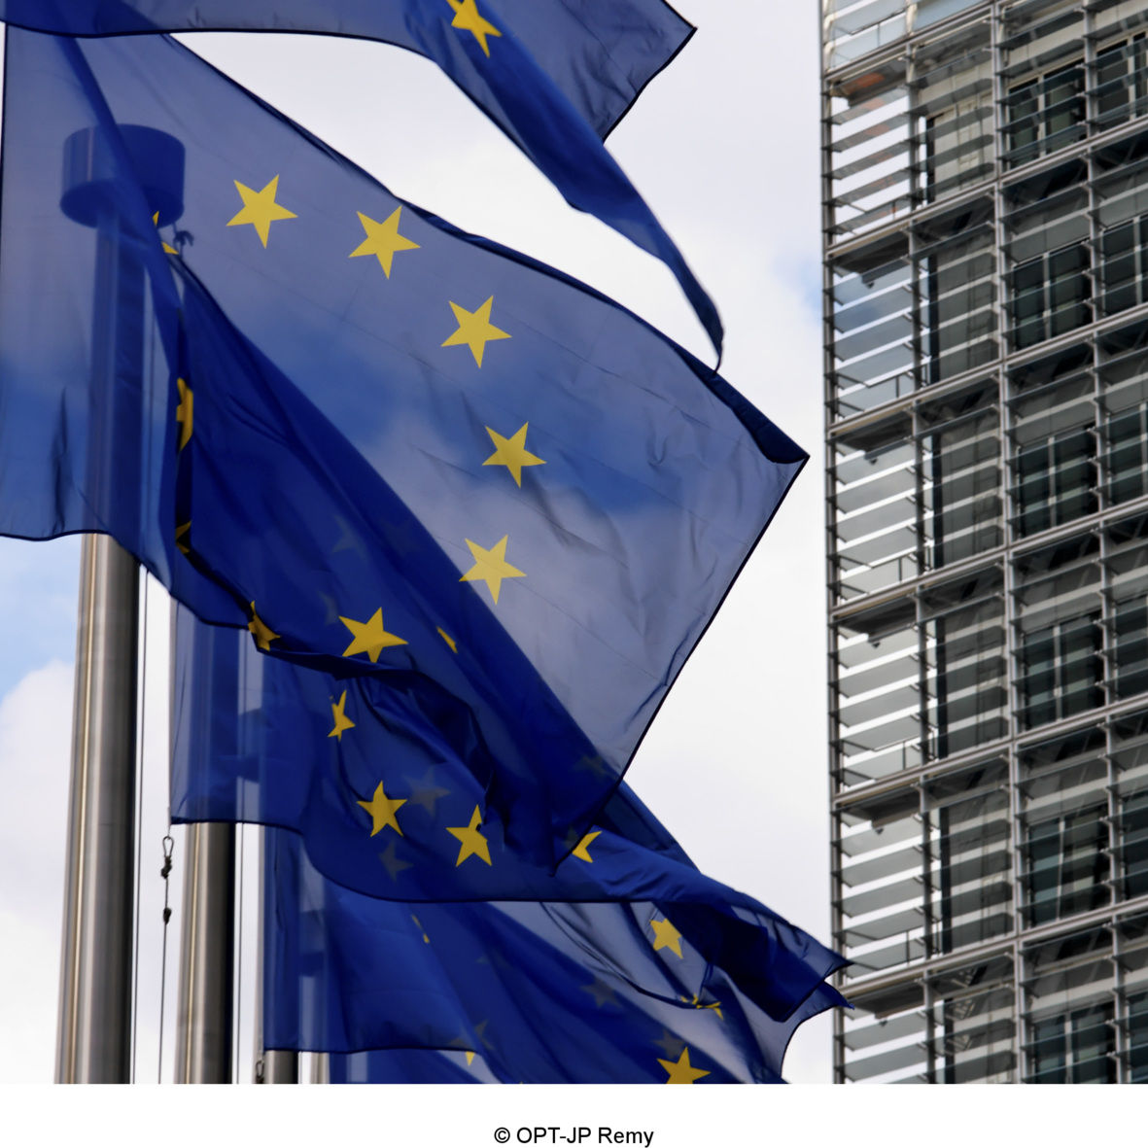
Conclusions
To sum up, both Brussels and Strasbourg are symbols of reconciliation between people and of future Europe. Their cultural heritage shows great importance and the strong European influence they have.
They can therefore be rightfully described as capitals of Europe and central cities for European Integration ‘cause they bear witness to it and also to the defense of human rights, democracy and the rule of law. Both cities have a lot of monuments and memorials in order to remind citizens of the importance of European integration as well as its history. The aim is to maintain a sense of belonging to Europe and a common European identity.

Slide 11
Thank you for your time!

Slide 12
Bibliography
archives.strasbourg.eu
culture.ec.europa
ec.europa.eu
echr.coe.int
lieudeurope.strasbourg.eu
lieudeurope.eu.strasbourg.eu
strasbourg-europe.eu
visiting.europarl.europa.eu
visit.brussels
Williams (2015)

