Slide 1
Post-Covid key words in academia
Key words
Covidfencing (Medeiros et al. 2021)
Border regions as ‚forgotten regions‘ (Böhm 2021; Goolsbee & Syverson 2020)
‚Crisis as a catalyst‘ (Hippe et al. 2022)
‘ crisis dementia’ (Chilla et al. 2023)
Border regions as laboratories… - or as museums?
Medical care
Transport infrastructure
Language
….

Slide 3
Positionpaper IMeG
Put border regions on political agenda
Formate urgency plans
Improve communication channels
Territorial monitoring
Establish crisis management institutions
Establish routines of information exchange
Improve solidarity in border reigons
Prepare cb taks-forces for next crises

Slide 4
Avoid ‘ crisis dementia’ (Chilla et al. 2023) – address ‘next level‘/ think bit
Functional perspective
• improve infrastructure
• manage / decrease differences
Institutional perspective
• close gaps in cooperation
• strategic thinking
Resilience: Learn from Covid times

Slide 5
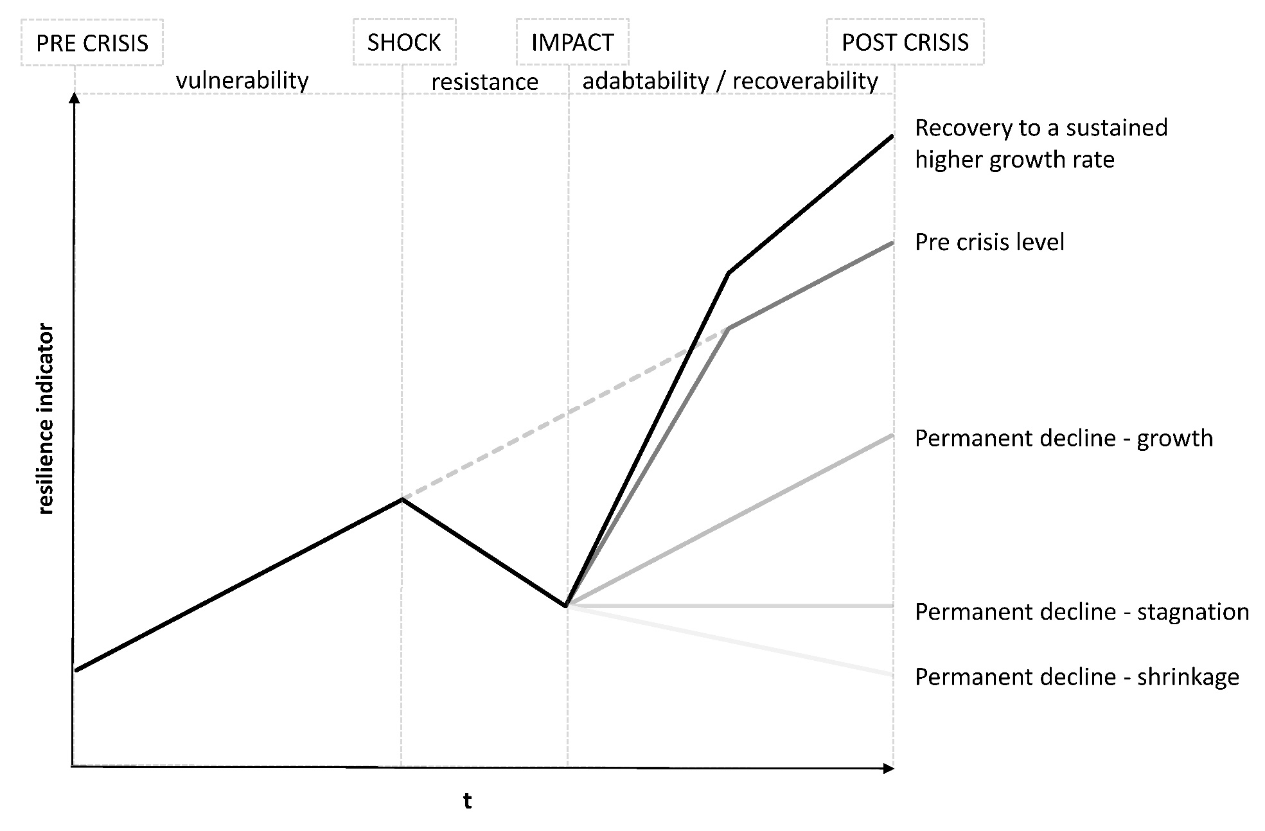
Resilience
Resilience paths of a system’s growth path Source: Hippe (2023) based on Martin (2012) and Martin & Sunley (2020)
!!
Type of territory (rural/urban, East-West, affiliations) ?
Kind of crises?

Slide 6
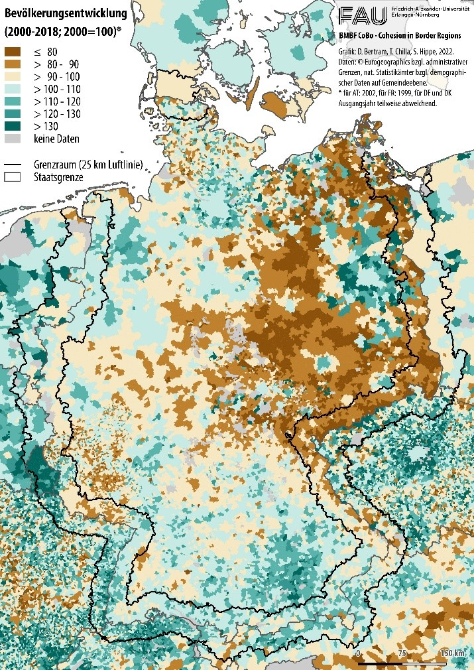
Resilience
!!
Type of territory (rural/urban, East-West, affiliations) ?
Kind of crises?

Slide 7
Border controls

