Slide 1
Abstract Construction - Border
Laurent REYNES Sculptor
with the group of students of political Science – Strasbourg
November 2023

Slide 2
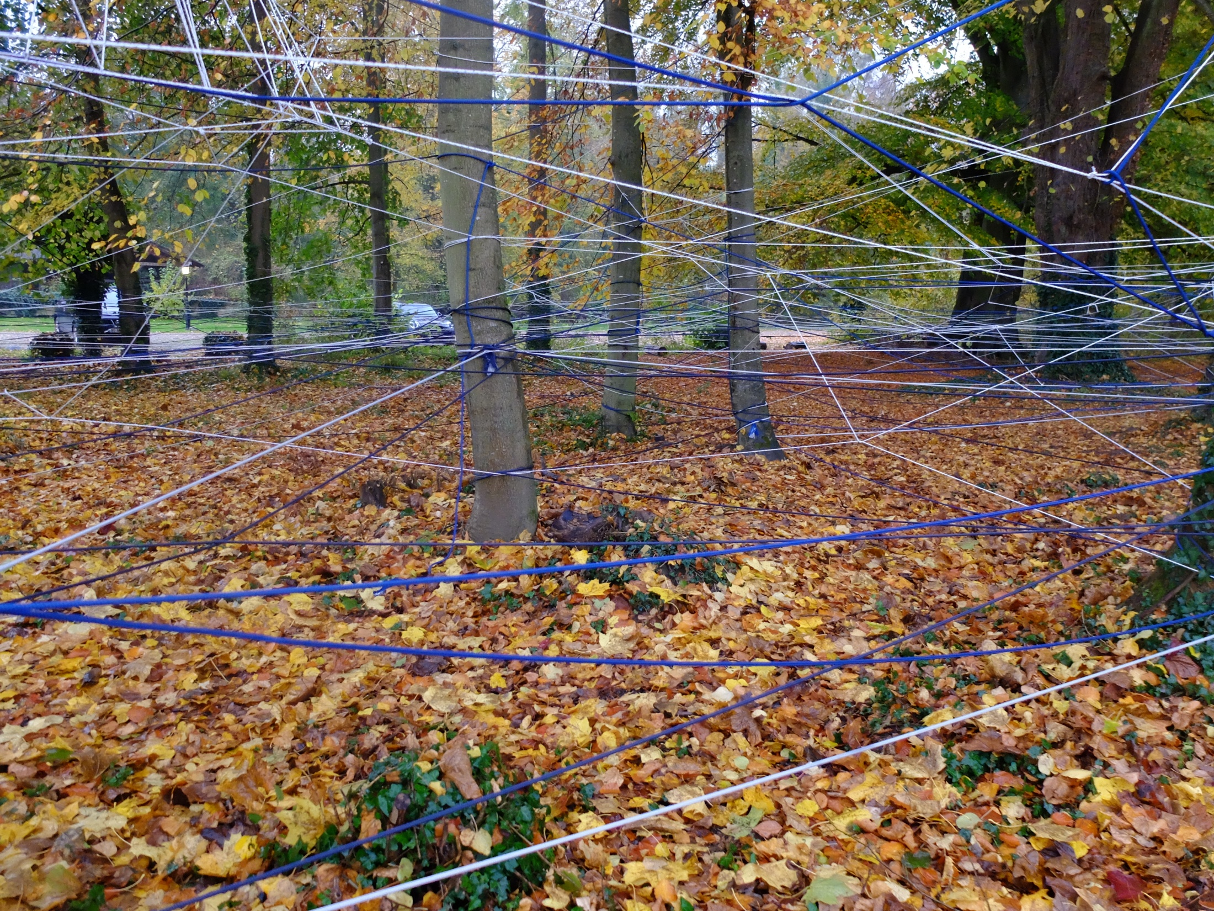

Slide 3
Concept
My Abstract Constructions emphasize concept, space, light, form, material, environment... or any other component relating to architecture and layout, reviewed through the lens of art.
Borders are abstract constructions, full of absurdities and contradictions, carrying closures and conflicts. They separate, cut, confront... They exacerbate conservatism, xenophobia, racism and pride. They reinforce the impossibility of living together and the narrowness of the human spirit.
However, the primary elements, air, water and earth, have no borders. Micro elements have no borders. The wind carries away these micro elements, meaning that border is above all a specific notion to the Man Animal. Through the tension of this numerous ropes, we will try to materialize the complexity of the idea of ​​border, to materialize this purely human concept, in the garden of Pourtalès, to illustrate the point of the IEP seminar in Strasbourg.
With the flexibility of the rope, the trees will be stretched with a random weaving forming a mesh, a lace which will cover their branches for a short period, revealing a net, a second skin. Links symbolize positive and negative of the imbroglio and sophistication that the border conveys.
This weft of threads, superimposed the weaving of branches and foliage, like a visualization of the complexity of the very idea that a border can convey. Like a spider's web woven between the stems, a border stops trade, but on the contrary, it stimulates others, legal and illegal. It stimulates imagination and transgression. There are countless links that can be woven visibly or invisibly across a border. The links cross in all directions, they are cut, reinforced, structured in a legal or illegal way, passing through, in a most often improbable way. Perhaps there are borders invisible to man between the trees of Pourtalès Park?
When the lines drawn on a map are complex and winding, they reflect a tumultuous history. When they are simple and rectilinear they are the result of a lack of thought and sensitivity to the territory. Nothing is more ambiguous, imprecise and confused than a border line...
Some borders are built, others are not. Some fluctuate, other don’t. Some are seen, others are not. Some are administrative, others are not. Some exists for some people and others don’t …

Slide 4
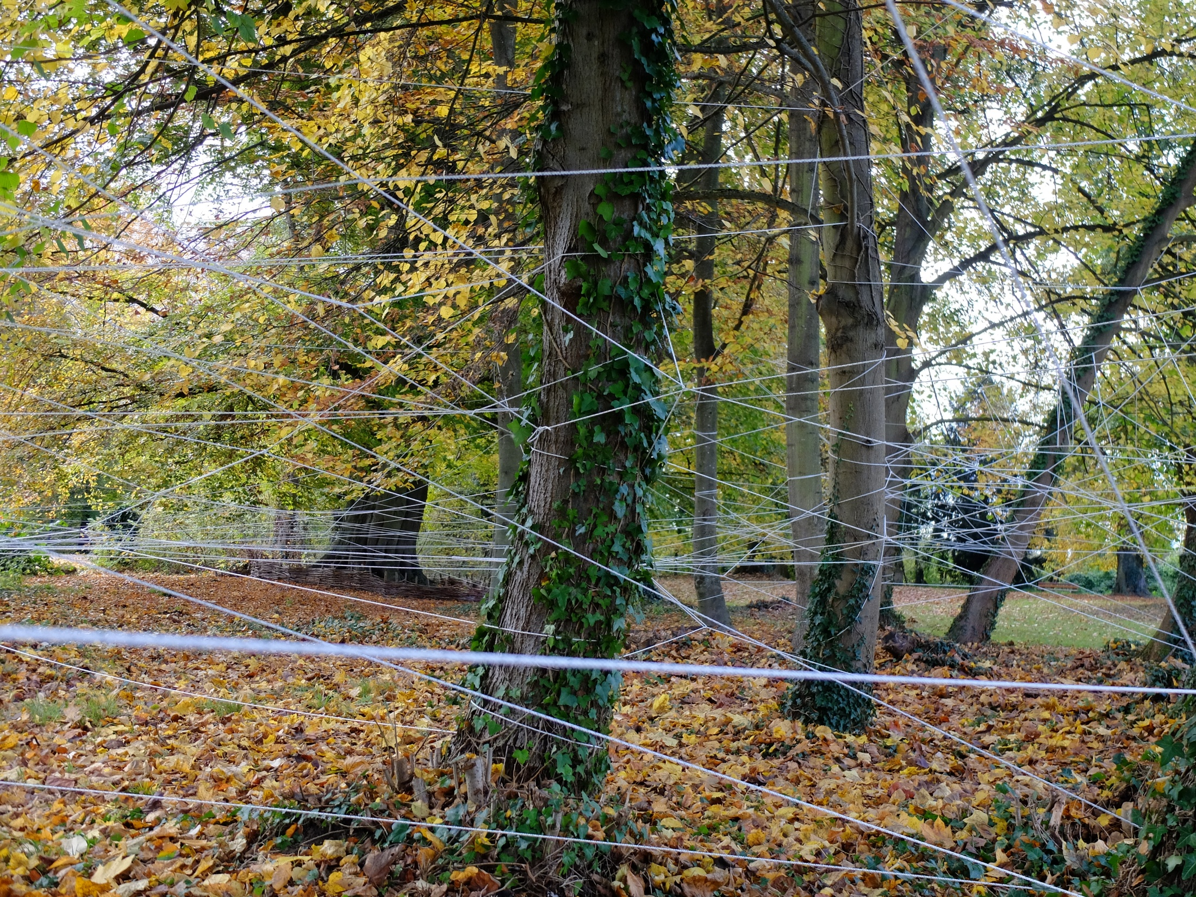

Slide 5
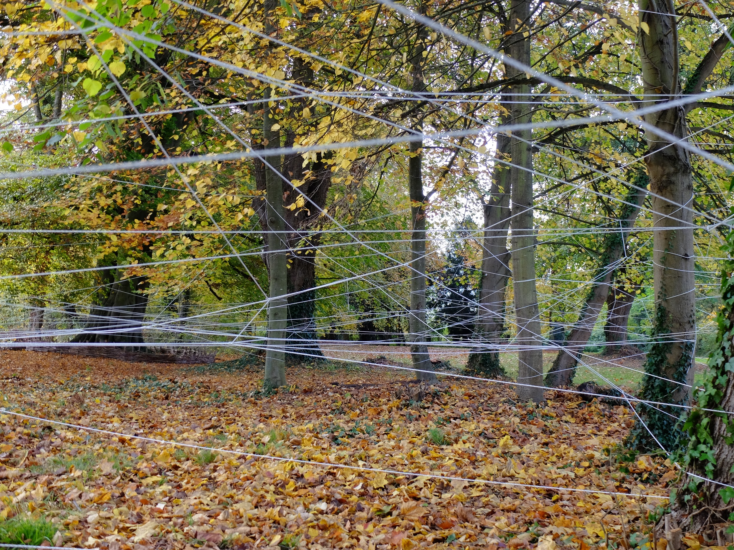

Slide 6
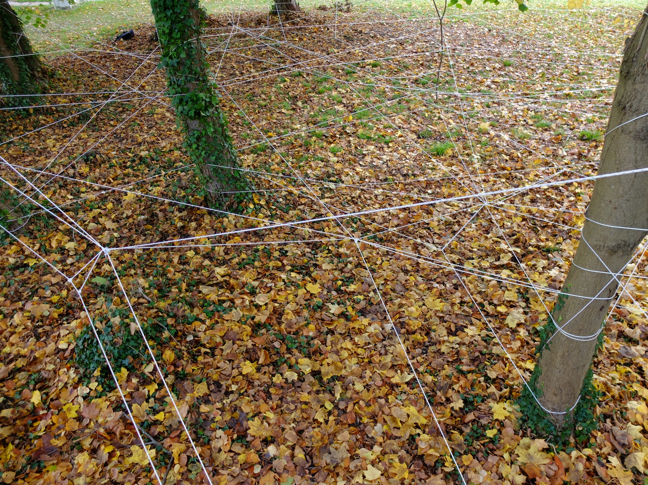

Slide 7
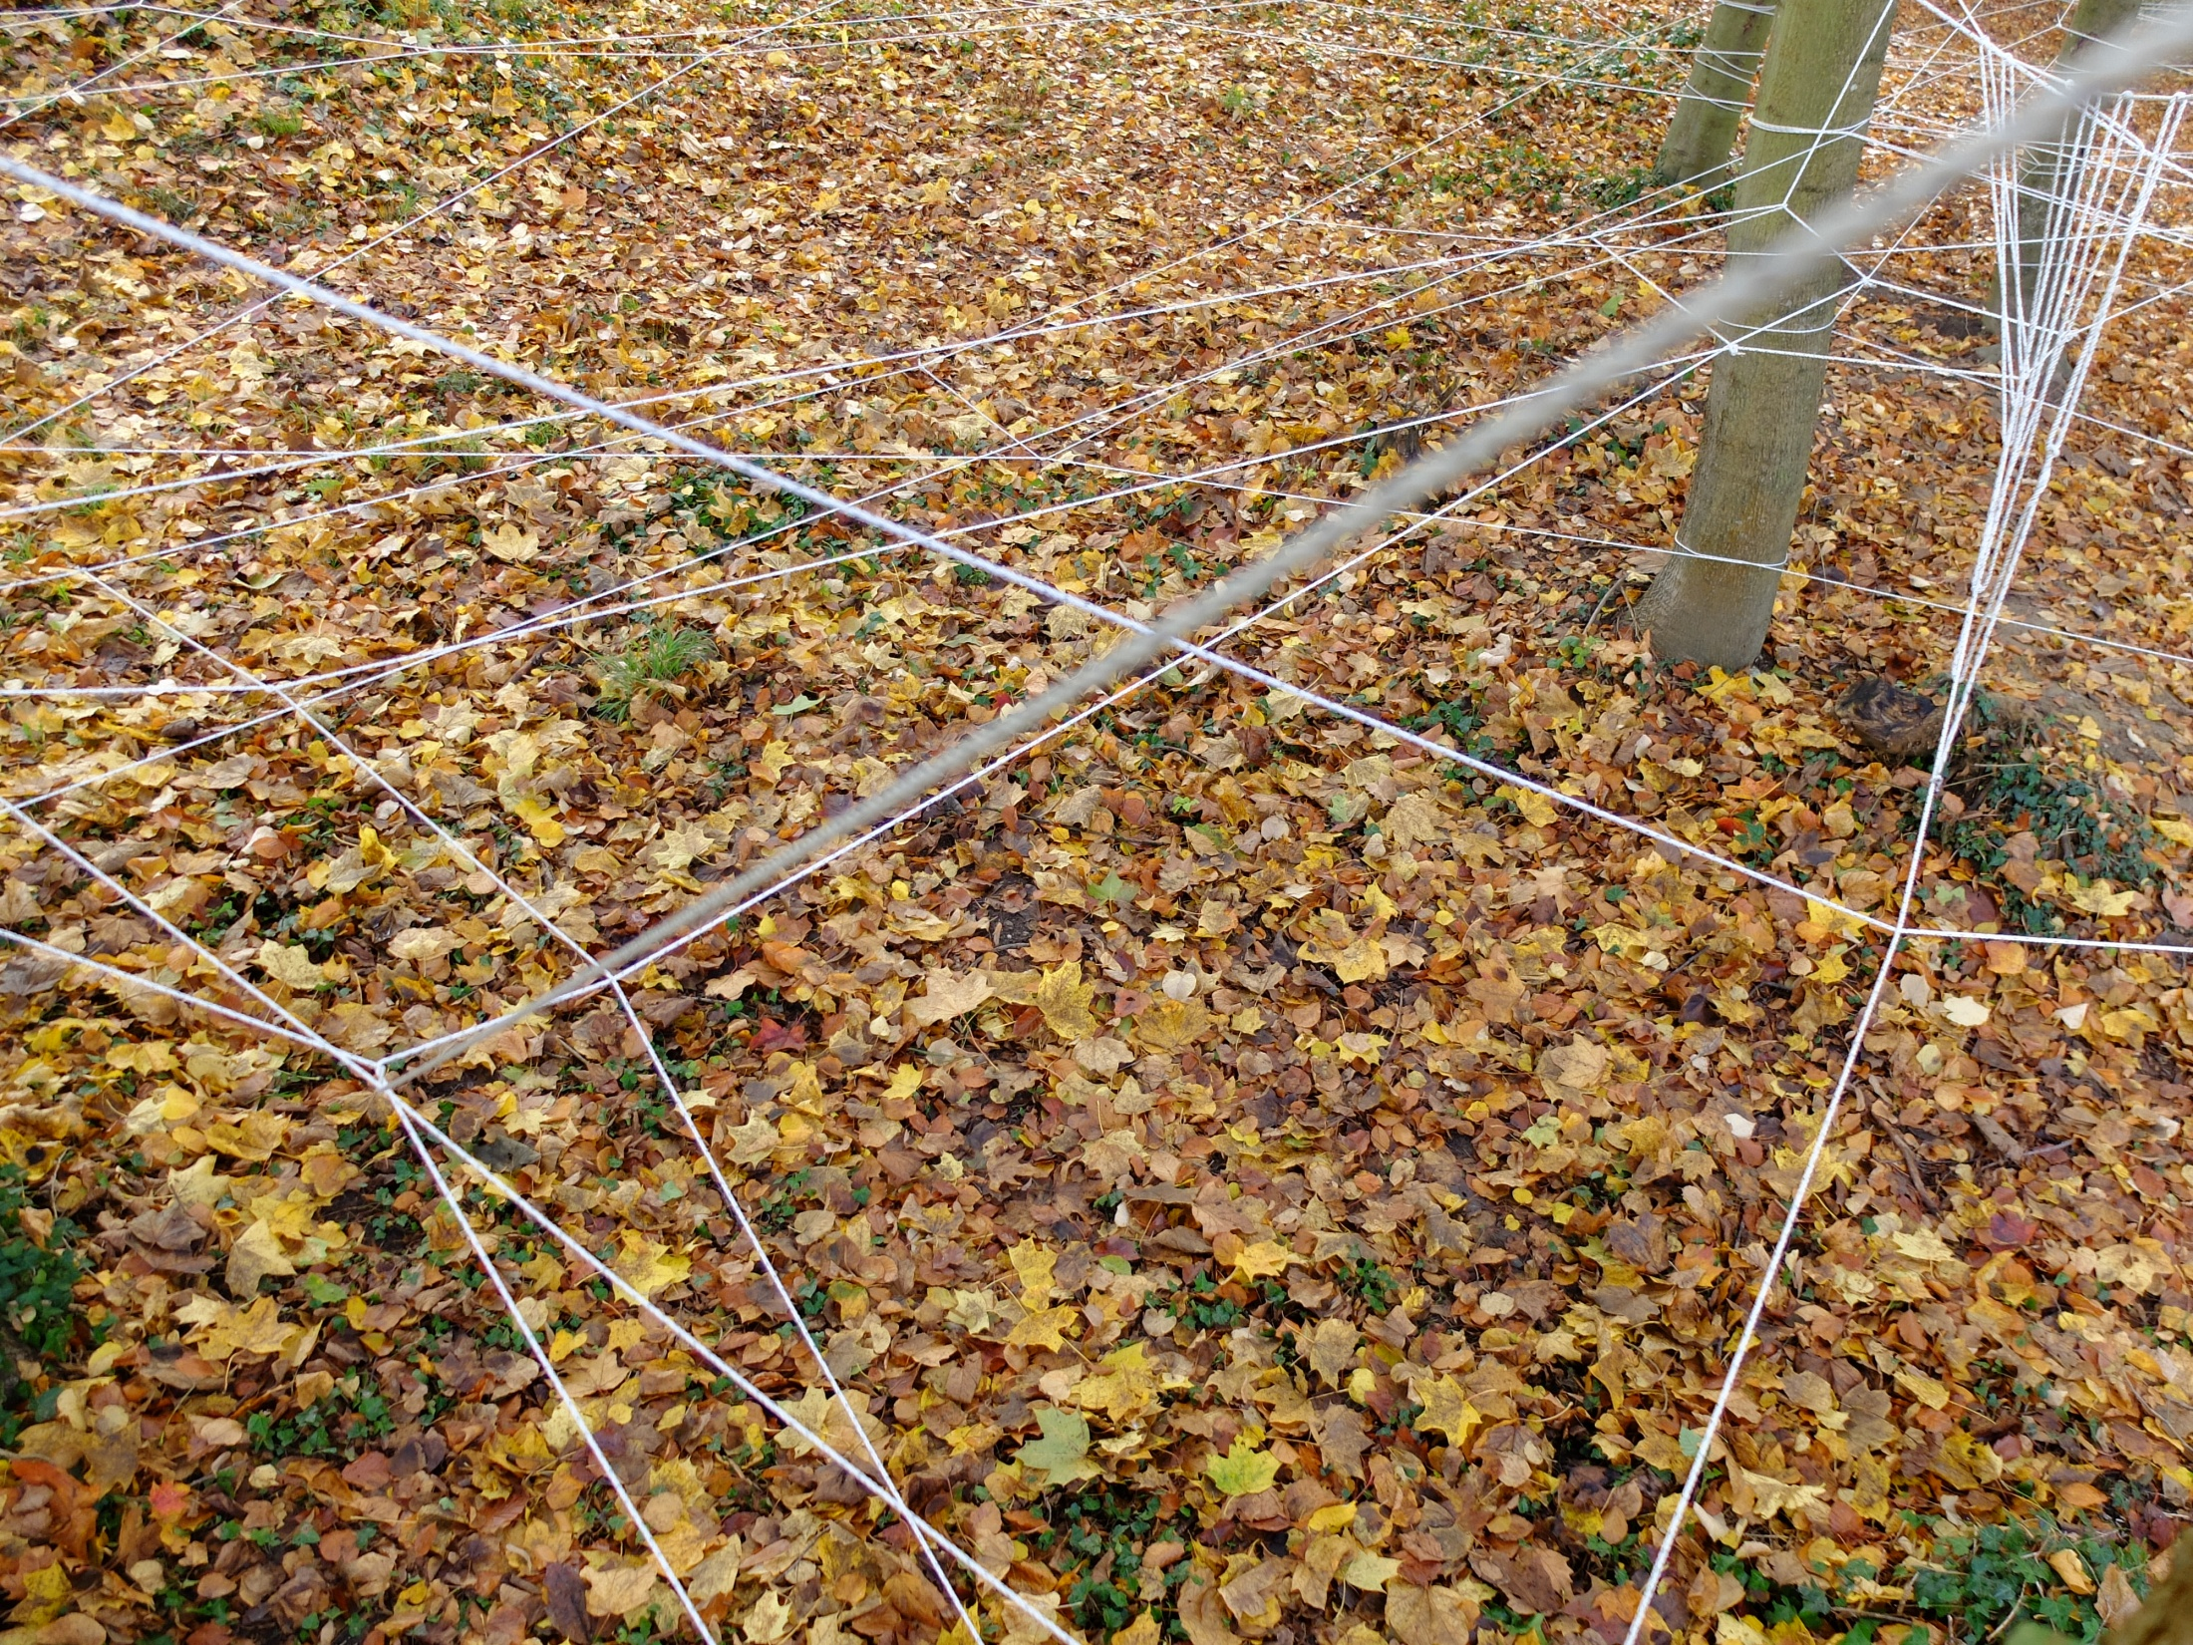

Slide 8
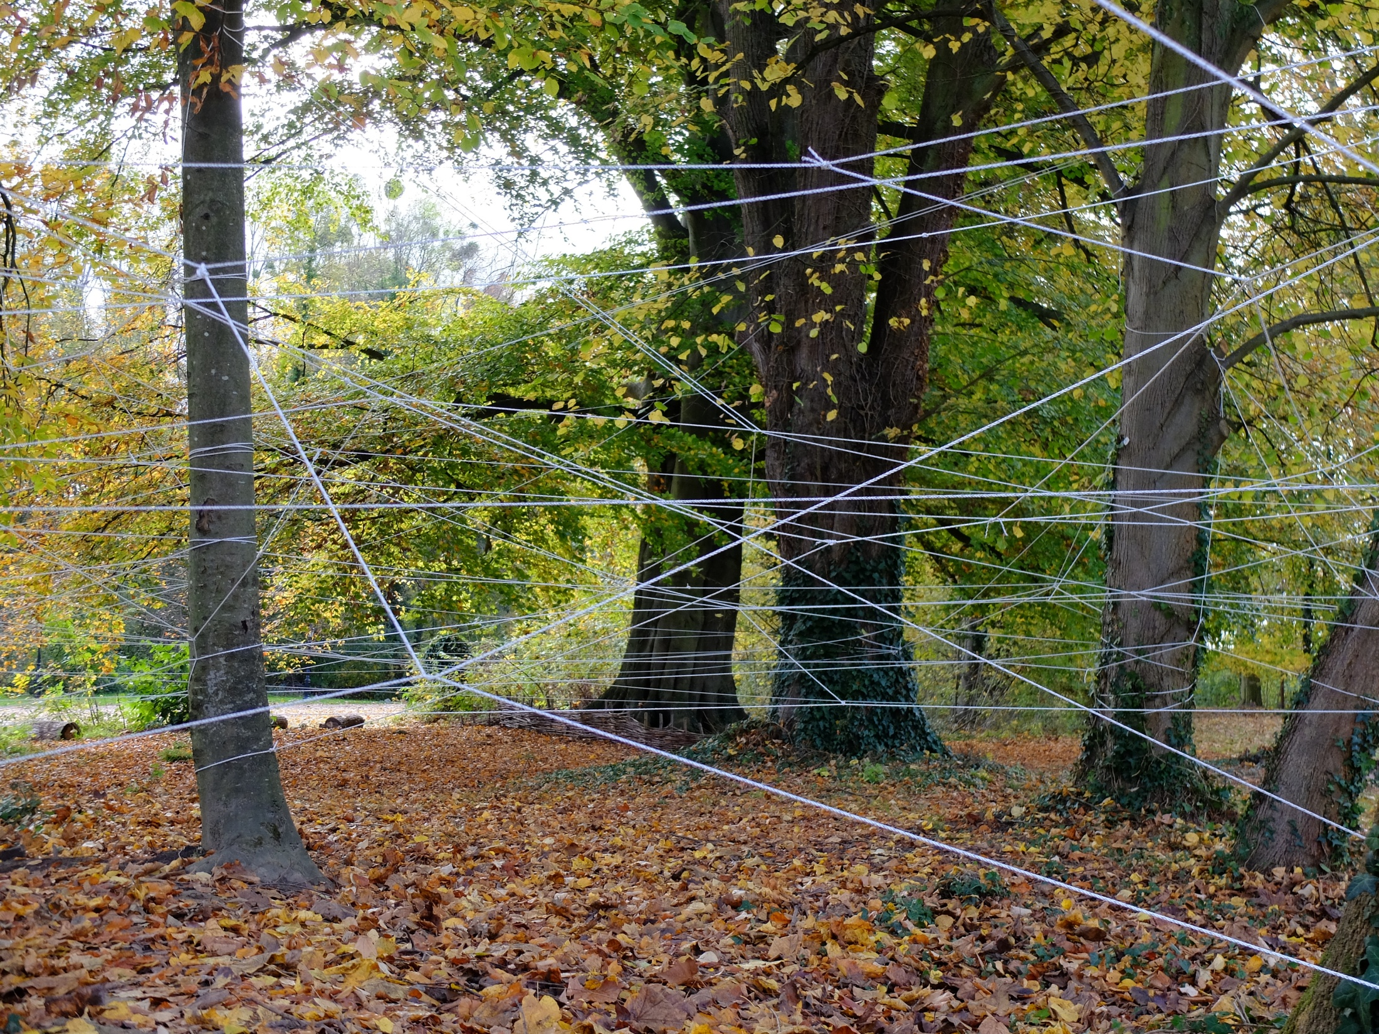

Slide 9
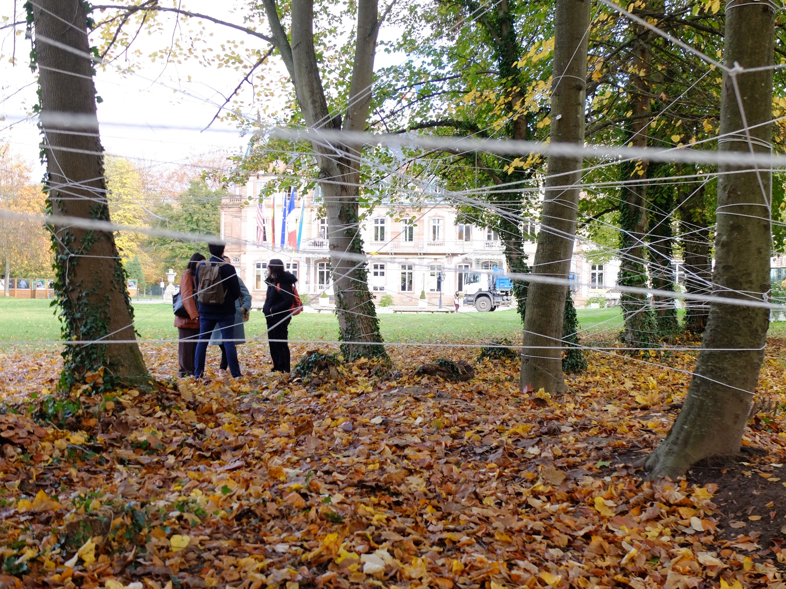

Slide 10
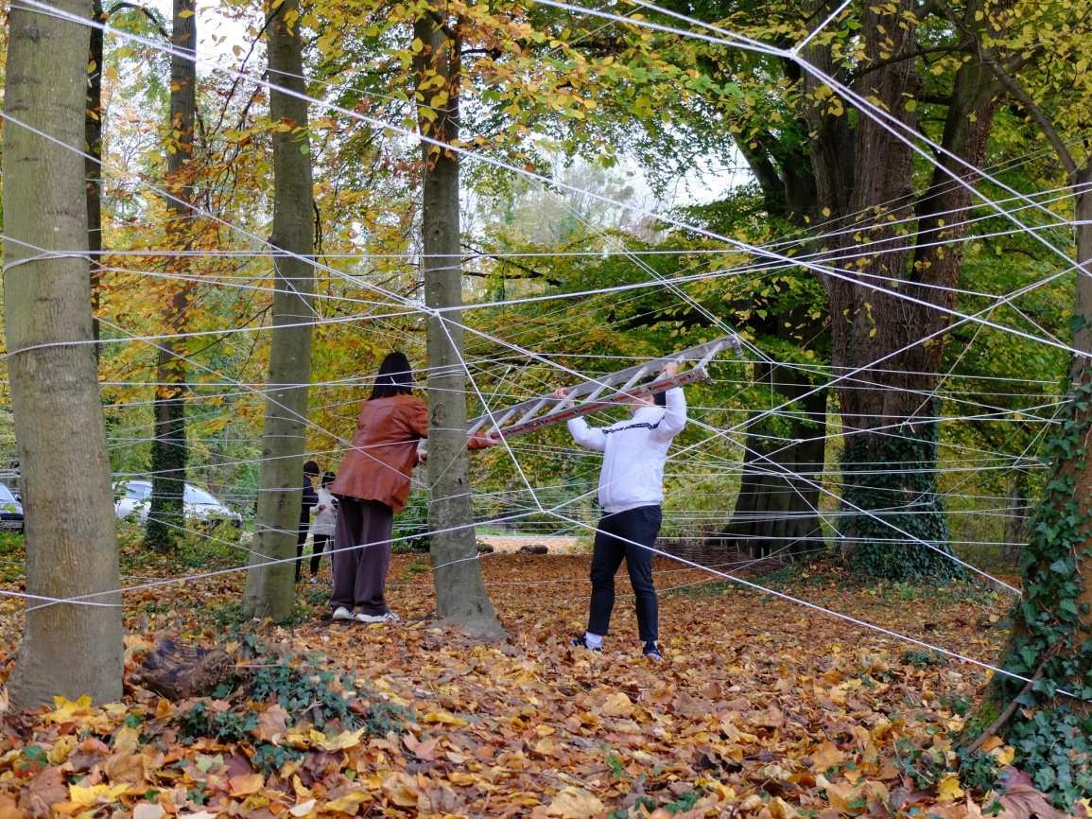
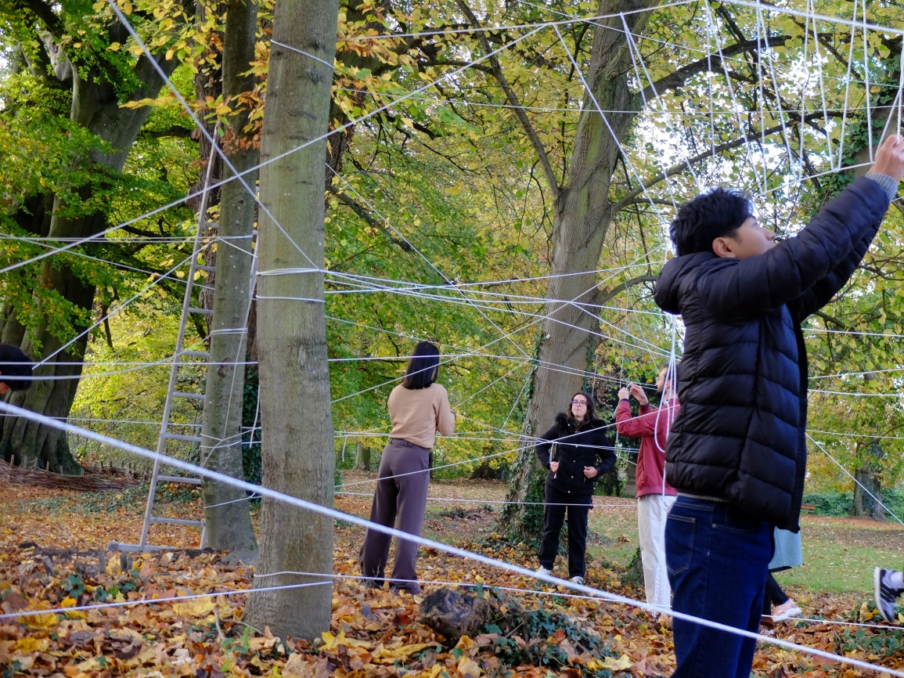
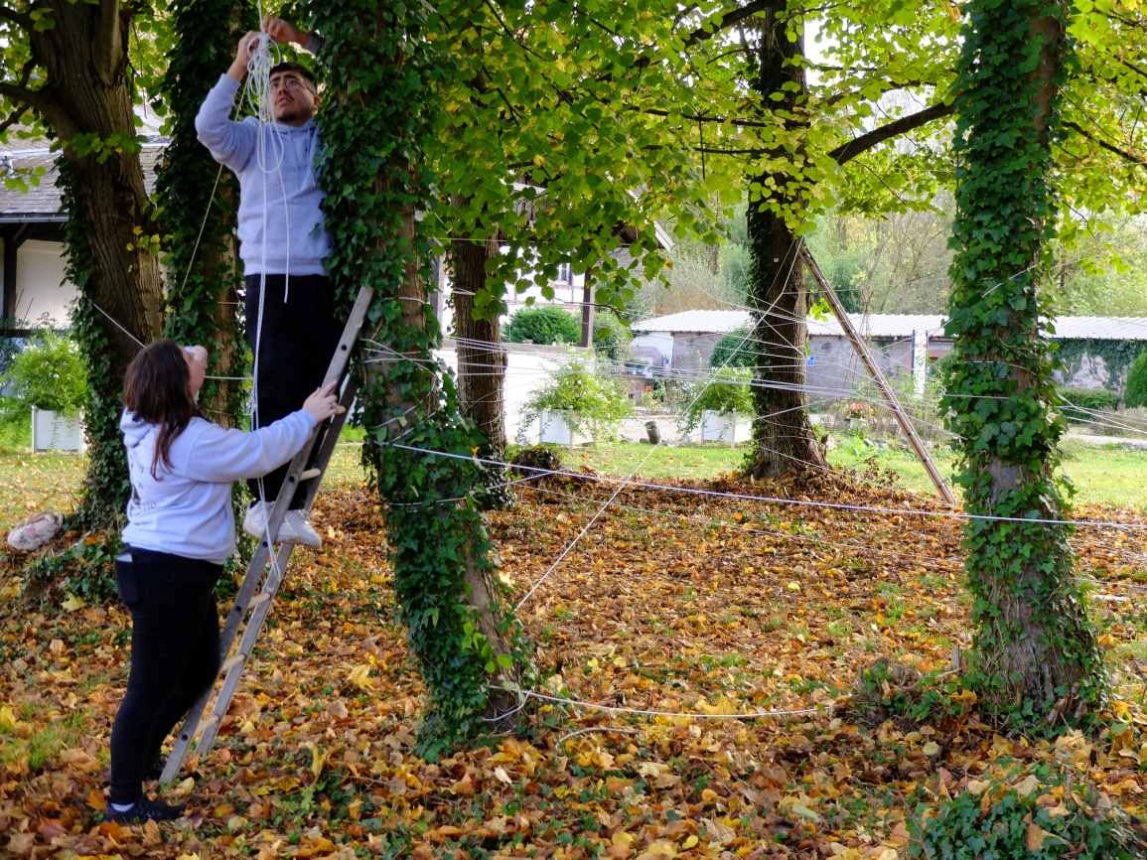
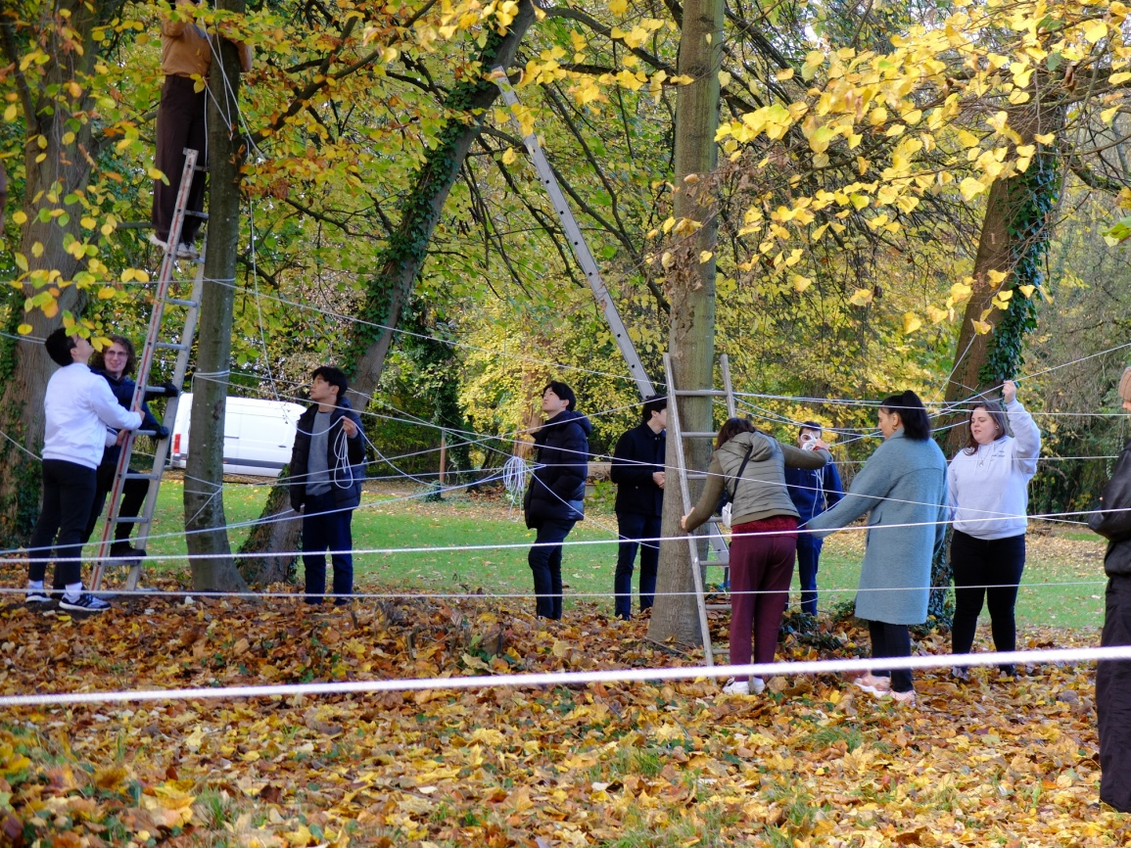

Slide 11
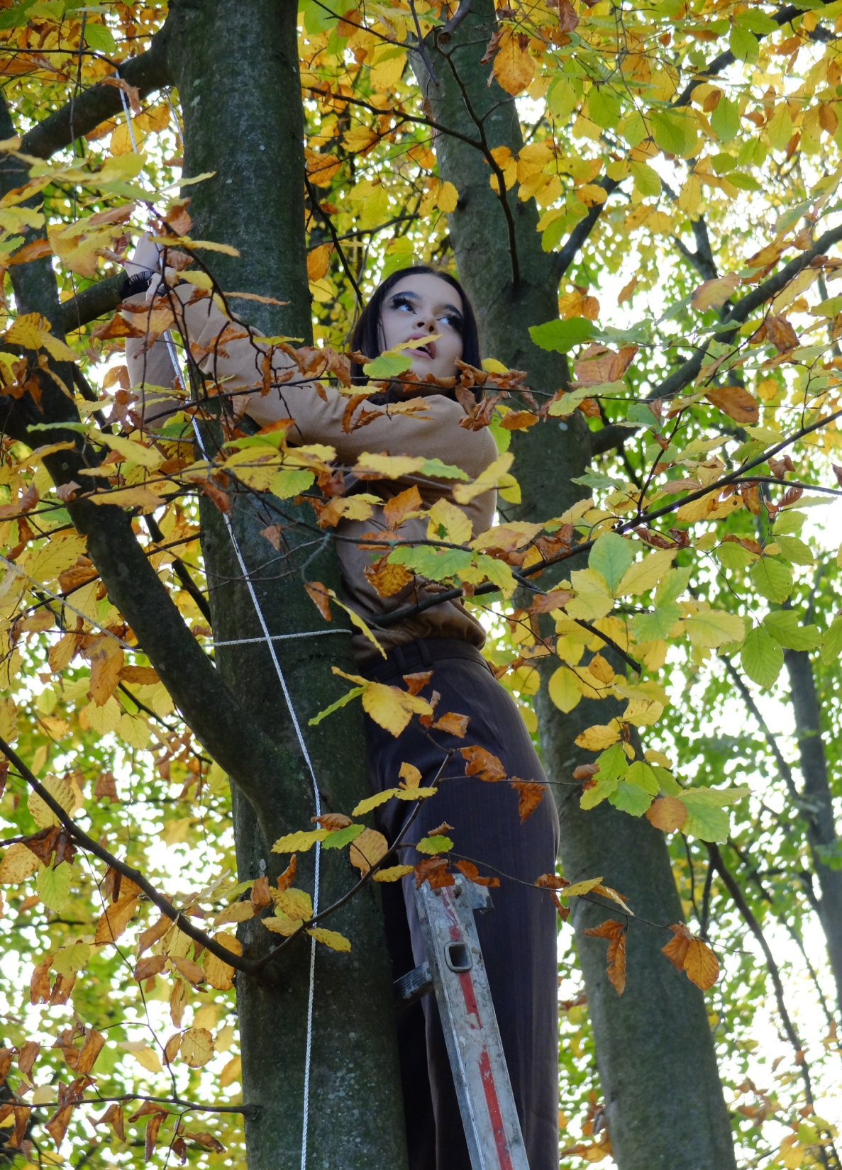
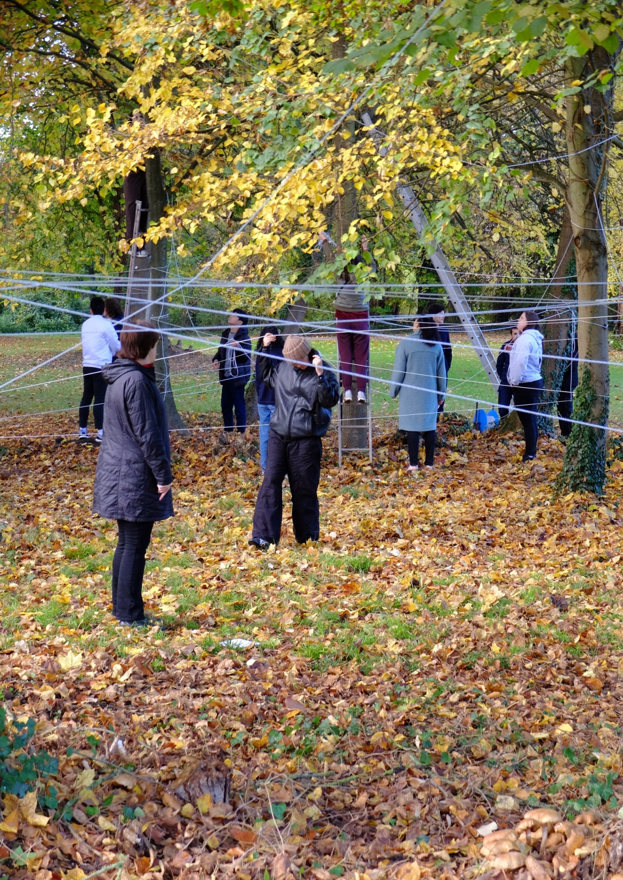

Slide 12
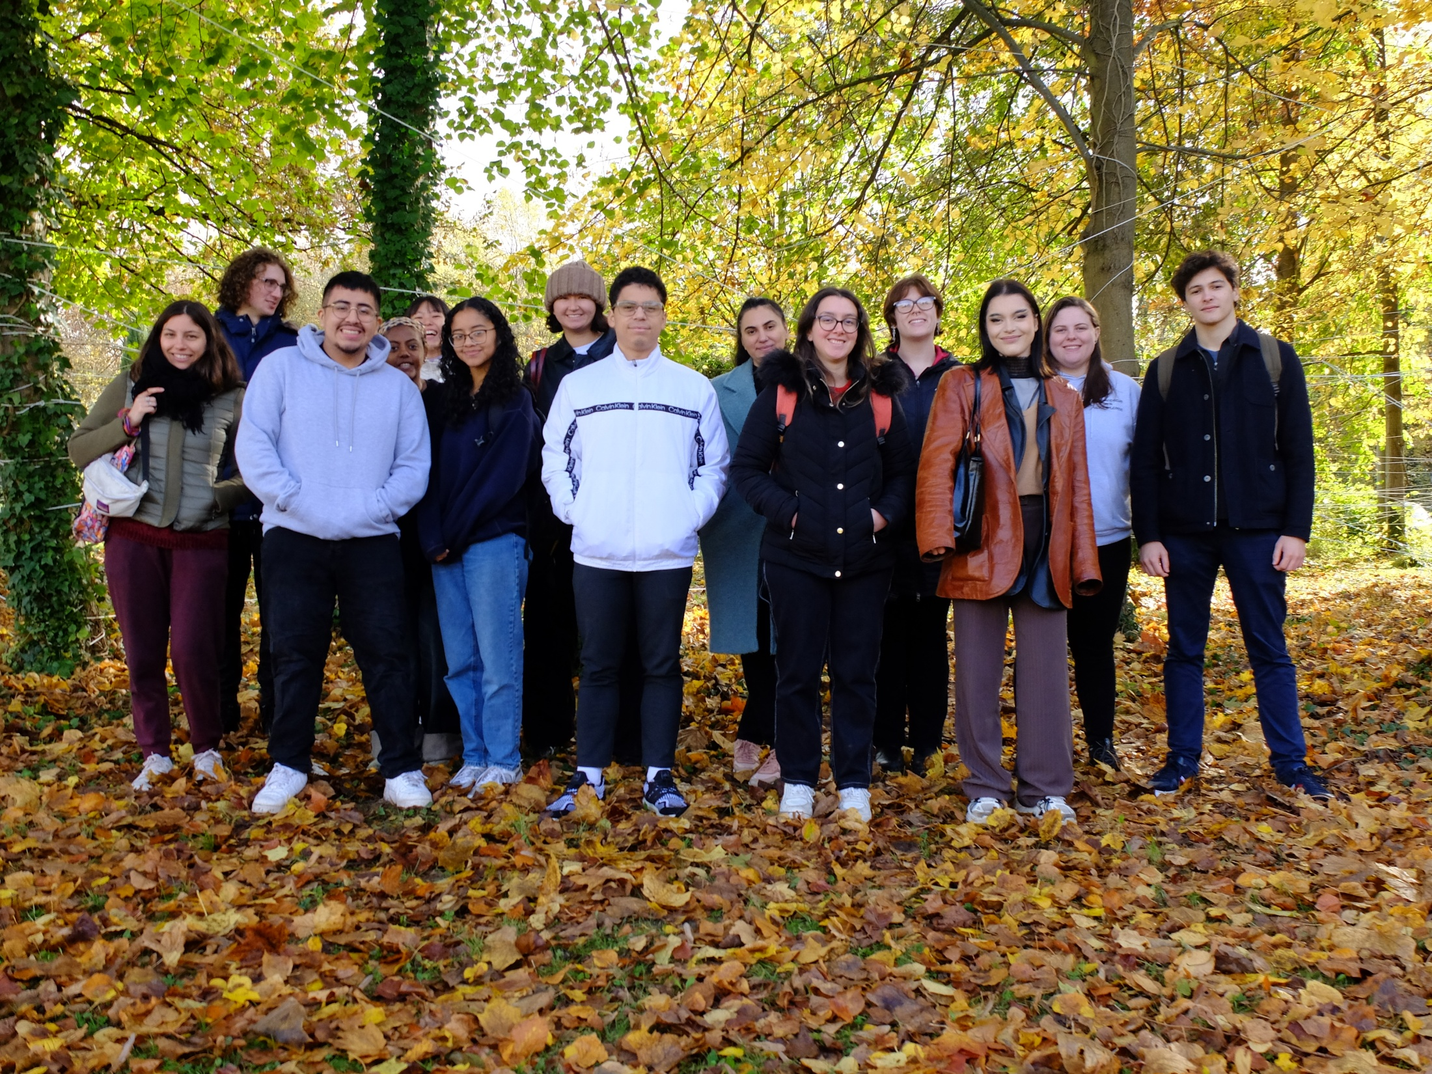

Slide 13
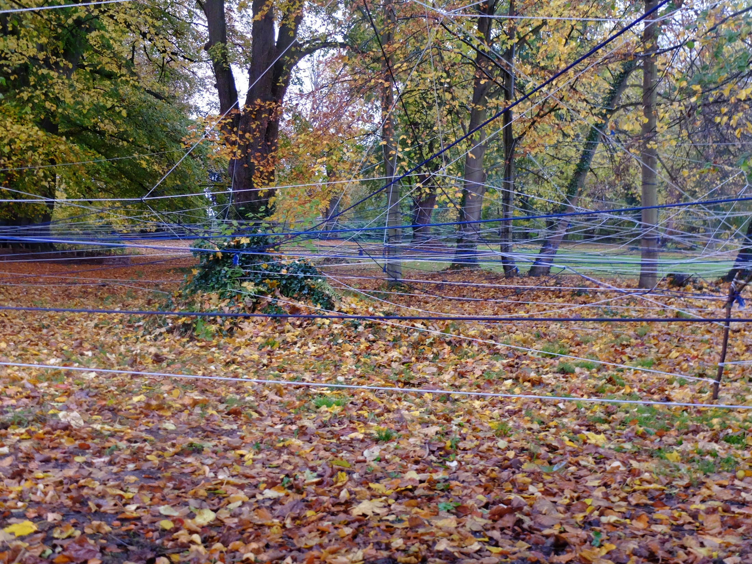

Slide 14
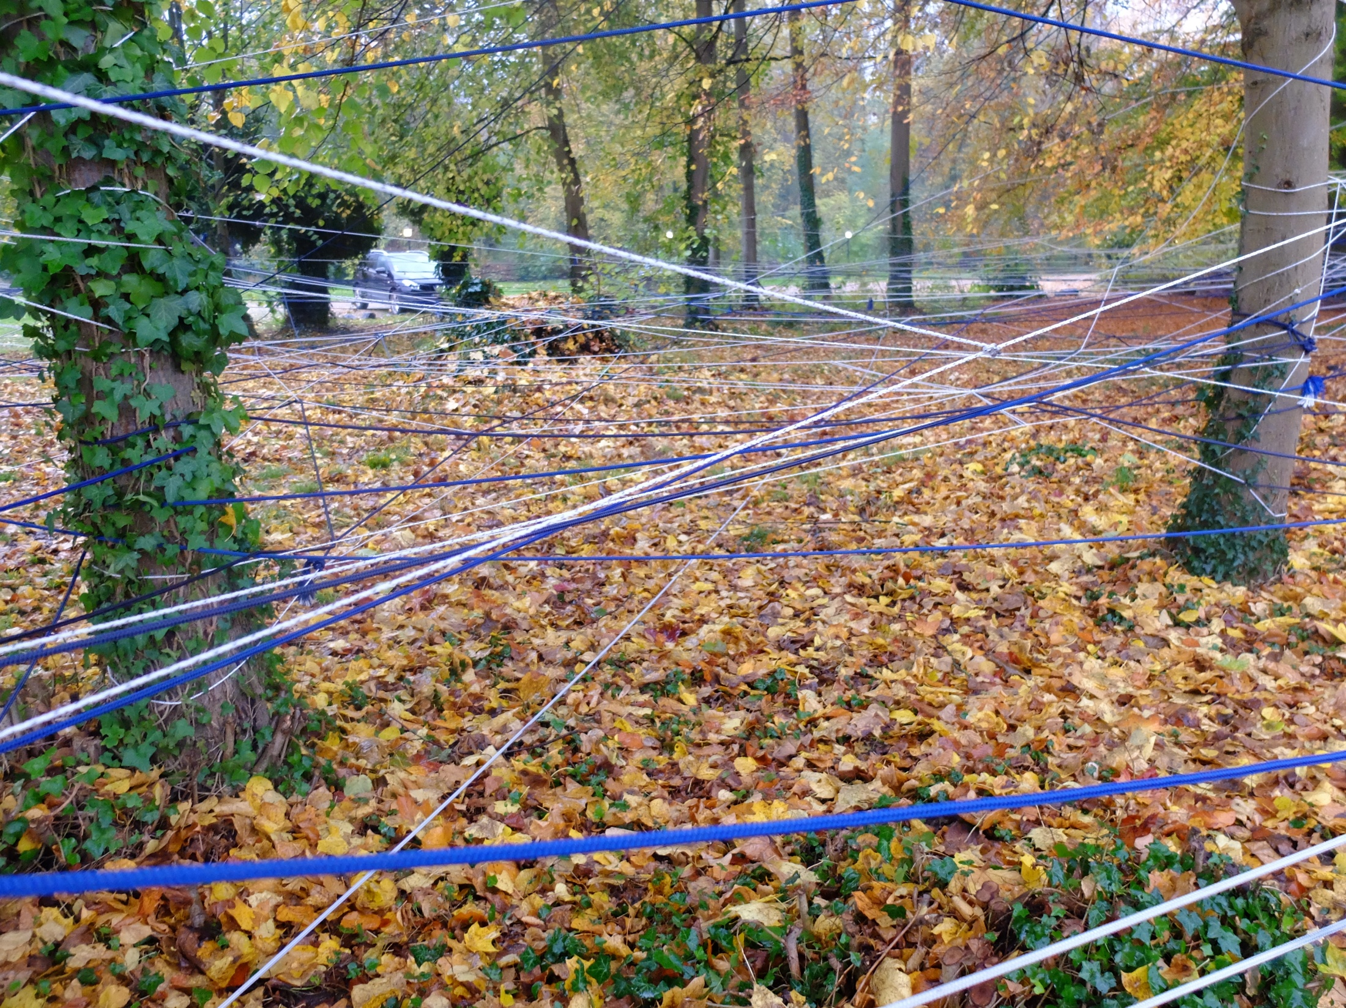

Slide 16
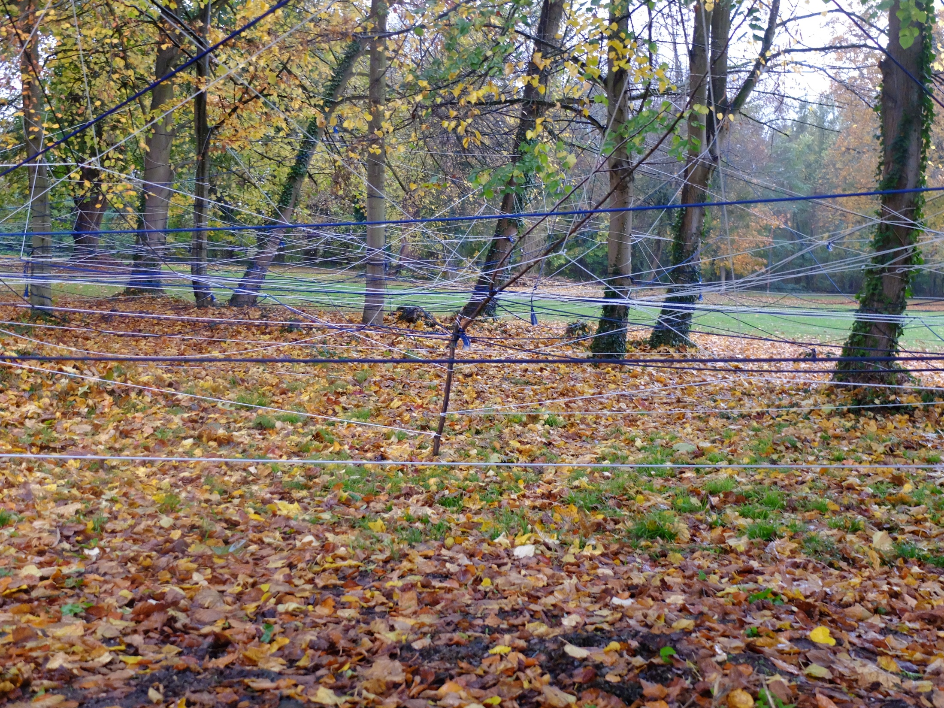

Slide 17
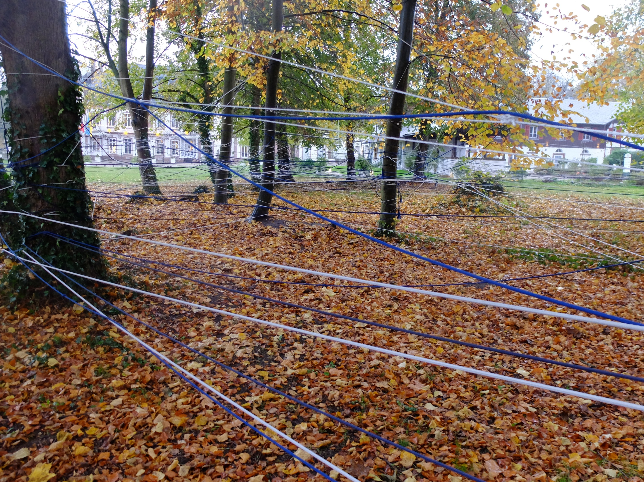

Slide 18
Thank you very much

