Slide 1
Revisiting resilient Border Narratives: the case of Canadian “Exceptionalism”
Castle Talks 2023
15th of November, 2023
Claude Beaupré
Ph.d. Candidate

Slide 2
Immigration & Canadian Exceptionalism
The Canadian approach to transnational human migration, has been labeled as a kind of Canadian exceptionalism, premised on the relative pro-immigration and pro-multicultural consensus across the political spectrum
Said Exceptionalism is premised upon –
History
Economic structure
Cultural factors
Institutional arrangements [internationally esteemed]
Geography

Slide 3
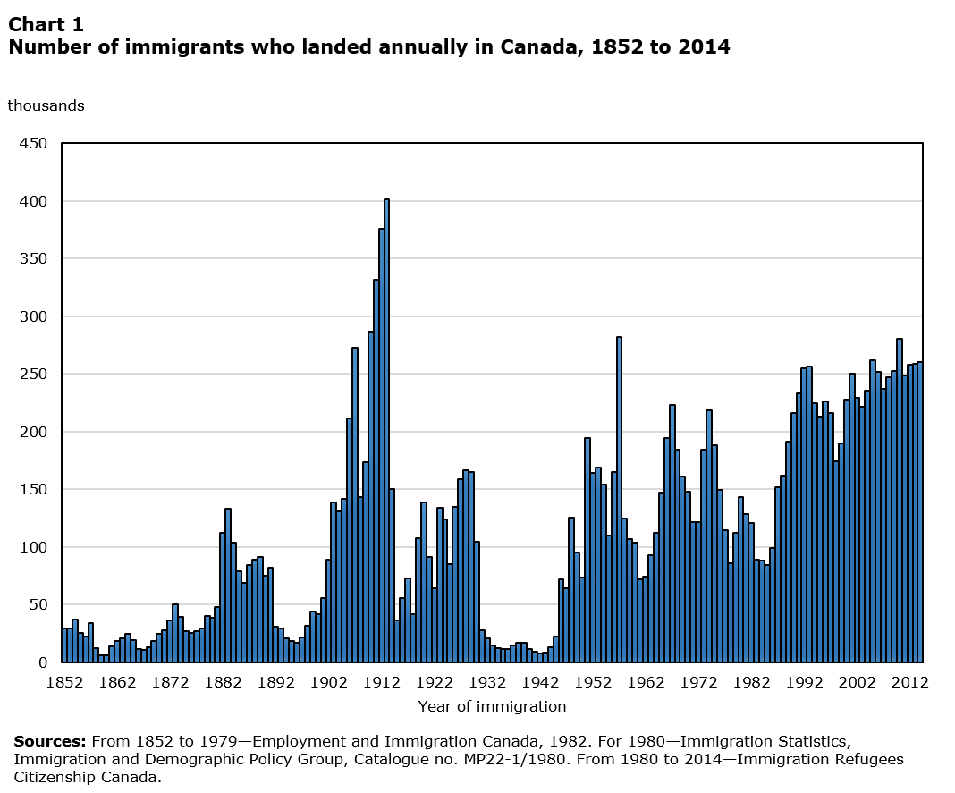
Since the mid-80s, Canada has been granting PR to avg. 250k/year [0.8 percent of its population]
Fertility is below the population replacement level; immigration is viewed as key to future social and economic development
From 2016 to 2021, immigrants accounted for four-fifths of labour force growth
In 2021, more than 8.3 million people, or almost one-quarter (23.0%) of the population, were, or had ever been, a landed immigrant or permanent resident in Canada

Slide 4
Immigration Integration
According to Statistics Canada as of 2021, 41.8% of nonpermanent residents and 16.1% of immigrants who moved to Canada in the past five years lived in poverty.
Commonly-cited barriers to integration:
Professional gatekeeping – ‘the sacrificed generation’
Affordable Housing crisis esp. in urban centers, Toronto, Vancouver and Montréal
Backlog of available support – services to newcomers [i.e., job training/transition, language courses, financial literacy, etc.]

Slide 5
Perception of Immigration
Canada was the first country to adopt multiculturalism as an official policy in 1971, championing a pro-immigration stance reinforced by a set of policies, in particular the 1982 Canadian Charter of Rights and Freedoms and the 1988 Canadian Multiculturalism Act.
Multiculturalism = the active role of the state in the preservation and promotion of different cultures, religions, and minority languages within the same territory [as opposed to assimilation-based immigration integration attitudes]
Multiculturalism for all is constitutionally protected – Singh v. Minister of Employment and Immigration [1985] = all individuals physically present in Canada are protected by Charter of Rights and Freedoms
USA’s “Melting Pot” vs Canada’s “Cultural Mosaic”

Slide 6
Pro-immigration? - depends from where
Canadian immigration policies have prioritised racialized/country-specific Immigration was the norm until the 1967 establishment of the points system
Notable precedent: from the late-19th-century Chinese head tax, which forced Chinese immigrants to pay a fee when entering the country
Literature shows that since the 1960’s Canada’s immigration perception turned towards issues of ‘diversity’ - while often outrightly mentioned as a national strength and indeed the central premise of the reigning multicultural model, it also signifies racially-assumed concerns for national unity and social cohesion.
For the majority of authors, “race,” “class,” “gender,” or “geography” (that is, country of origin), but also “skill level” and “entry class” combine with wider historical, and current structures of discrimination to shape the experiences of migrant workers and their migration experience today.
Recent examples:
Quebec’s highly controversial Bill 21, a law passed in 2019 that prohibits the display of religious symbols from public servants’ attire, including crosses, turbans, kippahs, and hijabs.
Perceivable rise in anti-Asian sentiment during the COVID-19 Pandemic throughout the country

Slide 7
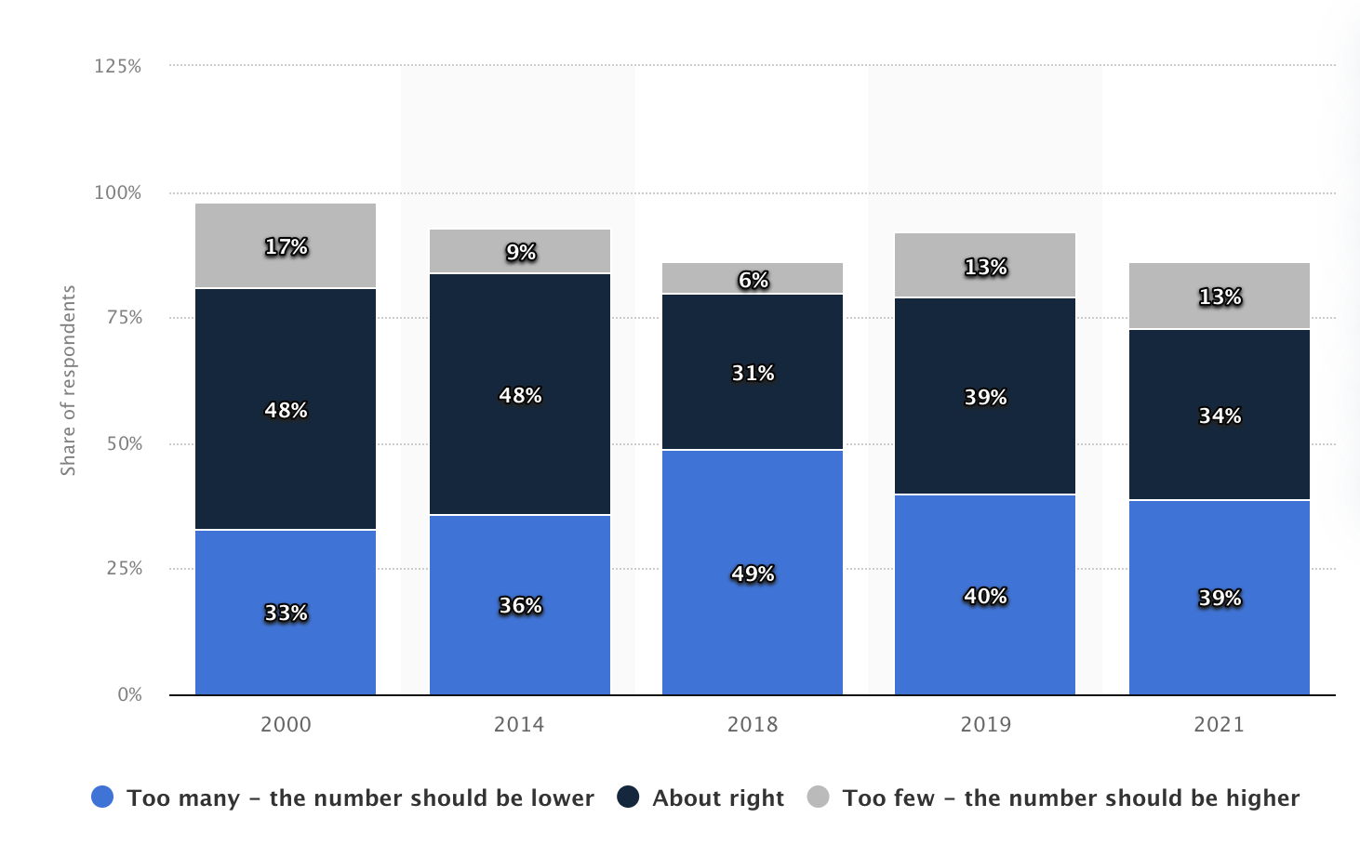
Public opinion on immigration targets in Canada from 2000 to 2021
The number of Canadian adults who think immigration levels are too high has increased [somewhat unsteadily] over the last two decades, rising from 33 percent in 2000 to 49 percent in 2018.
Notable recent developments:
virtually through the sizeable on-line mobilization of Canadians on far-right sites and forums [on the rise since 2019]
tangibly with the creation of the anti-immigration People’s Party of Canada [PPC] – received 3.6% in 2019 Federal election & 5% in 2021
Source: Statista, 2023

Slide 8
2023 Public Opinion on Immigration
Abacus data Poll - fielded from June 23 to 27, 2023, sampled 1,500 Canadian adults online. The comparable margin of error is +/- 2.6%, 19 times out of 20.
11% of Canadians rank “immigration” as a top 3 issue. [first time immigration was included in list of response categories]
The rising cost of living remains a top issue to more people (71%), with healthcare (48%) and housing (43%) rounding out the top 3.
61% believe that Canada’s target to welcome 500,000 immigrants next year is too high, including 37% who feel it is “way too high”.
When asked whether the number of immigrants coming to Canada is having a positive or negative impact on several possible areas, 63% feel it is having a negative impact on housing, 49% feel this way about its impact on traffic and congestion, and 49% feel immigration is having a negative impact on healthcare.
Half think immigration is having a positive impact on the availability of workers while 43% think immigration is having a positive impact on economic growth.

Slide 9
Exceptionalism v Crises
Notable Crises-affiliated developments:
The number of PR permits have mirrored the booms and busts of the economy [labour migration is vast majority of PR- +75%/year]
9/11 is linked with a rise in islamophobia & if did incite the country to boost border security cooperation with the US, but did not result in a reduction immigration [not even from Muslim-majority countries]
COVID-19 led to a stop in most migratory flows, but did result in Canada stopping to admit refugees unlike their southern neighbours
Humanitarian Migration – an interesting case: Of the approx. 0.8% of immigrants arriving in Canada every year, approx. 15-25% come as refugees; refugees and asylum seekers differ in legal status
Contrary to the country’s image as a leader in refugee resettlement, there is evidence of refugees being vilified [e.g., “queue-jumpers,” resource-drains, and security threats, etc.]
Notable events
1914 - The Komagata Maru: a vessel from India that docked in Vancouver with 376 passengers aboard of the Sikh diaspora
1970-1980– The Vietnamese Boat People: media coverage of events in the region led to the birth of private refugee sponsorship, Canada resettled 60,000 Indochinese refugees between 1979 and 1980, approximately 26,000 of whom were government assisted and 34,000 of whom were privately sponsored 1986 Canada received highly regarded UNHCR Fridtjof Nansen Medal for its contribution to the cause of refugees following the Vietnam War
1999 – the ‘Chinese Boat People’: 599 Chinese migrants arrived in Canada in four different vessels off the coast of British Columbia. Also colloquially labeled “boat people,” this time around the Canadian population was less than welcoming
2007 - The Mexican Refugee Crisis: 300 irregular entry influx in Windsor Ontario, perceived as crisis by media coverage
2010 - The Sri Lankan Tamil Refugee Crises: MV Sun Sea, a cargo ship carrying 492 Tamils seeking asylum from civil war in Sri Lanka docked in Esquimalt on Vancouver Island. Ten years later, some are still seeking relief.
2015 – ‘Roxam Road crisis’ vs Syrian resettlement program

Slide 10
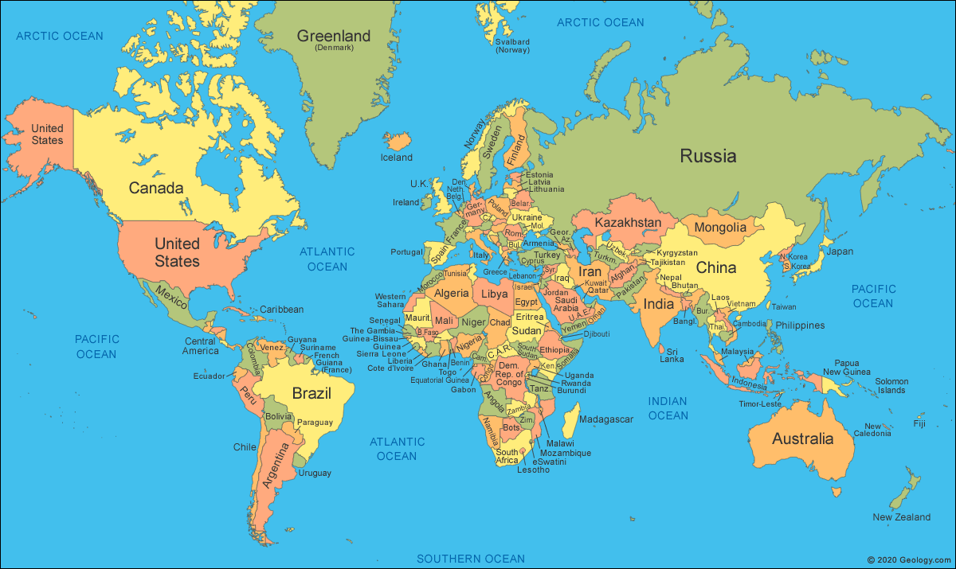
“It is easier to be relaxed about immigration when your only land border is protected by a wall the size of the United States.”
- The Economist, 2016

Slide 11
Conclusion
There is a disconnect between myth & reality when it comes to Canada’s Exceptionalism – how Canadians are viewed internationally and how they view themselves might not be as ‘benevolent’ and/or ‘open’ as imagined
Canada is not immune to the rise of racialized and xenophobic nativism in Western countries
It might be that Canadians are not pro-immigration per se as much as less anti-immigration as others

Slide 12
Thank you!
claudebeaupre@uvic.ca

