Slide 1
The resilience on cross-border mobility: The case of student mobility in the Greater Region
Castle Talks on Narratives on Borders in Europe
Resilience of border regions in times of crisis
Julia Dittel (Saarland University, European Studies)
Strasbourg, 15 November 2023

Slide 2
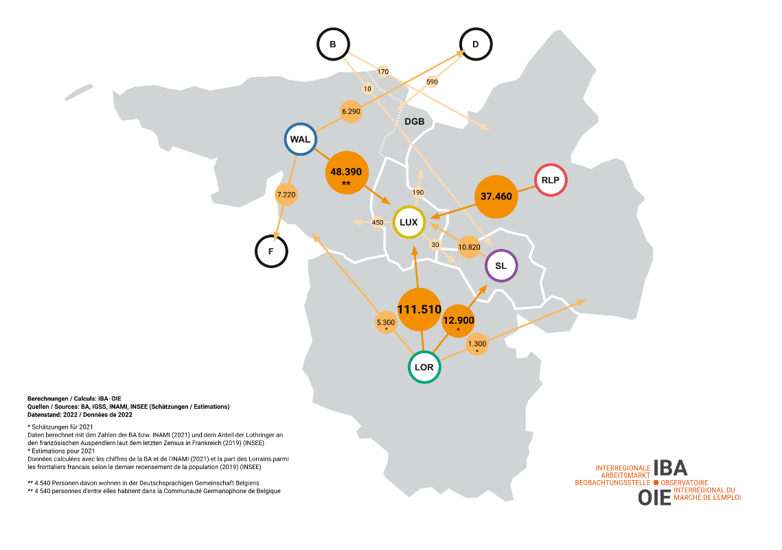
The Greater Region
highest cross-border mobility of employees in the EU!
2022: around 267,000 commuters, including over 200,000 to Luxembourg
Importance of cross-border commuters, retail, services, etc.
Source picture: https://www.iba-oie.eu/ (16.05.2023)
Notes:
The Greater Region is a hotspot of cross-border employment, with some 250,000 people commuting across borders for work every day.
The special significance of Luxembourg as a job magnet was already clear to most people before the pandemic.
But the role of Lorraine in this respect was less present in the media. The map shows that some 13,000 people commute from Lorraine to the Saarland every day, where they play a key role in both the healthcare and industrial sectors. Saarland’s retail trade is also very dependent on French customers

Slide 3
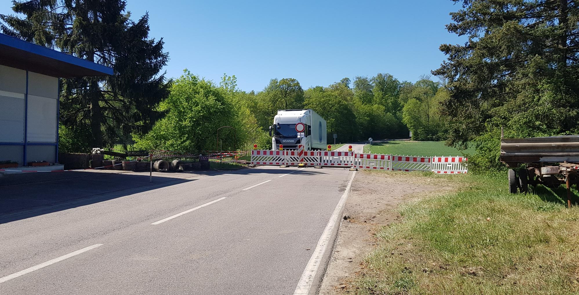
Different ‘border permeabilities’ for cross-border commuters
Merzig in the direction of Waldwisse in March 2020 – Closure of a ‘non-notified’ border crossing point for ‘channelling traffic flows’ in consultation with the federal police
Quelle Foto: Brigitte Weber 2020.
Notes:
However: Serious reasons only
After some disturbances: employees were able to pass
As I already sais: Covid-19 pandemic has shown that in some industries a strong dependence on labour from neighbouring regions.
Through cross-border training programmes, specialists with the relevant language and intercultural skills are educated, that are urgently needed on the labour market.
>> Let‘s look at the situation of cross-border students in the Greater Region

Slide 4
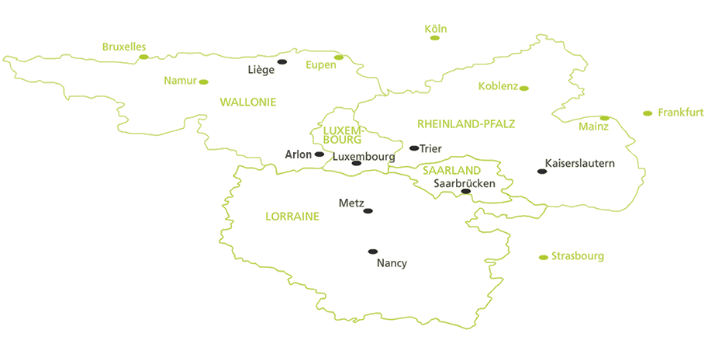
The University of the Greater Region
Source picture: https://www.uni-gr.eu/de/node/1957 (16.05.2023)
Notes:
The University of the Greater Region = Cross-border university network
established thanks to funding from the European Union as part of the Interreg IV A Greater Region programme.
Goal to build a network of universities across the border
The "University of the Greater Region" project was approved in September 2008, began on 15 October 2008 and ended in April 2013.
Since the end of the project period, the activities of the "University of the Greater Region" have been continued in the form of a cross-border university network with its own legal form (since 2015: an association under Luxembourg law).

Slide 5
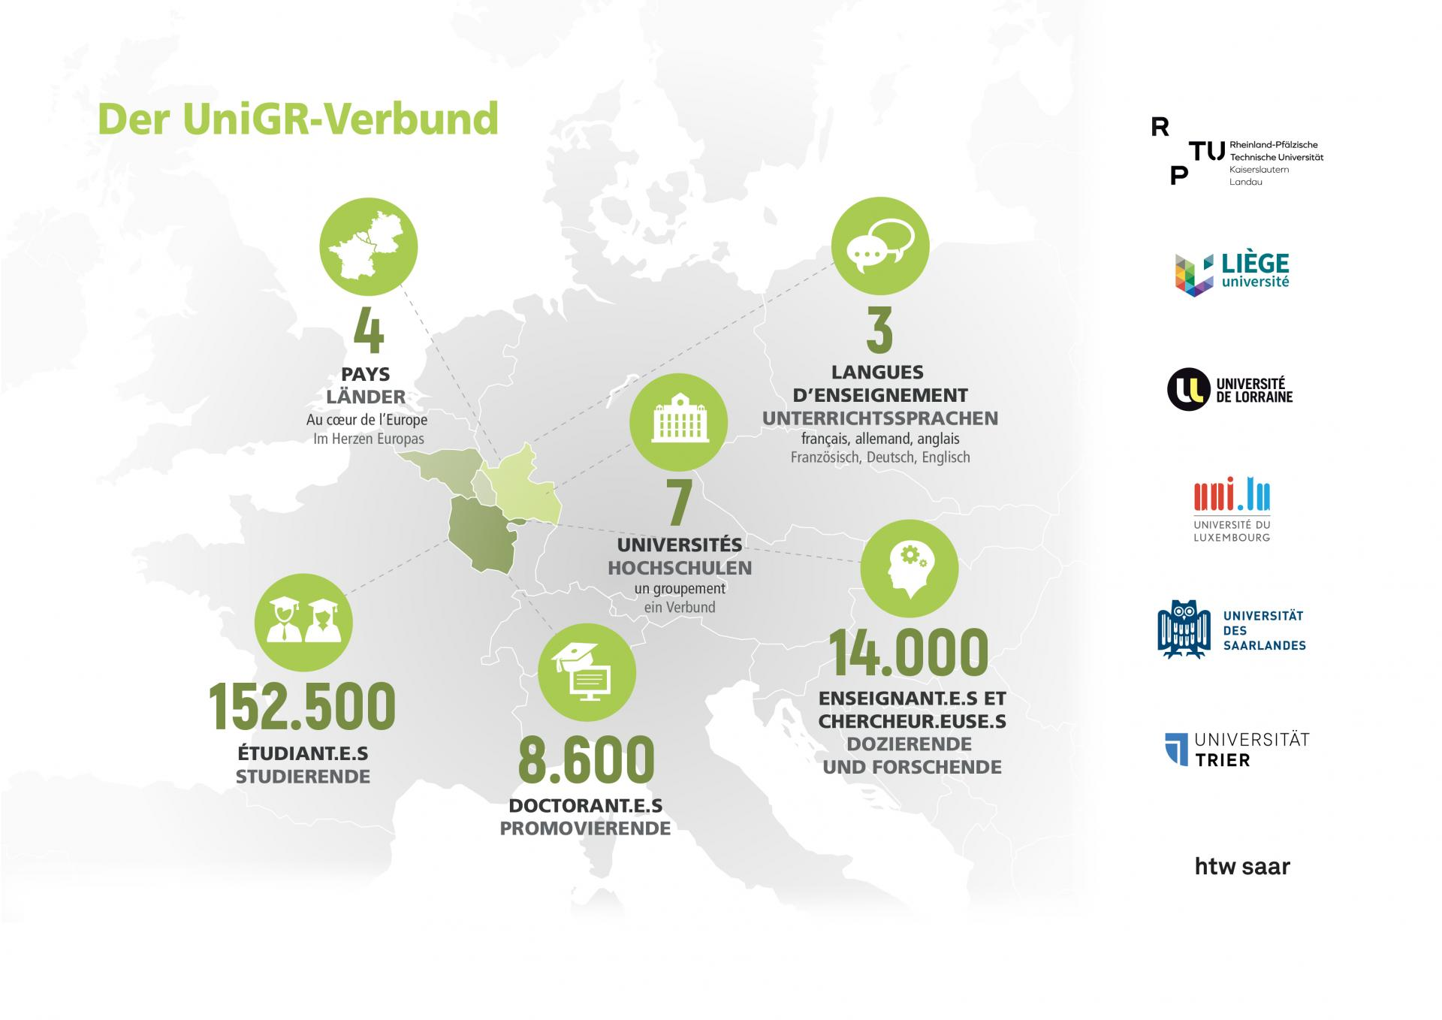
The University of the Greater Region
Source picture: https://www.uni-gr.eu/de/die-unigr-zahlen (16.05.2023)
Notes:
7 universities
4 countries
3 languages
Over 152,000 students
14,000 researchers

Slide 6
Some of the programs within the UniGR network
Advanced Mateirals Science and Engineering
Franco-German studies: cross-border communi-cation and cooperation
Border Studies
Développe-ment durable
German and French Law
Physics
Literature
Notes:
How does it work?
Study in more than one university
Some terms here and there
Multiple degrees
Mobility between counties
Not only experts in their fields, but get to know also different university systems
Some examples of cross-border study programs

Slide 7
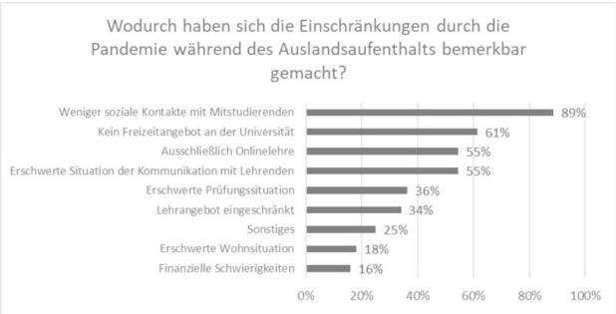
Cross-border students during the pandemic
Restrictions mentioned by the students surveyed during the pandemic (n = 44)
Survey: Ines Funk; Illustration: Paul Herzog.
Notes:
Online survey and qualitative qualitative interviews
show that while compulsory periods abroad have often taken place, immersion in the day-to-day life of studying and living in a neighbouring country has been very limited because of the new health regulations.
Master in Border Studies >> Pandemic has caused numbers to plummet, students trapped in halls of residence, curfew
It appears that, very often, the specific needs of students enrolled in cross-border courses were often not sufficiently considered during the pandemic.

Slide 8
What is missing?
better communication and coordination between the partner universities involved, e.g. for online teaching
the expansion of special counselling services at the partner universities
greater consideration of cross-border study programs in political decisions and measures of the universities

Slide 9
Thank you for your attention!
Castle Talks on Narratives on Borders in Europe
Resilience of border regions in times of crisis
Source picture: Florian Weber 2023.
Julia Dittel
(Saarland University, julia.dittel@uni-saarland.de)
Strasbourg, 15 November 2023
Source picture: Julia Dittel 2022.
Notes:
Crossing borders used to be cool, now it's not >> Increasingly international, but cross-border offerings are not a sure-fire success>> Question of resilience >> Dealing with this in more detail

