Slide 1
Resilience in the Current Migration Crisis in Lampedusa
By Iris Hankins, Naomi DeGasperi, Miyu Yoshie, Mareshet Pulliam, Kathya Zuniga-Gallegos

Slide 2
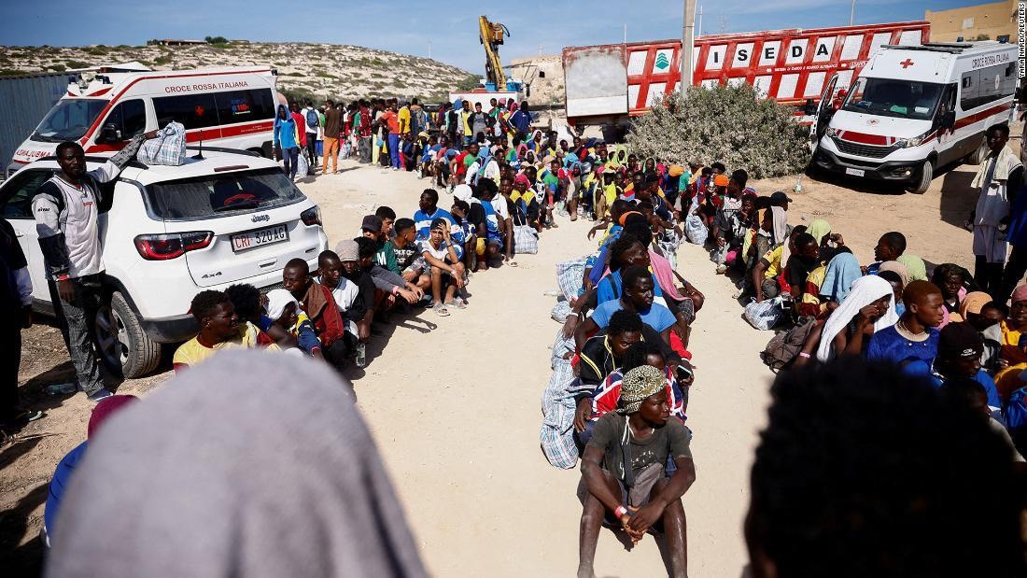
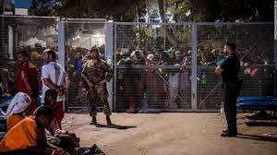
What is Lampedusa Island?
–Nearest European territory from North Africa
(only 113 km east of the Tunisian coast)
–Famous as a tourist destination
–The arrival of immigrants in numbers beyond
the island's capacity
(https://www.cnn.co.jp/world/35209194.html)
Notes:
Today, we’re talking about Resilience in the Current Migration Crisis in Lampedusa
This presentation focuses on the current migration crisis in Lampedusa, Italy while also recognizing the trend of European migration and how it relates to this issue as a whole. Our analytical approach will focus on tracing the crisis back to its colonial roots and explaining how it does not exist in a historical vacuum. We will highlight the importance of resiliency of the migrants coming into Europe even in the face of hopelessness. We aim to examine the role that both physical and social borders play in shaping the European perspective on immigration; as well as how the formation of nation states and the paradoxical rise of nationalism within Europe has contributed to the current crisis. We hope to identify who is responsible and see what policies are being offered as solutions. We offer an examination of the current solutions being brought forward and whether it is good enough to tackle the crisis.
Let’s start by what Lampedusa Island is. Lampedusa Island is the southernmost island of the Italian territory in the southern part of Sicily in the Mediterranean Sea ,nearest European territory from North Africa and only 113 km east of the Tunisian coast. It’s famous as a tourist destination and for its crystal clear waters. The population is about 6,000 people and the area is 20.2 km2. In recent years, the arrival of large numbers of migrants to the island has become a serious problem. The maximum number of people at the refugee detention center on Lampedusa Island is 400, but far more than that number of migrants sometimes arrive overnight.

Slide 3
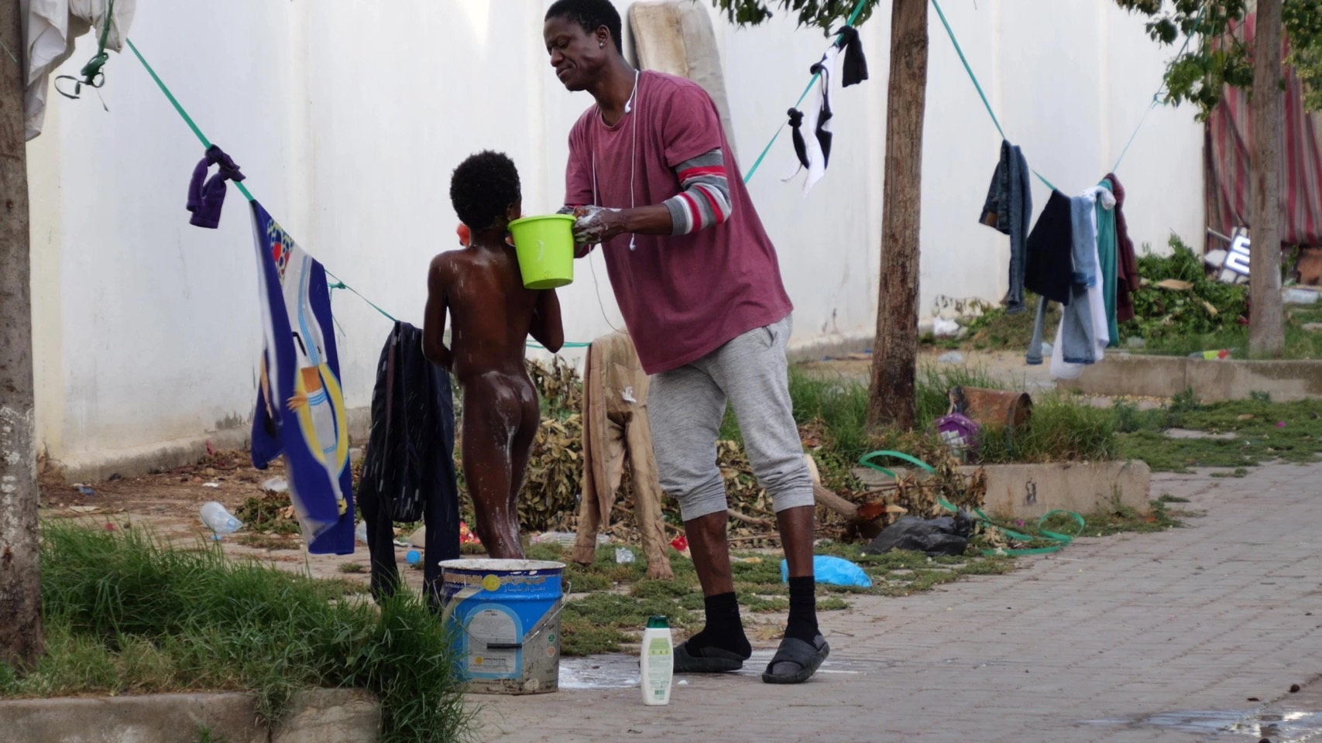
Why leave their home country?
・Who?
–Black people from West Africa, sub-Saharan Africans who were persecuted in Tunisia and had no place to live
・Why?
–Poverty and lack of prospects in their home countries
How do local people feel about migrants?
–Migrants have been welcomed and helped
–The new fences have been built by COVID-19
–Some people have good feelings about immigrants, while others have bad feelings about them
(https://www.asahi.com/withplanet/article/14942943) situation in Tunisia
Notes:
Next, why leave their home country? For the most part is Black people from West Africa, sub-Saharan Africans. They came to Tunisia but were persecuted in Tunisia and had no place to live. Libya has been the largest departure point so far, but Tunisia has exploded in 2023. It’s unbearable to reach the other side of the coast due to simple boats with crude welding. The reasons why they came Lampedusa is poverty and lack of prospects. Everyone has the right to a good life, but not in their own country. Why poverty in the first place? Conflicts, civil wars and terrorism. In addition to lack of basic education and less than simple jobs and lack of advanced medical infrastructure. In order to get out of poverty and become competitive, education reforms must be made. Also health and poverty are inextricably linked. There are also because of corruption persists and dependence on international aid.
What do the locals think of this? Migrants have been welcomed and helped, but are approaching their limits. Lampedusa refugee detention center can only accommodate 400 people. In the past, refugees and local residents were able to talk, watch live soccer games, and interact with each other, but now they are completely isolated, especially since the new fences have been built by Covid-19 and they cannot go outside. Before, locals could talk to them and understand why they came here from their homeland. But now that people are numbers, understanding is lost. So some local people think well, some think badly.

Slide 4
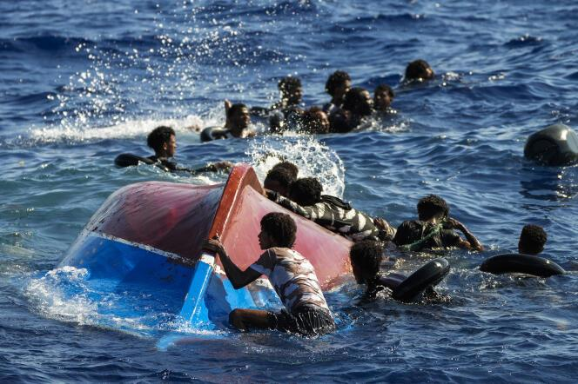
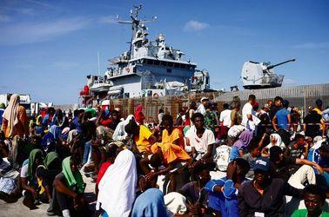
What is currently going on in Lampedusa?
126,000 migrants arrived in Italy this year
70% of these migrants entered through Lampedusa in recent months
Recent surge - 7,000 northern African migrants in 2 days
Lampedusa cannot keep up with influx of migrants
Overcrowded reception centers
Lack of supplies: water, food, and medical care
Lack of help
Outnumbered population
Locals forced to help migrants
Le Monde, “A Rescue operation by the Spanish NGO Open Arms,” August 22, 2022
Reuters, “Migrants Clandestins en Attente de Débarquer sur L‘île Sicilienne,” September 15, 2023
Notes:
Current Issue:
About 126,000 West African and sub-saharan African migrants have arrived on Italian shores in search of a more stable life. In August of this year, there was a recent surge in which 7,000 migrants arrived on the island of Lampedusa. Due to Lampedusa’s proximity to Northern Africa, 70% of incoming migrants have been received by the small island. The Italian island, however, has struggled to keep up with the consistent arrival of these migrants. According to Le Monde, Lampedusa’s reception centers are at full capacity, emergency workers are overwhelmed, and there is a lack of supplies like water, medical care and food to maintain these migrants. In addition, the influx of migrants has caused disorder among the Lampedusian locals, who are outnumbered by these migrants, forced to aid them like rescuing them at sea and opening their homes to them. This recent migrant surge in Lampedusa is unprecedented and is in need of urgent action at the European national level to make sure that the 2015 migrant shipwreck doesn’t occur again.

Slide 5
Historical Background on EU Borders
“Migrants did not choose Lampedusa, but were directed and diverted there by the Italian authorities as a way of controlling the flows of migration which were both increasing in numbers and diversifying in places of origin” (Kushner, p. 66).
Timeline:
Before 1990s: Movement among borders was viewed as an “ethnographic” interest
strengthening Italy’s relationship with the Southern Mediterranean
Focus on bringing newly independent North African countries towards the capitalist west
Migrants could enter Italy seasonally w/out visa
During 1990s: Redrawing of EU internal & external borders
EU creation in 1993 had harmonized immigration policy among EU countries
Implementation of Schengen agreement in 1995 eliminated internal borders, but led to the strengthening of external borders
Led to the increase of undocumented migration
Led to cooperation between EU countries and Southern Mediterranean countries in monitoring and strengthening Mediterranean border
2015-2016: “Long Summer of Migration”
EU institutions and policies to prevent the entry of refugees partially broken down
Germany partially opened its borders to refugees
Other EU countries followed
2016-2017: European Commission attempts to strengthen EU borders
Pushed for repressive policies on refugee entry into the EU through the “European Agenda on Migration”
In July 2016, EC passed sets of legislations that focused on strengthening the EU border and keep those from North Africa and beyond out.
Notes:
Historical Background - Gateway/ EU Borders:

Slide 6
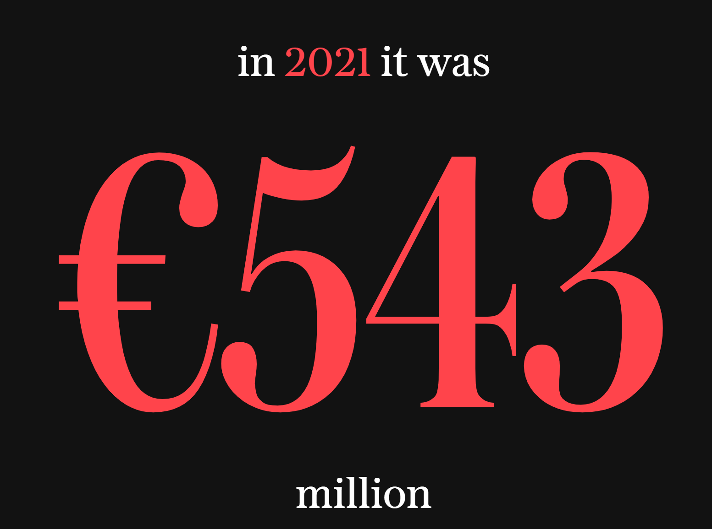
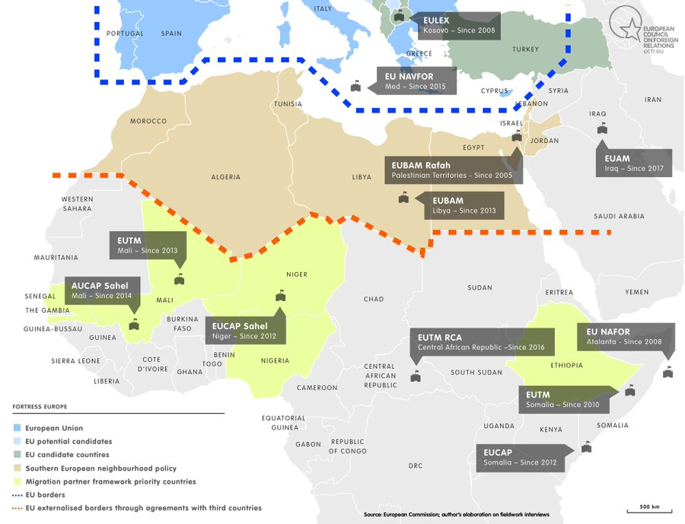
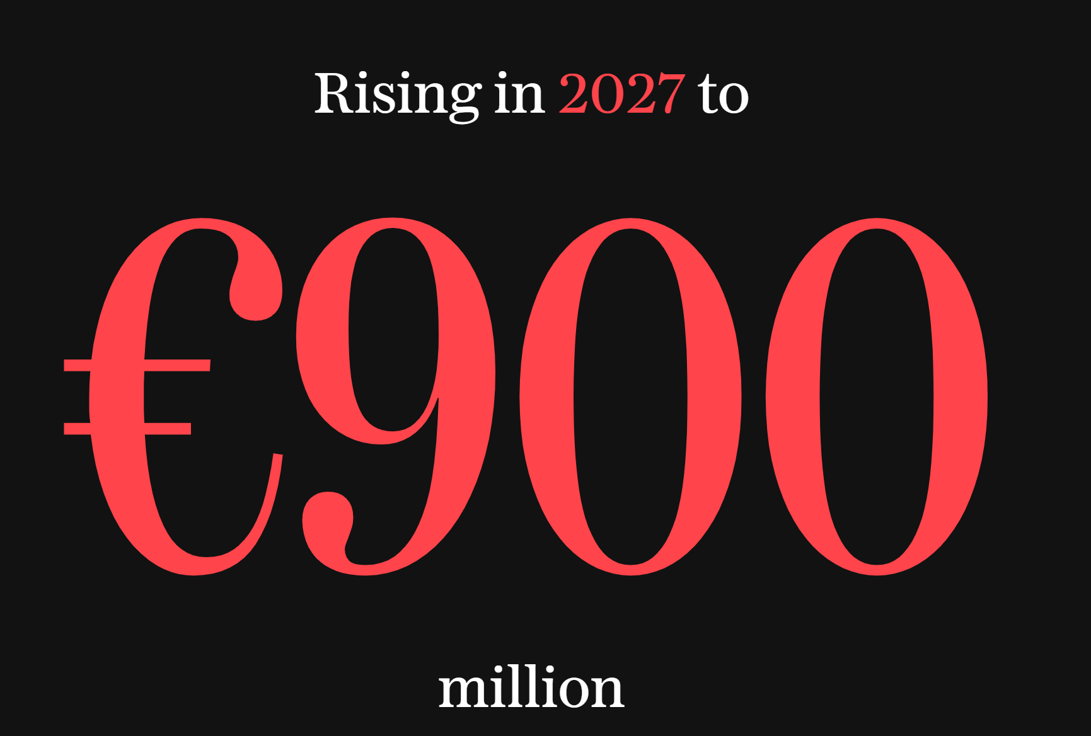
Borders: Physical, Social, and Political
Paradox of “Fortress Europe” vs “Borderless Europe”
Externalizing EU borders
EU policies: human rights, or security and migration “management”?
(Fortress Europe, The Telegraph, 2022)
(Migration Through the Mediterranean: Mapping the EU Response, Stefano M. Torelli, 2018)

Slide 7
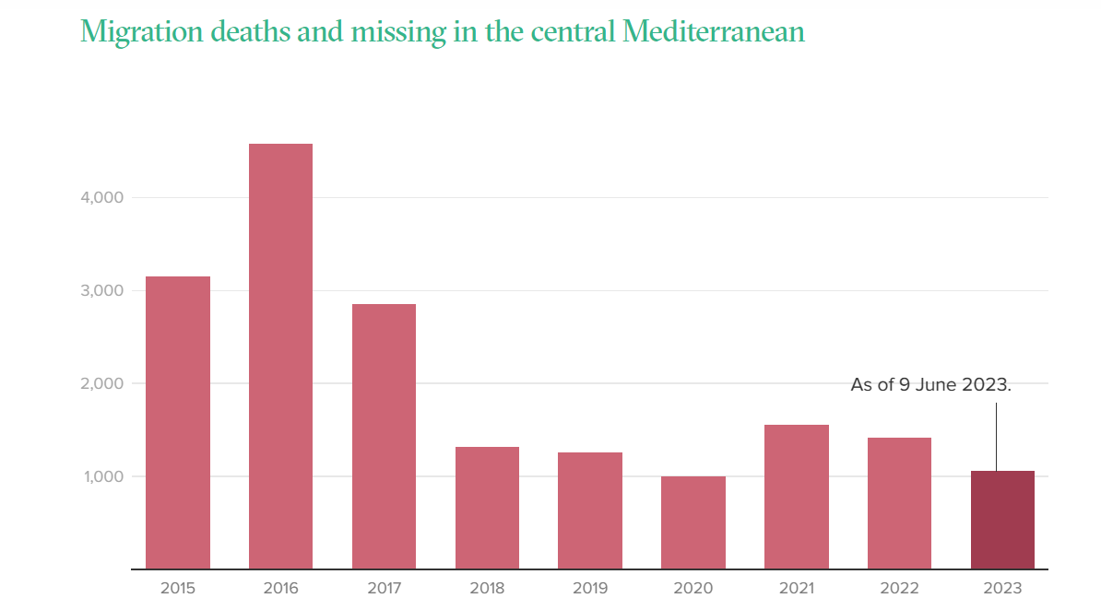
Define Resilience (defending human rights)
Dublin Regulation
“I cannot go back; there’s a war in my country. But I cannot stay here either; they hate us for our black skin.” - Saddam, a 28-year-old from Darfur
Reception Centers - Human Rights
Case of J.A and Others vs Italy
Longstanding Crisis - State of Emergency
Source: IOM Missing Migrants Project
64.8% of migrants reported health problems resulting from their migration journey, 21.1% showed symptoms from a nonspecific cause, and 12.7% already had symptoms in their country of origin.
Regarding violence, 75.9% of participants reported having experienced at least one form of violence (out of six types) since leaving their country of origin.
Notes:
Long standing crisis - Over 20 years of government failure especially from the EU. We see countries like France and Germany tightening their borders and leaving Italy to solve the crisis on their own. The real issue is the not the numbers of migrants as the Eu would like you to believe. The real issue is the way the migrants arrive and how they are received. Migrants take on the perilous journey and if they are lucky enough to survive and make it to Lampedusa they are faced with heavily militarised ports and Frontex (EU border agency).
What does resilience look like for this current crisis?
Which human rights are at stake?
Has there been much resilience?

Slide 8
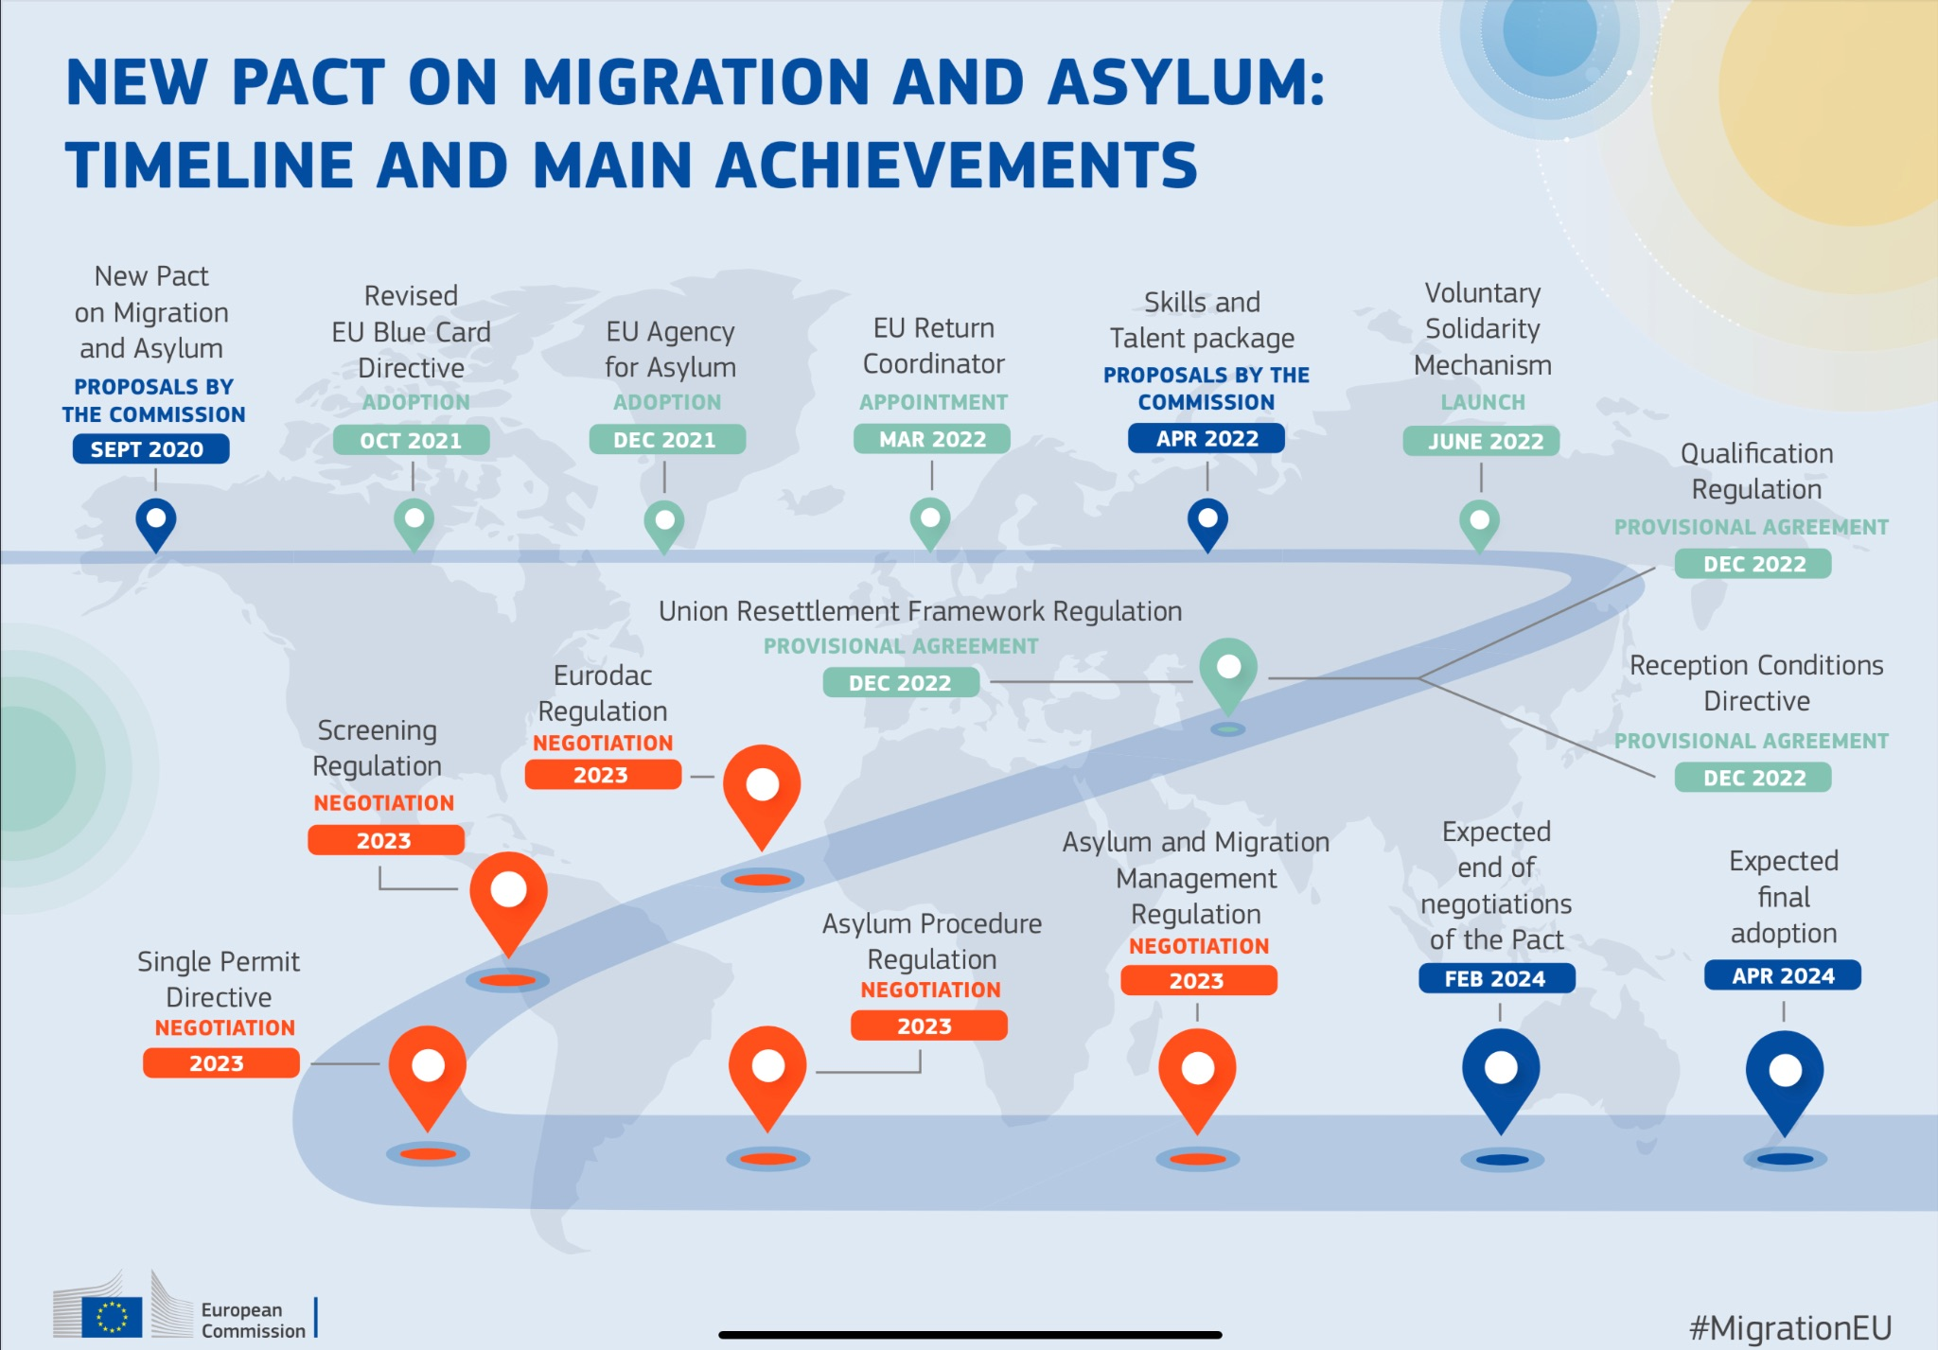
Solutions to the Crisis
What solutions have been offered?
New Pact on Migration and Asylum
10 point plan
Italy’s crackdown
Memorandum of Understanding with Tunisia
Why are current policies/approaches insufficient?
(European Commision, New Pact on Migration and Asylum Timeline, September 2020)

Slide 9
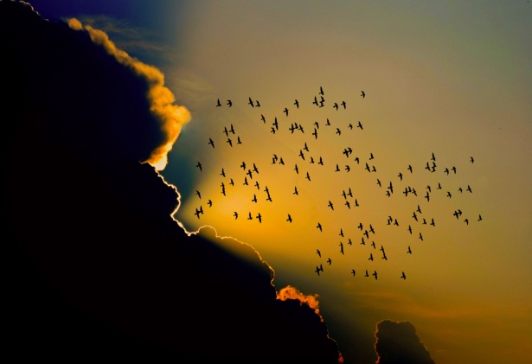
More on solutions and resistance
The approaches so far do not address the root cause of migration
Heightened military and surveillance is dangerous even for the sake of security
Increasing security won’t solve the issue of irregular migration
How do we solve poverty, political instability, and overall conflict?

Slide 10
Citations
Georgi, Fabian. “THE ROLE OF RACISM IN THE EUROPEAN ‘MIGRATION CRISIS’: A HISTORICAL MATERIALIST PERSPECTIVE.” Racism After Apartheid: Challenges for Marxism and Anti-Racism, edited by Vishwas Satgar, Wits University Press, 2019, pp. 96–117. JSTOR, https://doi.org/10.18772/22019033061.9. Accessed 12 Nov. 2023.
Fröhlich, Christiane, and Lea Müller-Funk. Perceiving Migration Crises: A View from the European Neighbourhood. German Institute of Global and Area Studies (GIGA), 2020. JSTOR, http://www.jstor.org/stable/resrep27061. Accessed 12 Nov. 2023.
Kushner , T. (2016). “Lampedusa and the migrant crisis ,Ethics representation and history.” Media Culture Studies, 2, 59–92.
Sendhardt, Bastian. “Border Types and Bordering Processes: A Theoretical Approach to the EU/Polish-Ukrainian Border as a Multi-Dimensional Phenomenon.” Borders and Border Regions in Europe: Changes, Challenges and Chances, edited by Arnaud Lechevalier and Jan Wielgohs, Transcript Verlag, 2013, pp. 21–44. JSTOR, http://www.jstor.org/stable/j.ctv1fxhcq.4. Accessed 12 Nov. 2023.
WITTENBERG, LISKA. “The EU Response.” Managing Mixed Migration: The Central Mediterranean Route to Europe, International Peace Institute, 2017, pp. 14–17. JSTOR, http://www.jstor.org/stable/resrep09576.7. Accessed 12 Nov. 2023.
Robert Press. “Dangerous Crossings: Voices from the African Migration to Italy/Europe.” Africa Today, vol. 64, no. 1, 2017, pp. 3–27. JSTOR, https://doi.org/10.2979/africatoday.64.1.01. Accessed 12 Nov. 2023.
Roberts, H. (2023, September 18). Italy’s Meloni gets tough on migrants. POLITICO. https://www.politico.eu/article/italy-prime-minister-giorgia-meloni-immigration-crackdown/
Press corner. (n.d.). European Commission - European Commission. https://ec.europa.eu/commission/presscorner/detail/en/ip_23_3887
Segneri, Maria Concetta, et al. “Anthropological Research Study of Migrants at the First Aid and Reception Center (CPSA) of Lampedusa.” International Journal of Environmental Research and Public Health, vol. 19, no. 9, Multidisciplinary Digital Publishing Institute, Apr. 2022, p. 5337. https://doi.org/10.3390/ijerph19095337.
D’Ignoti, Stefania. “How Politics and Neglect Have Hobbled Italy’s Migration Reception System.” The New Humanitarian, 22 June 2023, www.thenewhumanitarian.org/news-feature/2023/06/22/how-politics-and-neglect-have-hobbled-italys-migration-reception-system.

Slide 11
Merci beaucoup
jhankins@willamette.edu
mtpulliam@willamette.edu
miyu28a.a@gmail.com
kathyazuniga7@gmail.com

