Slide 1
Cross Border Regions And Climate Change:
Legal Tools Of Cross Border Friendly Legislation For Coherent Actions
Prof. Dr. Frey, Mag. rer. publ.,
University of Applied Sciences Kehl

Slide 2
Cross Border Regions And Climate Change:
Legal Tools Of Cross Border Friendly Legislation For Coherent Actions
Topic:
Legal and administrative issues of cross border climate protection and possible solutions
Research Question:
What legal tools are available to implement coherent cross-border climate protection measures?
Prof. Dr. Frey, Mag. rer. publ.,
University of Applied Sciences Kehl

Slide 3
Cross Border Regions And Climate Change:
Legal Tools Of Cross Border Friendly Legislation For Coherent Actions
Context:
Border regions are often more sensible to climate change than internal regions, due to their nature (e.g. natural borders)
Cross border climate protection measures are due to legal and administrative issues (sovereignty) more difficult to realize
But there are some legal tools to overcome these obstacles, classic ones like bi- or multilateral treaties and modern ones like opening and experimental clauses at all legal levels
Prof. Dr. Frey, Mag. rer. publ.,
University of Applied Sciences Kehl

Slide 4
Cross Border Regions And Climate Change:
Legal Tools Of Cross Border Friendly Legislation For Coherent Actions
Definition of Cross-border climate protection measures:
Those measures between two or more states that consist either in concrete joint action (such as joint construction of a coastal protection measure) or in national measures that are coordinated across borders (such as green concepts or flood retention).
They are distinguished from non-coordinated, purely national measures in border regions by the characteristic of at least cross-border coordination.
Prof. Dr. Frey, Mag. rer. publ.,
University of Applied Sciences Kehl

Slide 5
Cross Border Regions And Climate Change:
Legal Tools Of Cross Border Friendly Legislation For Coherent Actions
Key research findings (1):
Cross border climate protection measures could be categorized by their nature, their degree of cross border integration and their legal basis.
On their nature (common structure across the border, coordinated measures on both sides, structure on one side, used by both partners)
On their degree of cross border integration (information, coordination, joint planning, joint decision making, joint implementation)
On their legal basis (bi- or multilateral treaty, legal form of supra-national or national law)
Prof. Dr. Frey, Mag. rer. publ.,
University of Applied Sciences Kehl

Slide 6
Cross Border Regions And Climate Change:
Legal Tools Of Cross Border Friendly Legislation For Coherent Actions
Key research findings (2): Classic tools: transfer of sovereignty
Prof. Dr. Frey, Mag. rer. publ.,
University of Applied Sciences Kehl

Slide 7
Cross Border Regions And Climate Change:
Legal Tools Of Cross Border Friendly Legislation For Coherent Actions
Key research findings (3): Elements of Cross-border friendly legislation
Cross border impact assessment
  Systematic analysis of cross border impacts at the stage of prospective impact assessment (transpositions of EU-directives; legal projects with cross-border impacts; e.g. legalisation of cannabis)
Experimentation clauses, opening clauses and exception clauses, real-life-laboratories
Transfer of sovereignty rights
Prof. Dr. Frey, Mag. rer. publ.,
University of Applied Sciences Kehl

Slide 8
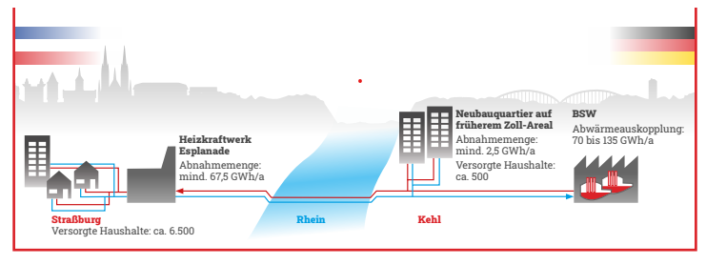
Cross Border Regions And Climate Change:
Legal Tools Of Cross Border Friendly Legislation For Coherent Actions
Cross border climate protection: some examples (1):
Cross-border local heating network Kehl/Strasbourg
  Heat supply for a Strasbourg residential area using waste heat from a German steel plant.
  Funded by INTERREG
Prof. Dr. Frey, Mag. rer. publ.,
University of Applied Sciences Kehl

Slide 9

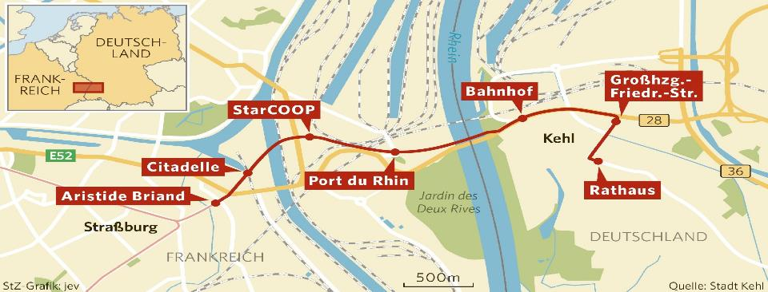
Cross Border Regions And Climate Change:
Legal Tools Of Cross Border Friendly Legislation For Coherent Actions
Cross border climate protection: some examples (2):
Cross border enlargement of tram line D
Prof. Dr. Frey, Mag. rer. publ.,
University of Applied Sciences Kehl

Slide 10
Cross Border Regions And Climate Change:
Legal Tools Of Cross Border Friendly Legislation For Coherent Actions
Conclusion
Border regions are particularly vulnerable to the effects of climate change (natural borders)
Cross-border climate protection measures are nevertheless relatively rare
One reason for this is the particular legal and administrative complexity.
However, there are numerous classical and modern solutions to solve this obstacle (cession of sovereign rights, experimentation and opening clauses; transboundary impact assessment).
In the end, the political will to use these instruments is lacking.
Prof. Dr. Frey, Mag. rer. publ.,
University of Applied Sciences Kehl

Slide 11
Cross Border Regions And Climate Change:
Legal Tools Of Cross Border Friendly Legislation For Coherent Actions
Thanks for your attention.
We remain at your disposal for any questions and suggestions:
frey@hs-kehl.de
Prof. Dr. Frey, Mag. rer. publ.,
University of Applied Sciences Kehl

