Slide 1
Cross-Border Cooperation & the Canada – US Border
The role of regional governance
Laurie Trautman, PhD
Director, Border Policy Research Institute, Western Washington University
Global Fellow, Woodrow Wilson Center & Canadian Global Affairs Institute
Notes:
Start with a brief snapshot of the binational scale between CA and US, top down
Overview of what we do in Cascadia through a more bottom-up approach
Use COVID-19 border restrictions as a lens through which to compare how these approaches impact borderland communities and how we can move forward

Slide 2
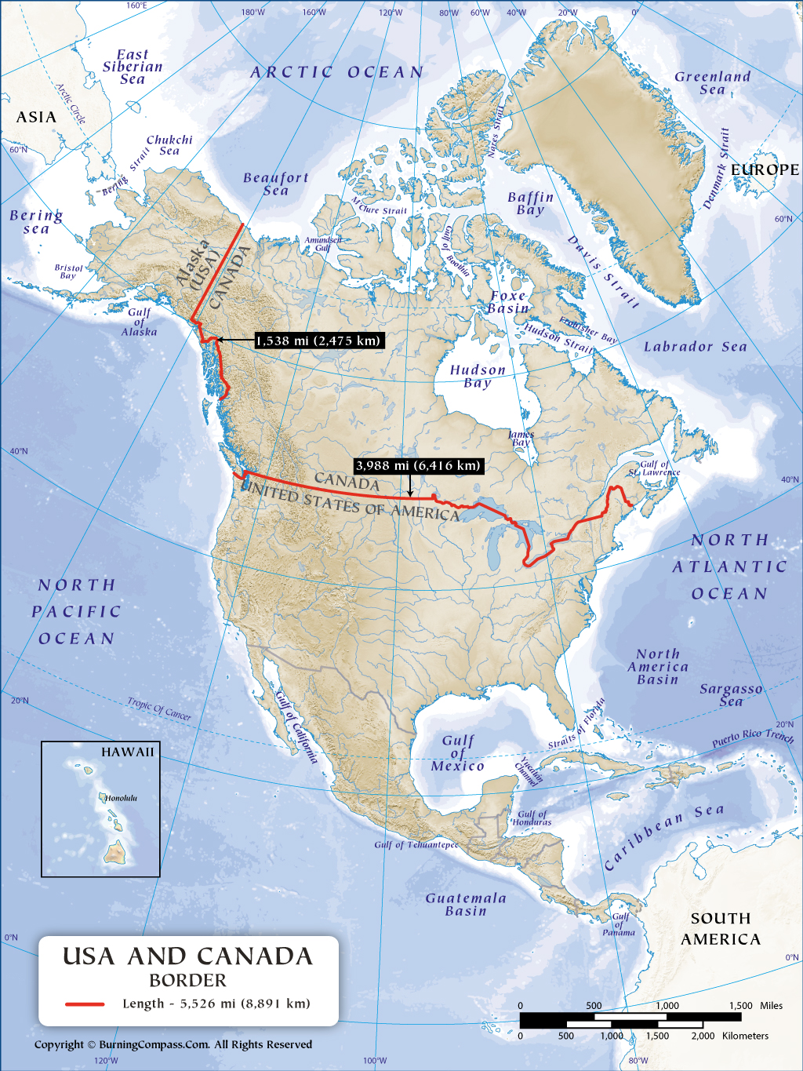
Canada & US share the longest land border in the world, composed of diverse regions

Slide 3
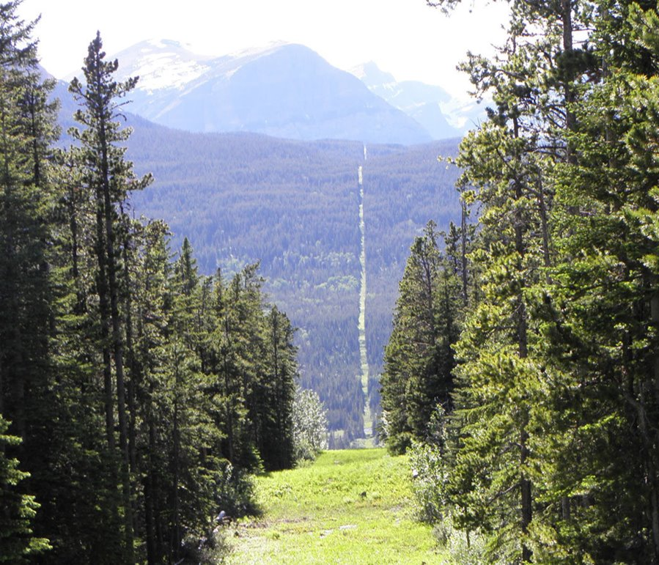
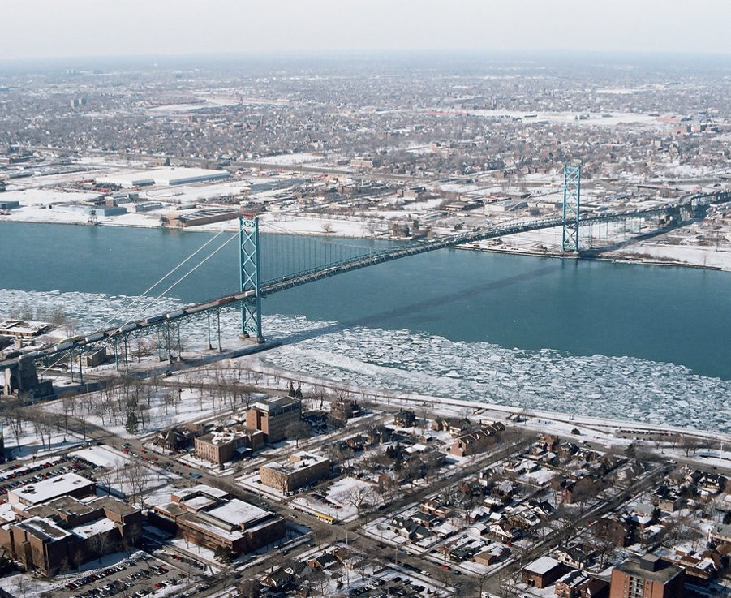
The border zone is not homogenous...
...but border policy in North America is, which is a challenge for place-based models of cross-border cooperation
Notes:
Look different, connected differently, function in different ways
CA – US border policy is same throughout its 8,000 km

Slide 4
Tension between territorial divisive bordering and connective spatial bordering
Connective
Trust
Shared identity
Industries that are competitive OR complimentary that enhance development
Infrastructure and transportation
Divisive:
Friction of the border
Misalignment of systems (labor, legal frameworks, governance)
Lack of structure/funding for collaboration
Notes:
Economic integration driven by private sector (Microsoft, Amazon)

Slide 5
What exists at the top-down, binational framework? (goal of policy parallelism over integration)
Collaboration (shared work/common goals)
Security relationship
Border policy (Perimeter approach)
Cooperation (implementation/parallelism)
NORAD
Free trade agreements
Coordination (information/communications)
Striving for regulatory alignment
Strong networks
Preclearance
Trusted Traveler & Trader programs
Agency to agency channels
Notes:
Borrowed the 3Cs model from Christian Leuprecht, EBJ
CA – US border policy relationship is very advanced and robust, which is why its surprising it broke down so much during the pandemic

Slide 6
Canada – US pandemic border restrictions
Coordination was marginal
Collaboration broke down
ArriveCAN
Cooperation was weak
Different definitions of 'essential' and 'non-essential'
Aligned on cargo and trade
Trump -Trudeau relationship
Uncoordinated easing of restrictions
Inconsistencies between modes, testing requirements, vaccinations
Hollowing out of US bureaucracy
Lack of trust
Trusted Traveler program frayed
Notes:
Inconsistencies very difficult for travelers to navigate
As we learned during COVID, a lot of things that function well can break down during times of crisis

Slide 7
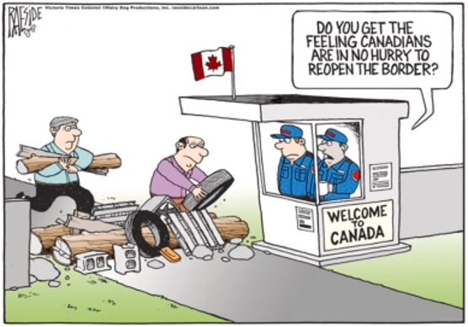
COVID-19 Border Restrictions & Borderlands
Hardening of borders prolonged in
the North American context compared to the EU
Very little awareness or recognition of impacts on border communities
Transborder designation for 3 remote areas
Policies divorced from borderland realities
Severe social and economic repercussions that continue
Absence of a joint inquiry into ‘lessons learned’
Notes:
Transborder communities, Nov. 2020; Campobello Island, NW Angle, Hyder-Stewart
Canada's 3 day test requirement, US flights
Haven't yet returned to pre-pandemic travel land borders
EU is revisiting policies and institutions, common goal of deep collaboration, the US and Canada are going further down the road of policy parallelism
Distinct departure from the border management relationship developed post-9/11 years, which was collaborative

Slide 8
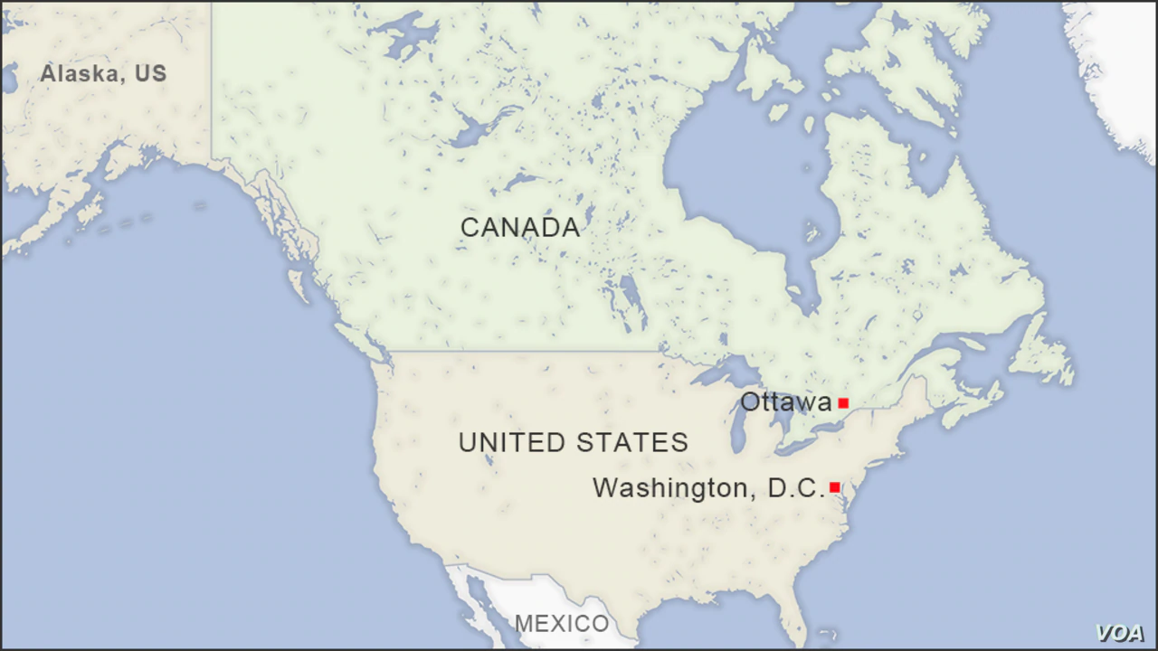
Cross-Border Cooperation: A bottom-up approach in Cascadia
Notes:
Overview of a bottom-up approach in Cascadia, my panel presentation tomorrow will be more descriptive
First I'll again use the example of the pandemic border restrictions and a unique situation from Cascadia to illustrate multi-scale governance in practice

Slide 9
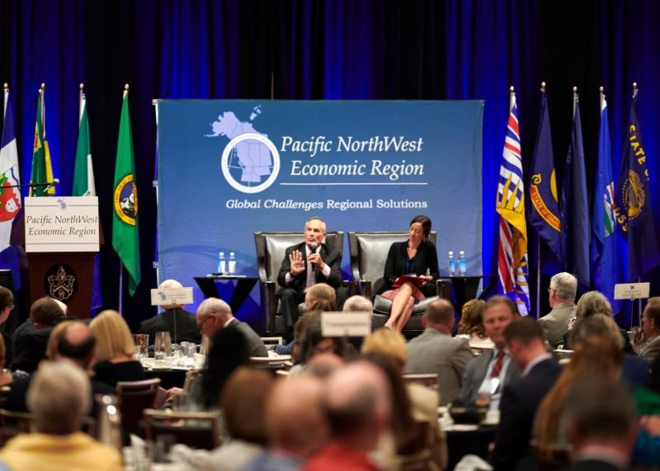
Cascadia: Entities focused on cross-border cooperation (our equivalent of EGTCs?)
Cascadia Innovation Corridor
International Mobility & Trade Corridor Program
PNWER
Notes:
Several organizations and initiatives whose primary focus is on cross-border relationships and tackling shared challenges
Provide framework for those vertical (multi-scale) connections, and horizontal (cross-border)
Isn't necessarily the case in other cross-border areas of the CA-US border

Slide 10
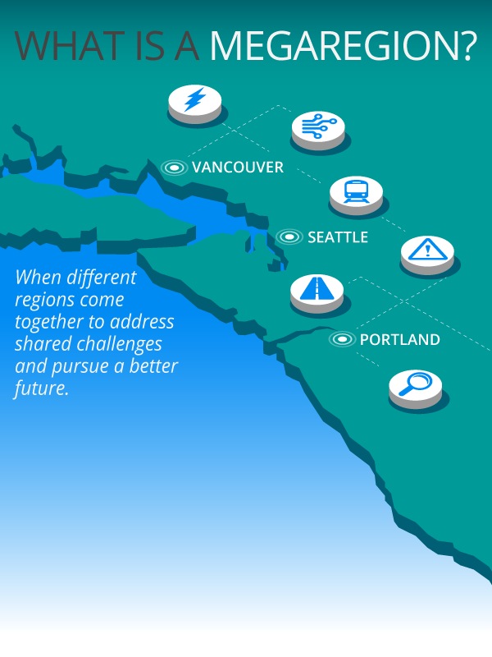
Cascadia Innovation Corridor
Bringing together:
Business
Academia
Government
Civil society
To facilitate:
Congestion/transportation
Life sciences
Transformative tech
Sustainability
On both sides of the border
Notes:
1. A variety of organizations and initiatives engaged in cross-border collaboration
2. CIC is one I'm involved in
3. Regional approach, connecting BC/WA/OR
each year, the premier of BC and the governors of Washington and Oregon participate in the CIC conference to help spur various economic, trade, and academic initiatives, including high-speed rail

Slide 11
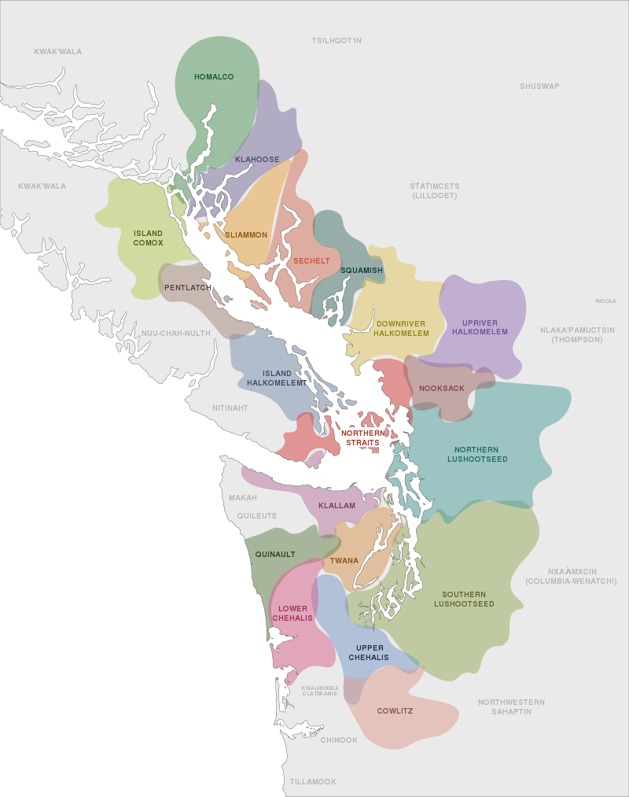
Coast Salish Indigenous Nations
“It’s been put on us to bring an Indigenous framework to this Western way. With local governments, county governments, state governments, federal governments and agencies, we have to ensure that the framework of Indigenous traditional cultures are valued — at the same level as science.”
-Lummi Tribal elder
Coast Salish Dialects and Territories
Notes:
“Coast Salish” refers to a language family, including two dozen distinct languages and many dialects, and is used to indicate the cultural group of indigenous peoples who speak or spoke these languages.
60 + Tribes and First nations
Many have ancestral ties across the border
Increasing influence in governance space

Slide 12
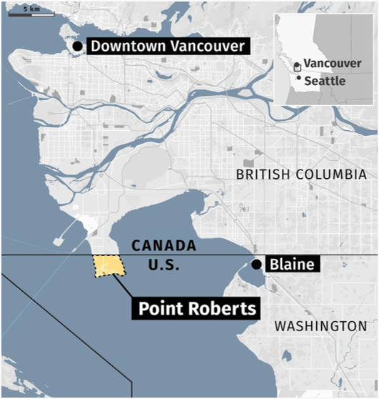
Pandemic restrictions & the borderlands
Working relationships & channels of communication:
Community leaders
Elected officials
Health authorities
Border agencies
Vertical linkages
connect borderland community with various scales of government
Horizontal linkages
connect jurisdictions on either side of the border
Notes:
1,200 residents, dual citizens, 49th parallel
Allowed to transit through CA to reach US for essential purposes
Cross-Border Task Force, involved a lot of actors and stakeholders
VERTICAL: state, provincial, federal
HORIZONTAL: state and province, US CBP and CBSA, consulates, etc.
Difficult to evaluate the success of these efforts. We were able to get some exceptions for Pt. Roberts, but not to the extent that we'd expect given the close relationship between CA and US, and the dependency of these residents on the border (no COVID cases until 2021)
Ex. illustrates how multi-scale governance worked in practice and how critical sub-national scale is during times of crisis and especially for borderland communities.

Slide 13
Cross-Border cooperation in Cascadia is a mix of informal, dynamic, and multi-scale networks...
Relatively strong regional structures and organizations
built on trust and a 'culture of collaboration’
hybrid state/civil society/private sector organizations
Indigenous Nations that span the border and are increasingly influential
Tangible benefits
Times of crisis
Advancing border policies
Notes:
NEXUS, IBETs, EDLs

Slide 14
...comes up against a very formal and strict border regime
Informal structures are vulnerable to political turnover, lack of funding, and capacity constraints
Functional linkages may not be enough to advance structural integration
Requires long-term capital investment
Legal frameworks

Slide 15
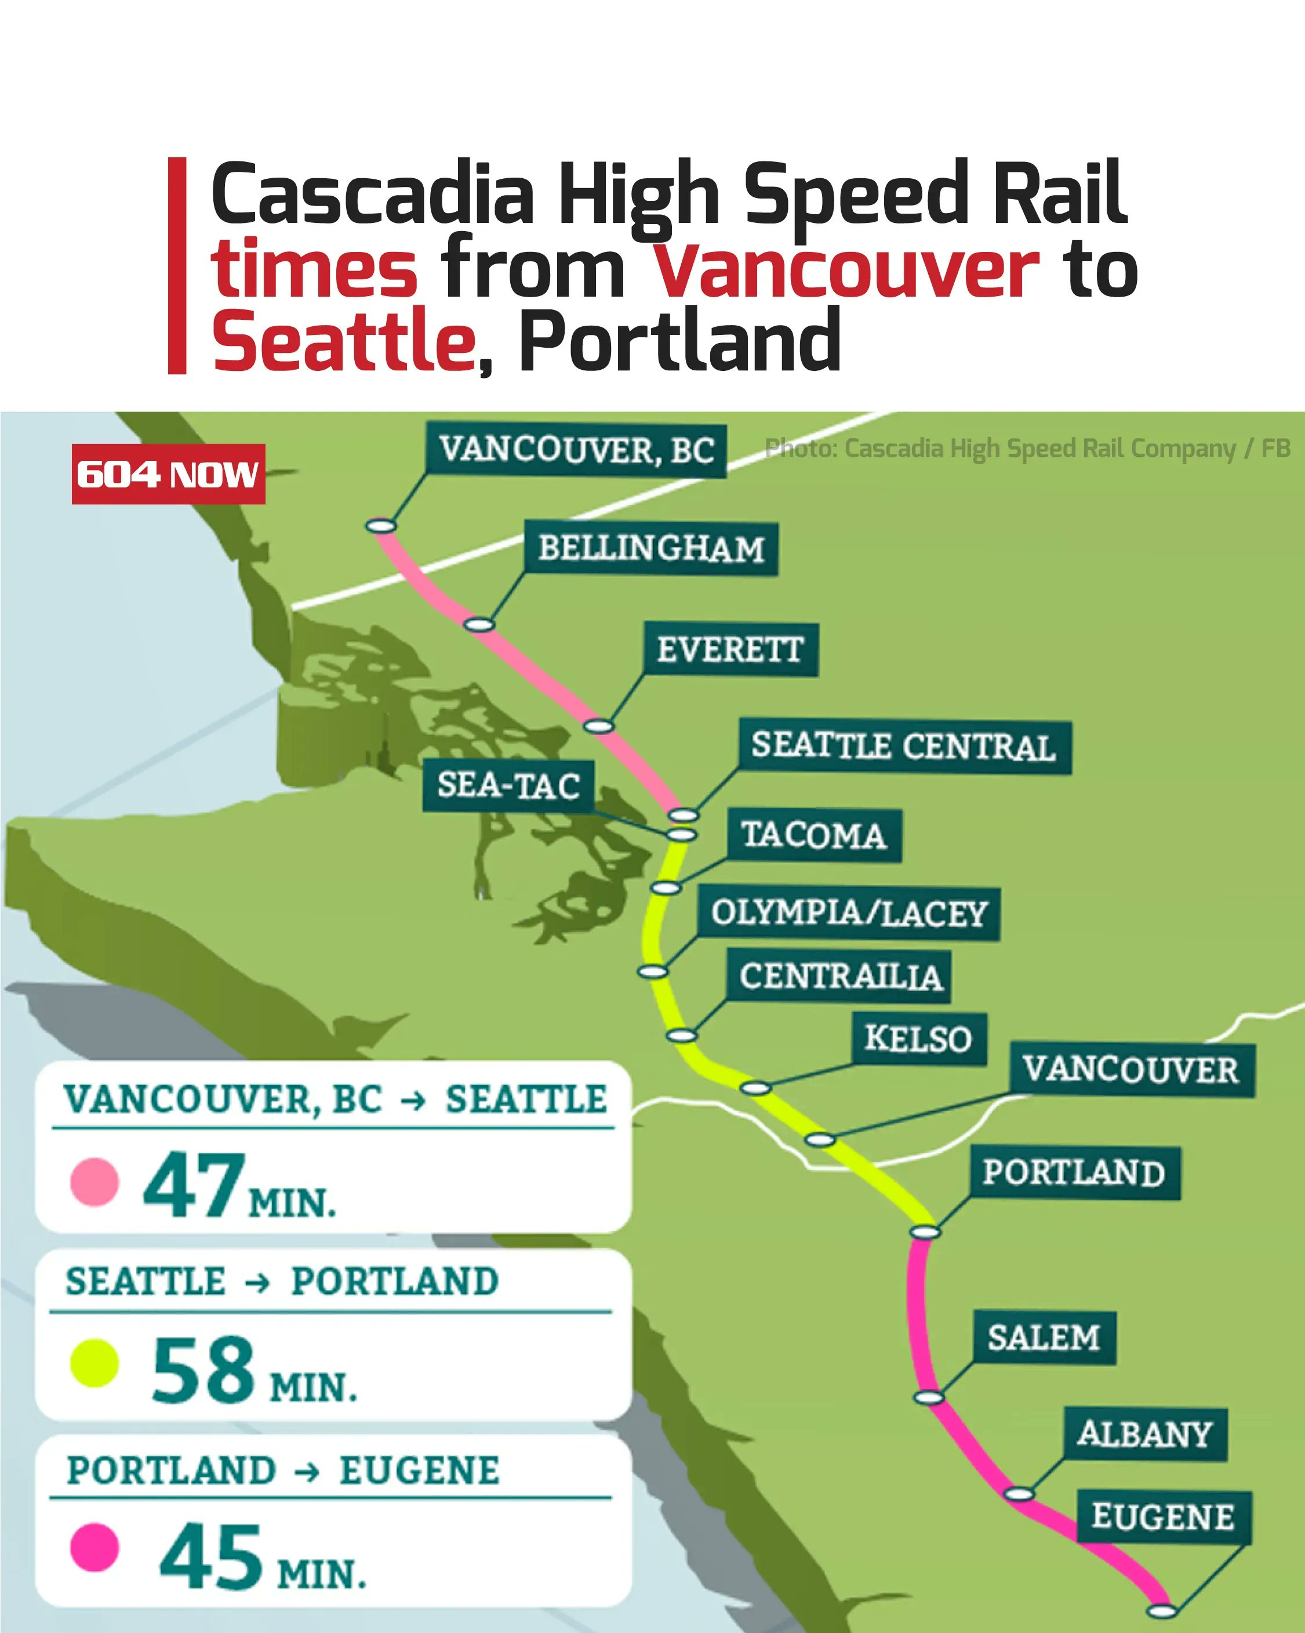
Can policy parallelism support cross-border infrastructure?

Slide 16
Future or the Canada – US border relationship
Increasing challenges that know no borders
pandemic border restrictions
climate-induced environmental challenges (floods, forest fires, rising sea levels)
Requires innovative and adaptable models of governance
Indigenous Nations
The sub-national scale is where the CA – US relationship is most functional
Cascadia region is a leader

Slide 17
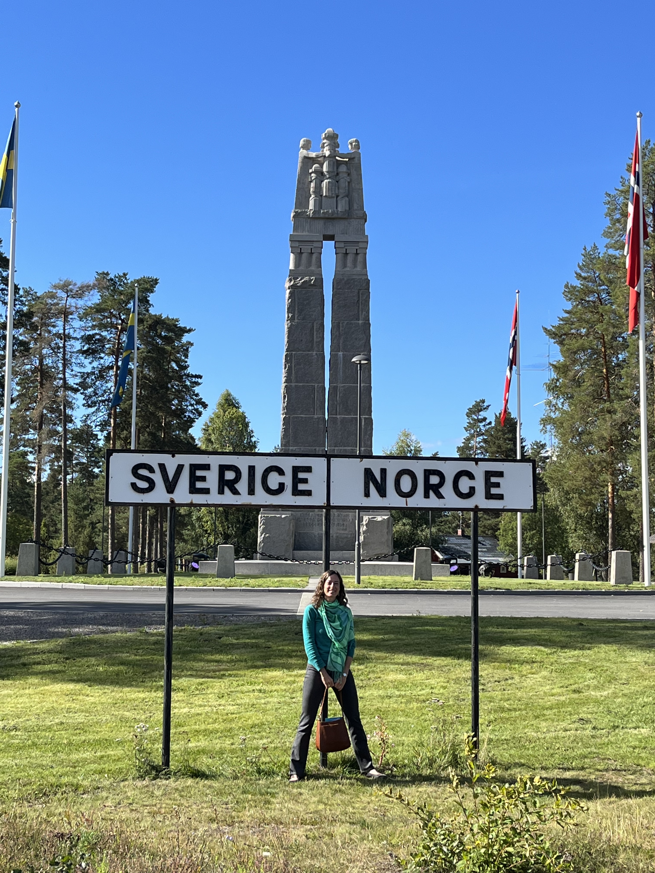
100+ years of a peaceful border
Norway - Sweden
Canada – United States
Notes:
Peace between two neighboring countries has the greatest impact in borderland communities
Both in Europe and N. America, governance emanating from those communities, where there is a lived experience of the border, is where we are most likely to develop and advance solutions to the challenges that borders create.

