Slide 2
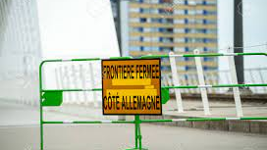
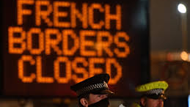
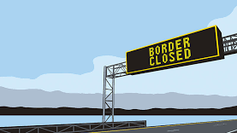
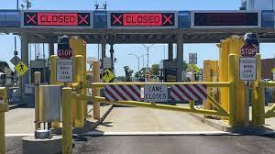

Slide 3
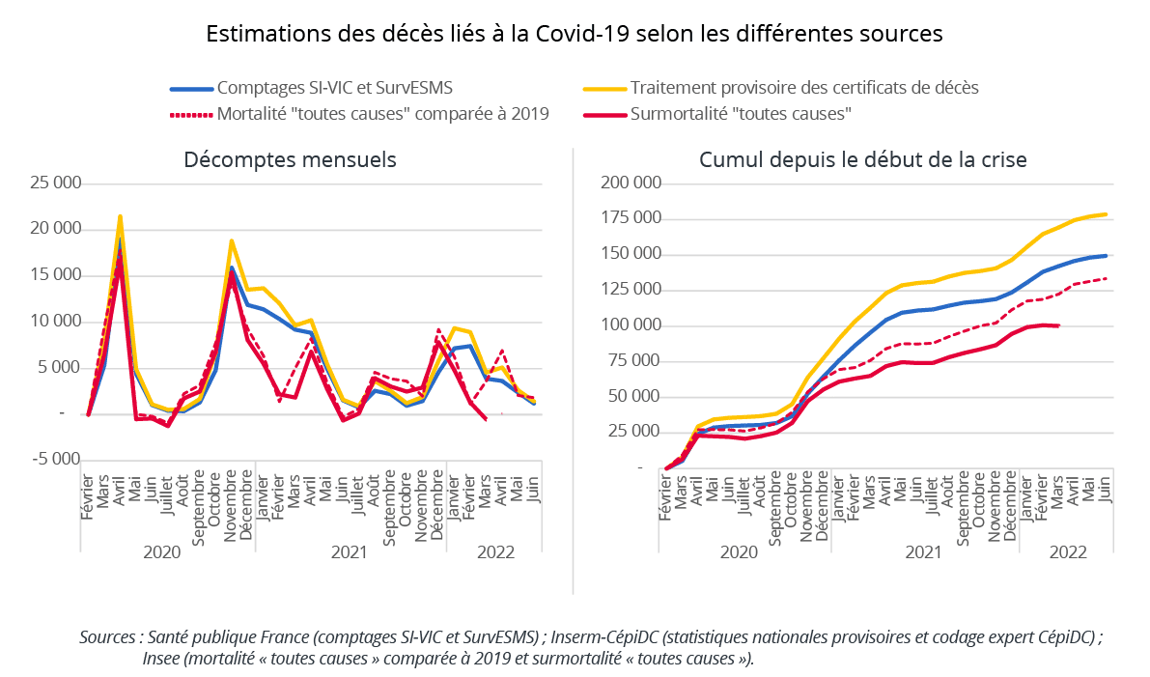
20 millions deaths worlwide since the start of the pandemic
between 2020 and 2023: 1/10 person is contaminated
Tedros Adhanom Ghebreyesus

Slide 4
How did borders, the key paws during the covid crisis, find themselves at the heart of European cooperation?

Slide 5
From invisible to inescapable: borders under the spotlight during the covid crisis
Borders, key paws put aside before the covid crisis
Health emergencies: perfect timing for borders to come into play
The slow erasement of the borders by resilience : an uneasy play
The emergence of resilience and cooperation, tackling the borders
The gradual removal of borders from the board: fading stars overshadowed by resilience

Slide 6
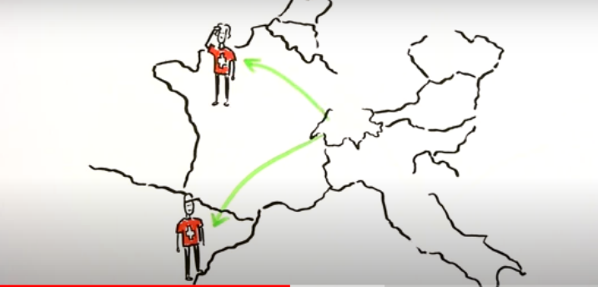
A) Borders, key paws put aside before the covid crisis
Free movement
Lack of control
Disapeaning borders
Domestic market
Schengen area
Between all members states
Free movement of goods
Free movement of services
Free movement of people
Free movement of capital
Free movement of people:
23 Member States + Norway; Icland; Switzerland & Lietchtenstein

Slide 7
A) Borders, key paws put aside before the covid crisis
Existence of legal restriction
The possibility of an a posteriori control of border crossings
As identity control of people
Domestic market
Restriction on the freee movement of persons justified by:
Public order
Public security
Public health
Schengen area
Borders can be temporary re-established on the ground of:
Public order
National security

Slide 8
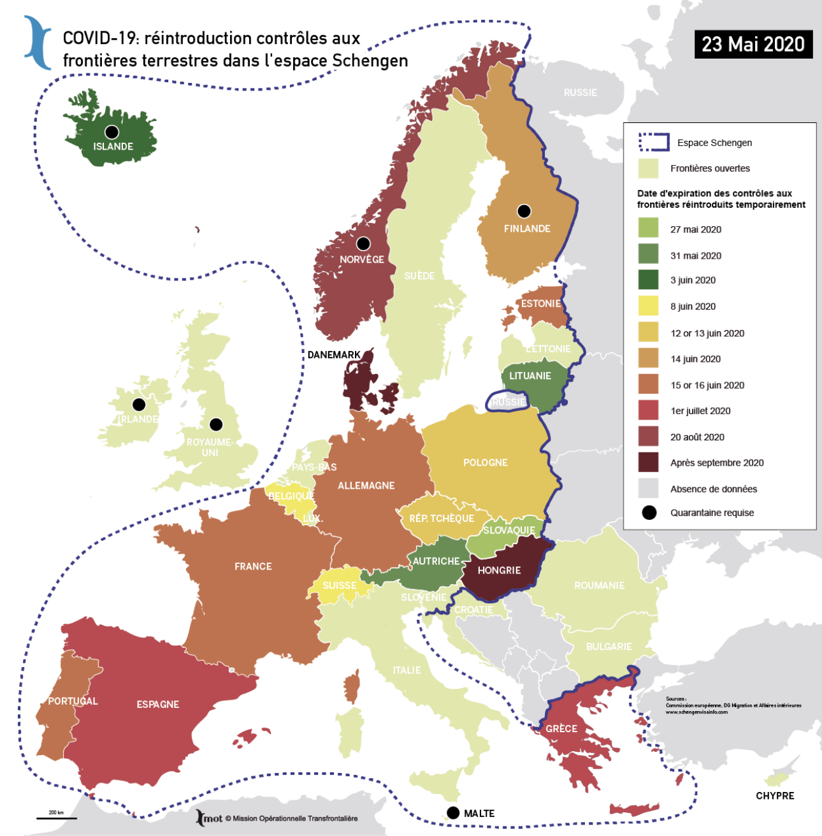
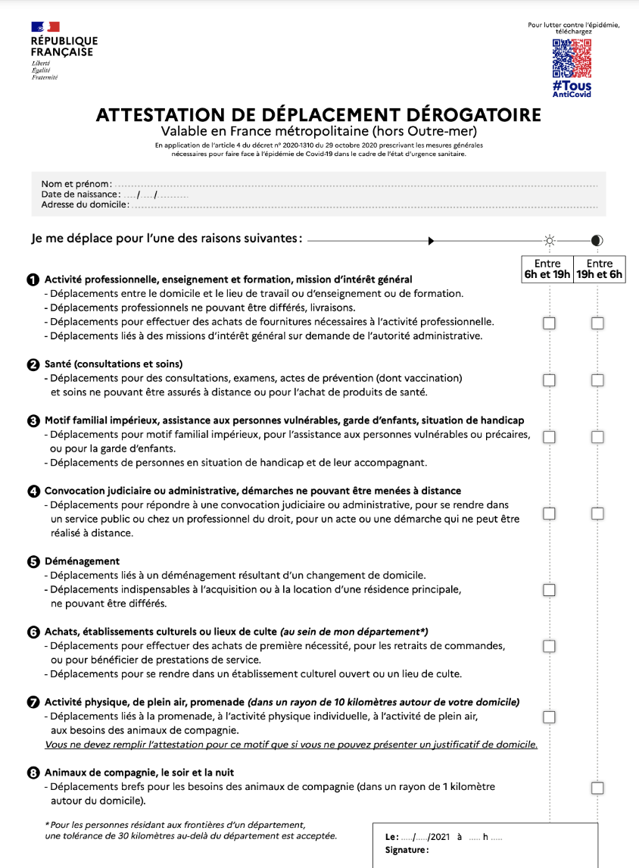
B) Health emergencies: perfect timing for borders to come into play
Borders in EU
Borders in France (between regions…)

Slide 9
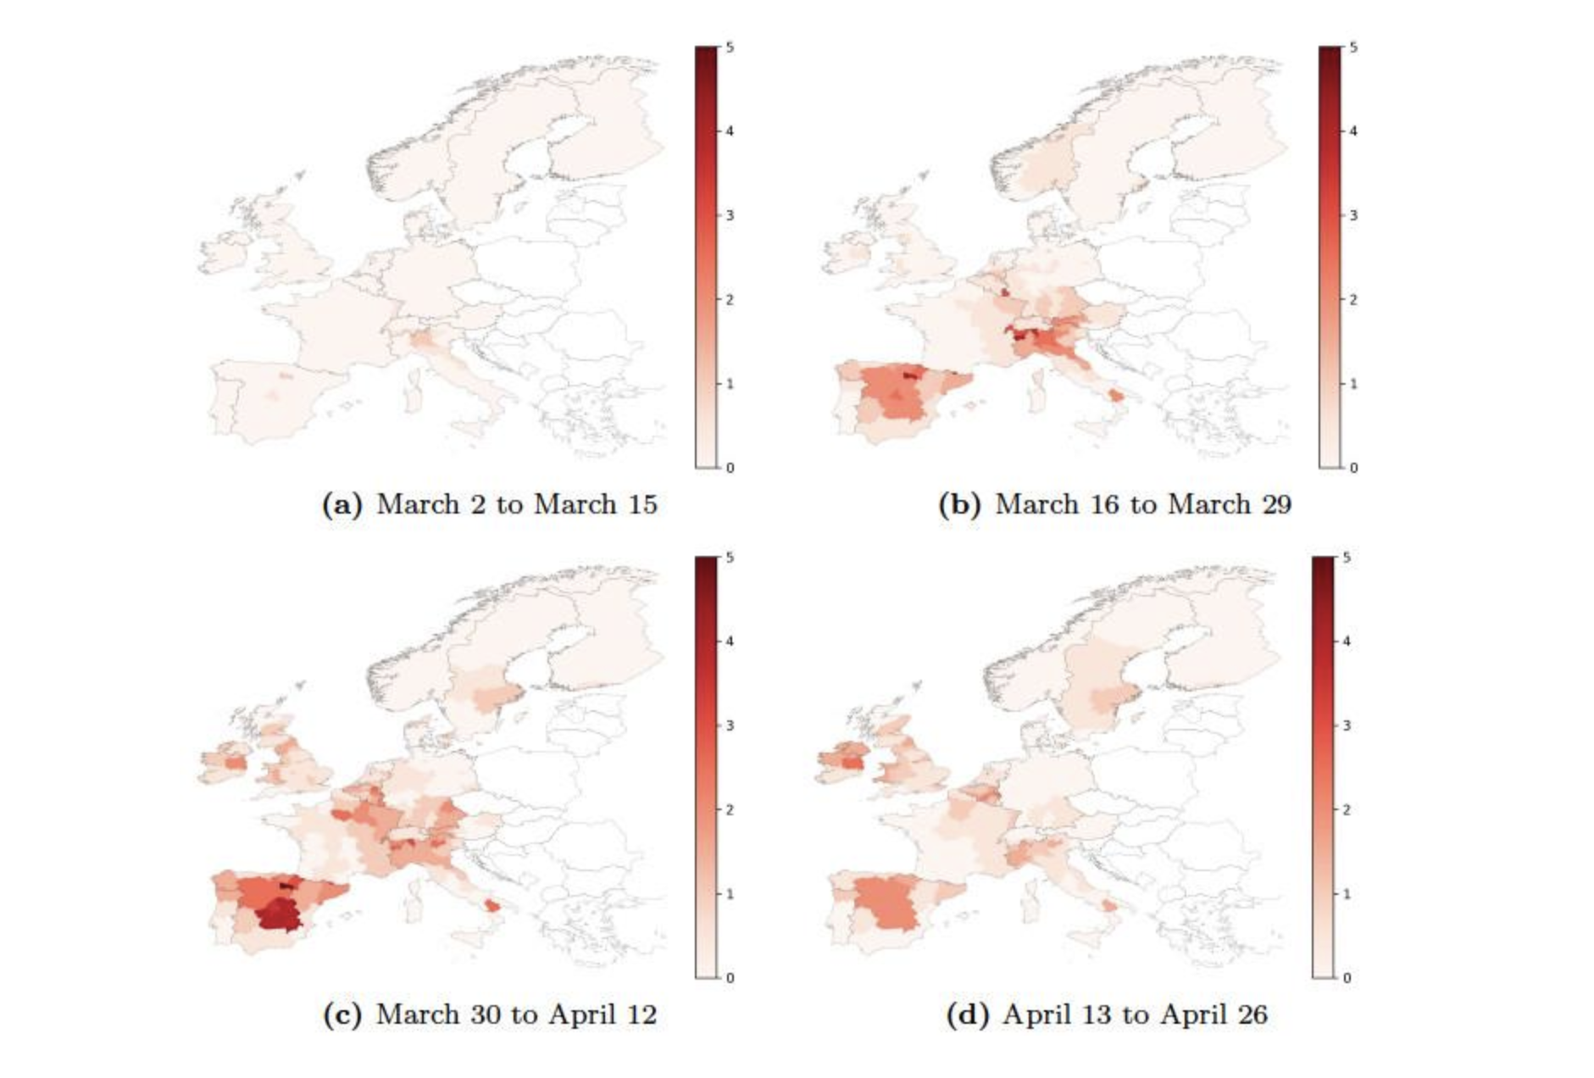
II. The slow erasement of the borders by resilience : an uneasy play
The impact of border closures: before and after

Slide 10
A) The emergence of resilience and cooperation, tackling the borders
this seemed to be a challenge for both countries
Diplomats, administrations had to work with the differences existing between the two countries.
Communication was very difficult

Slide 11
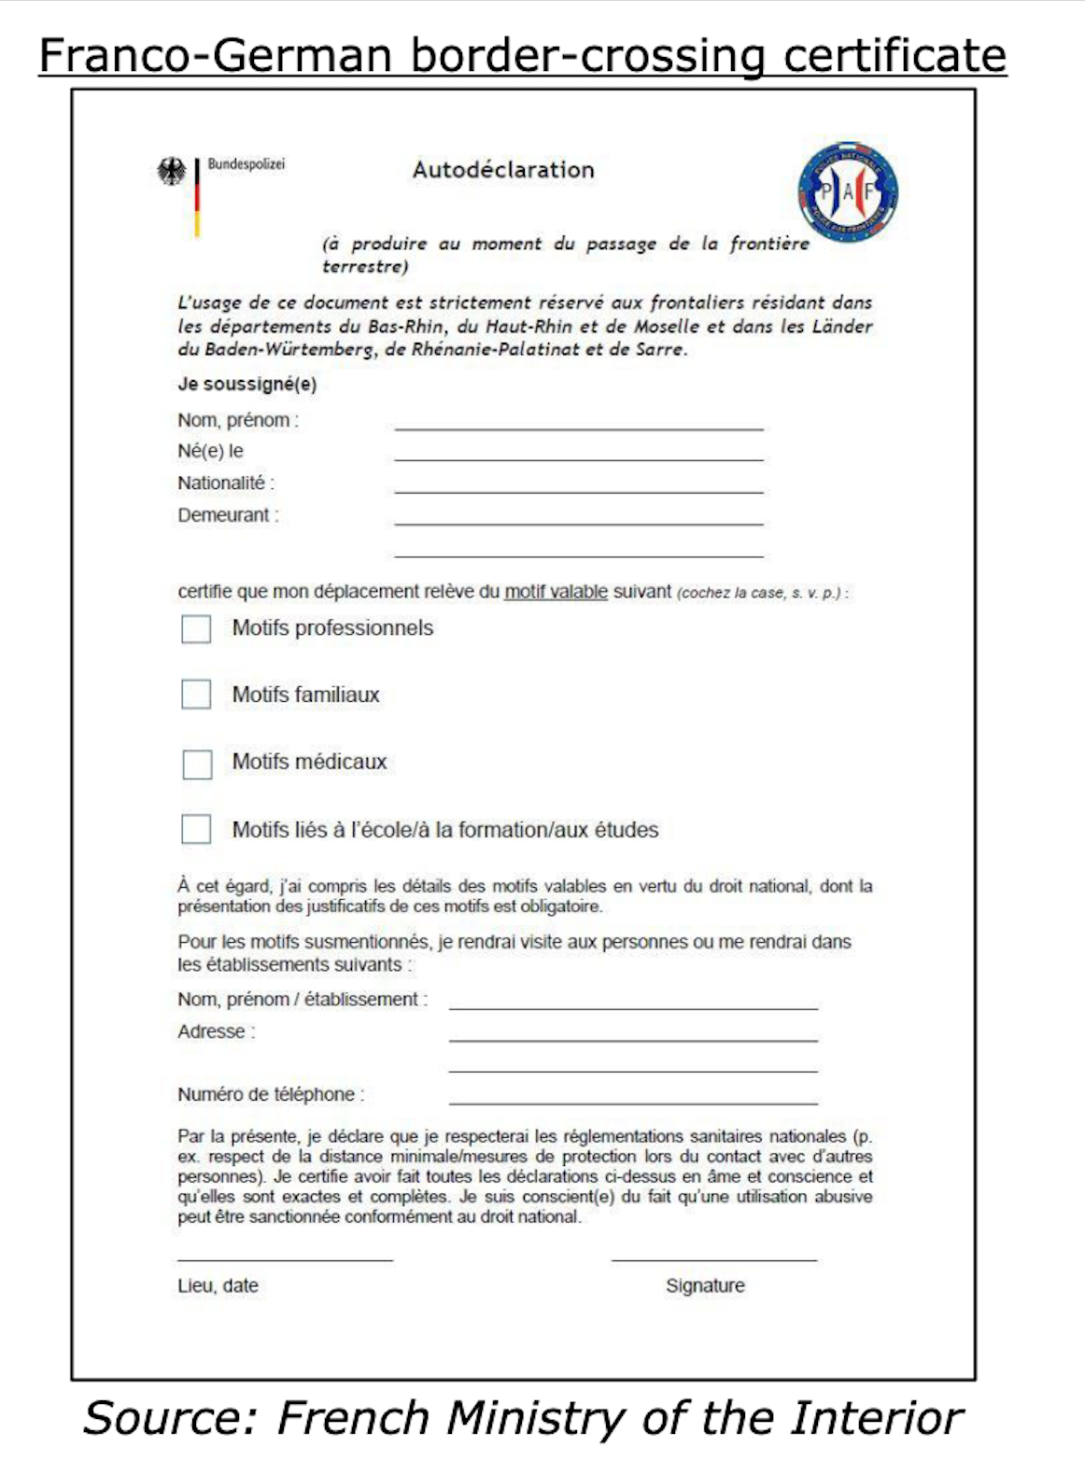
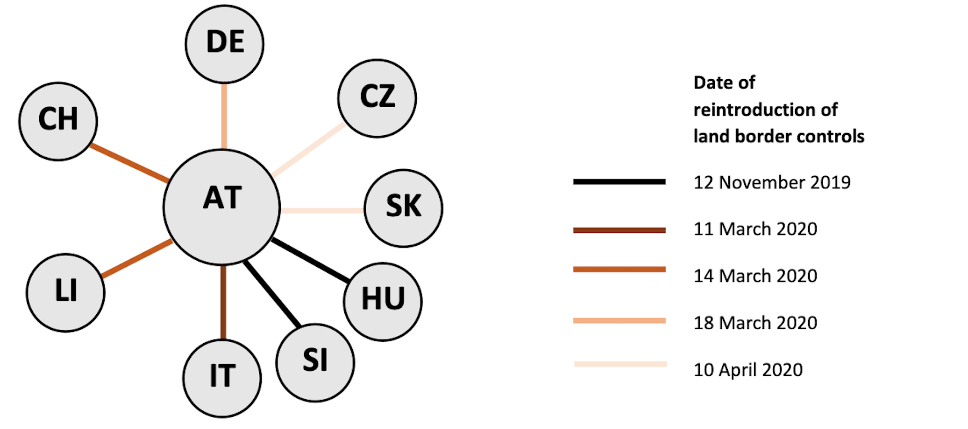
A) The emergence of resilience and cooperation, tackling the borders

Slide 12
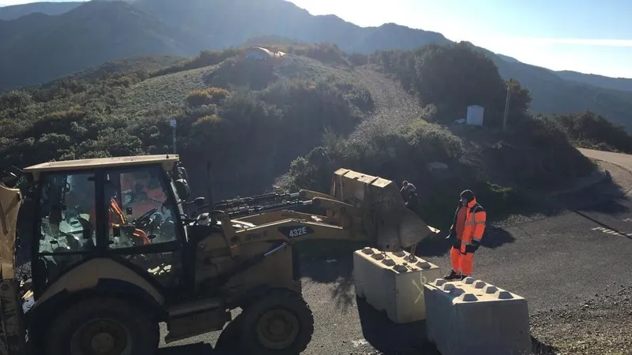
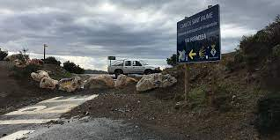
B) The gradual removal of borders from the board: fading stars overshadowed by resilience

